Slide 1
Response to Visual
English 30-2
(notes adapted from Sandy Ens, Alberta Education)

Slide 2
In English Language Arts class you are expected to be able to communicate in all 6 strands:
    Reading, writing, listening, speaking, viewing and representing

Slide 3
Visuals are Texts Too
Yes, pictures are texts too!
  Pictures can contain deeper meaning (just like stories)
    responding to a visual means picking out this deeper meaning!
BUT HOW?
Start by examining and critiquing the

Slide 4
There are 6 Visual Elements
SUBJECT
COMPOSITION
LEVELS
FOCUS
BODY LANGUAGE
FACIAL EXPRESSIONS

Slide 5
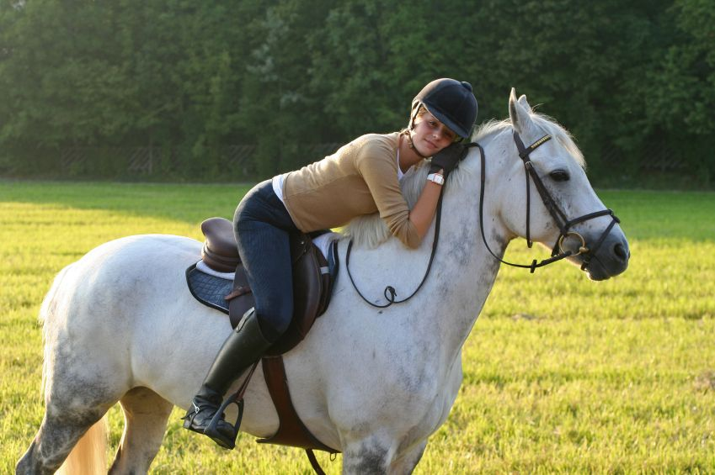
Subject
The people, things, setting that make up the content of the picture
Literally, what is in the picture
  Ex. a picture of a girl and a horse standing in a field

Slide 6
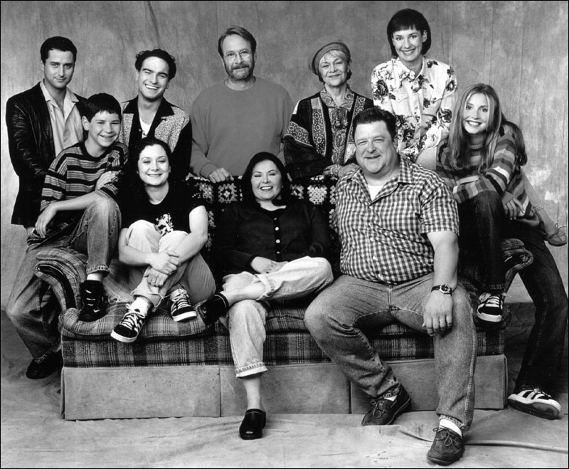
Levels
Some parts of the content may be low, some high, others in between to create interest and variety
  Ex. The stereotypical family photo!

Slide 7
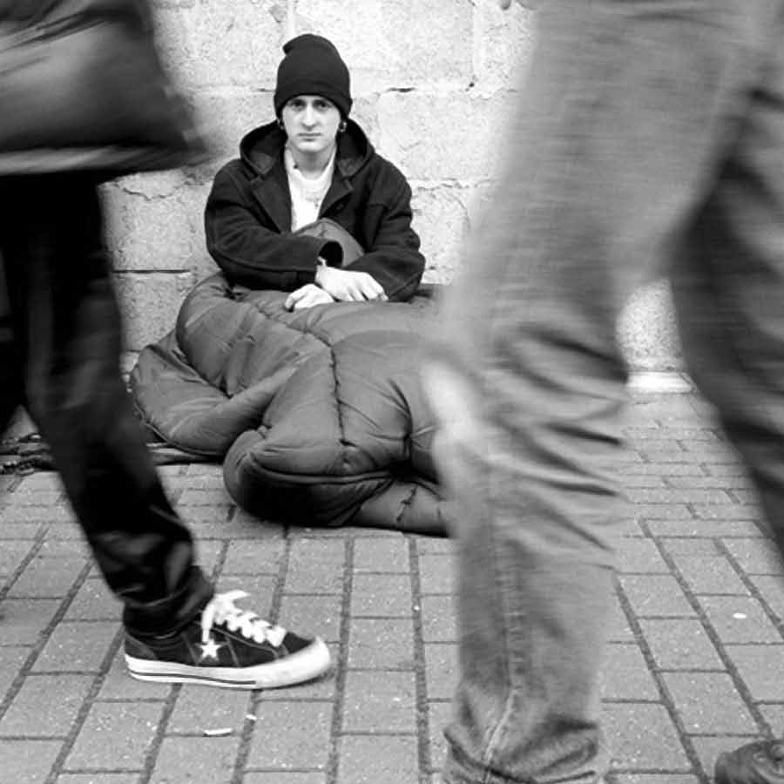
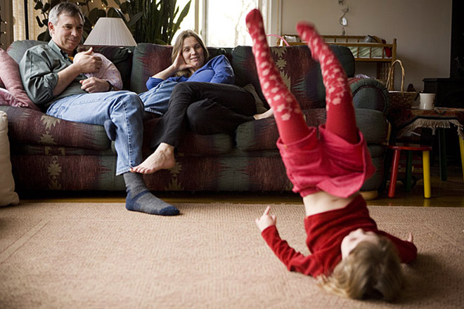
Focus
One part of the content is selected for particular interest and/or meaning
What is your eye immediately drawn to?

Slide 8
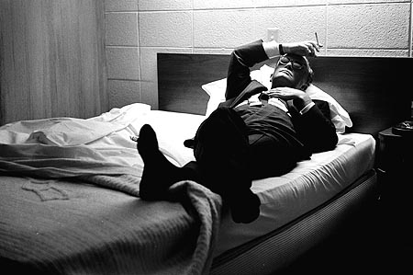
Body Language
The way a subject assumes a posture or uses a gesture can indicate how that subject is feeling or what they are thinking

Slide 9
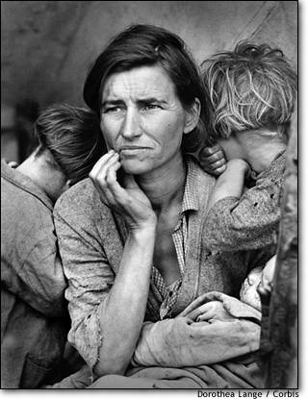
Facial Expressions
The look on a subject’s face conveys a message about his or her thoughts or feelings
How well do you read facial expressions?

Slide 10
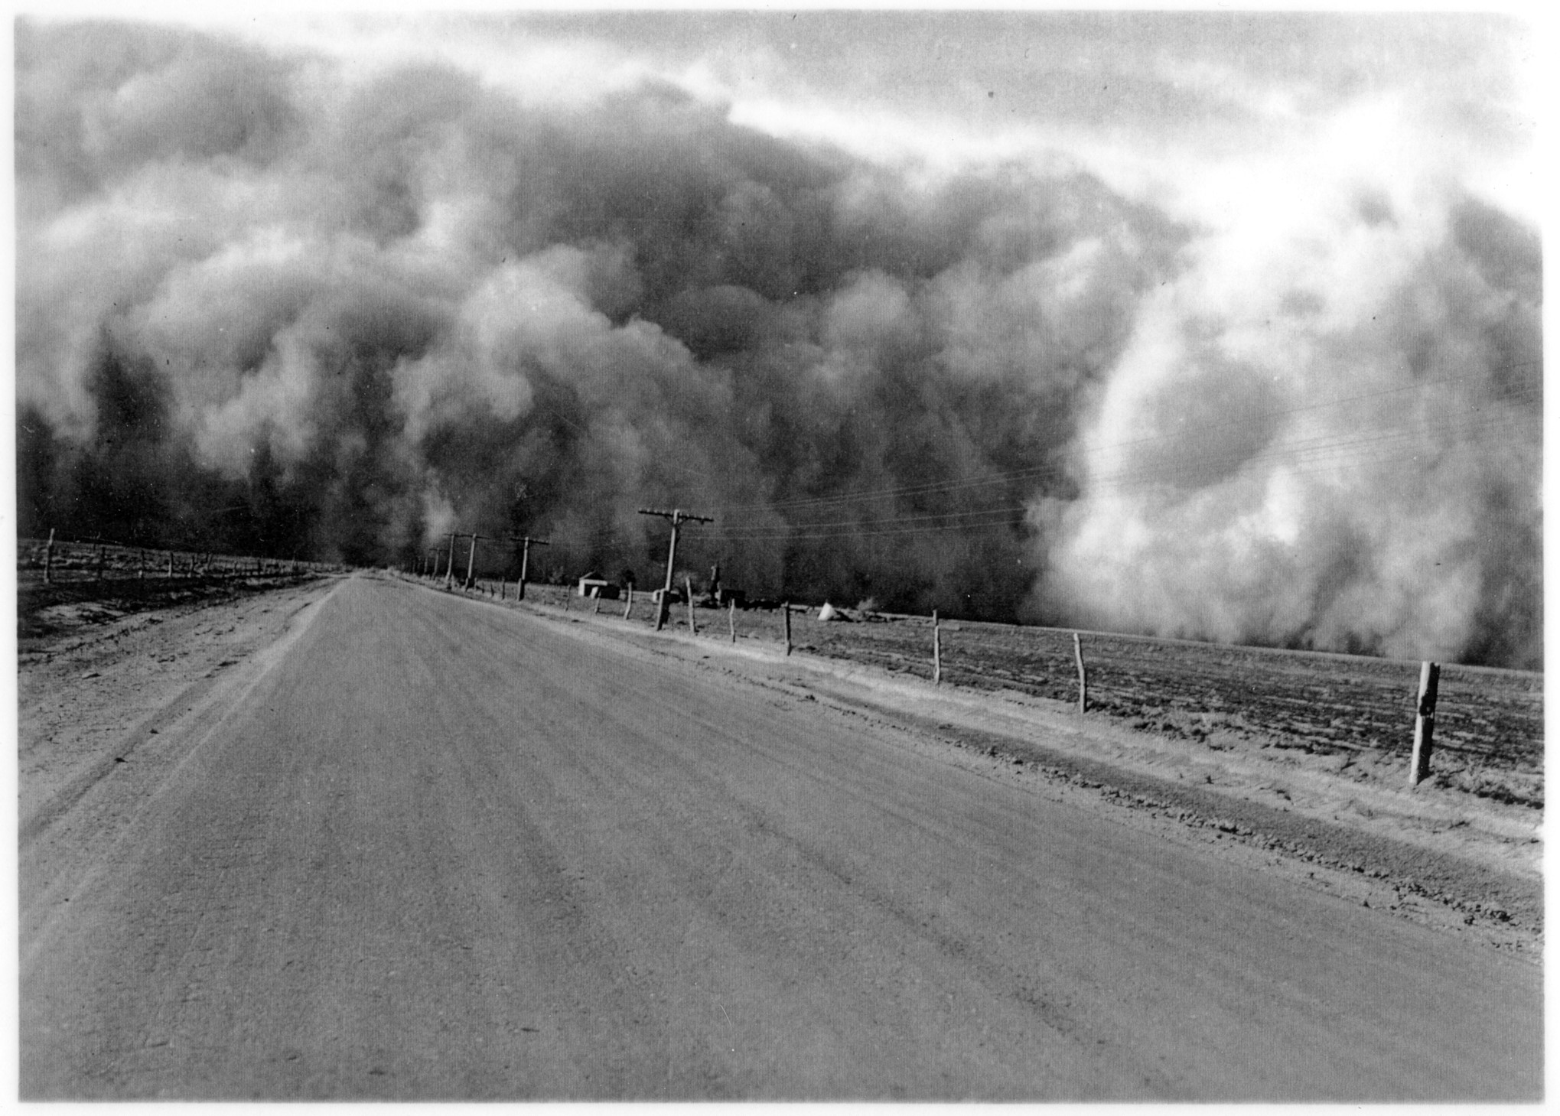
Composition
The way the parts of the content—or things in the picture –are arranged to create an effect
  Ex. The dust cloud is coming towards the forefront of the picture—creating a menacing and threatening effect

Slide 11
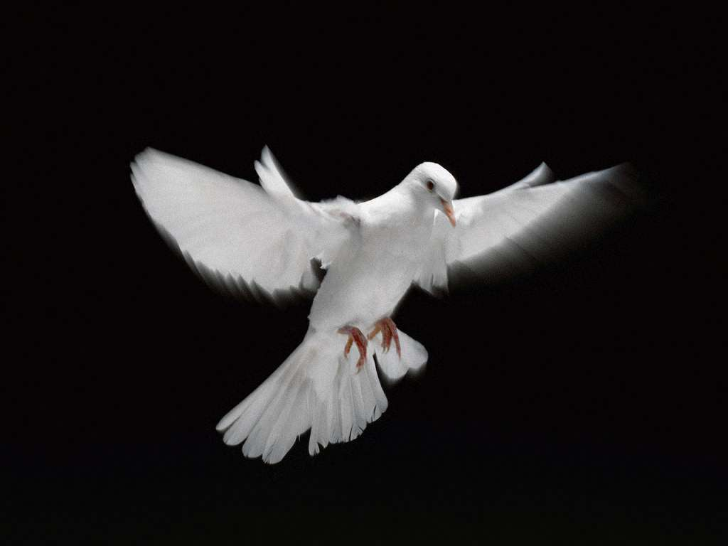
Symbols
Once you have completed the 6 elements analysis it is important to look for symbols that will help determine the visual’s purpose
Symbolism occurs when a thing or idea represents something more that what it literally is
  Ex. A dove is typically symbolic of peace
Symbols are used a lot in pictures to help get a deeper meaning across—so, always ask yourself:
  What could the subject, composition, levels, focus, body language, and facial expressions

Slide 12
When you look at a visual, start by writing down the six elements of an effective picture
  Always be asking yourself WHY? and WHAT?
    Why does the picture look the way it does?
    Why is the subject(s) positioned the way they are?
    What could/does the lighting, colour, arrangement (composition), and focus mean? And why is this important?
Write down any symbols you identify

Slide 13
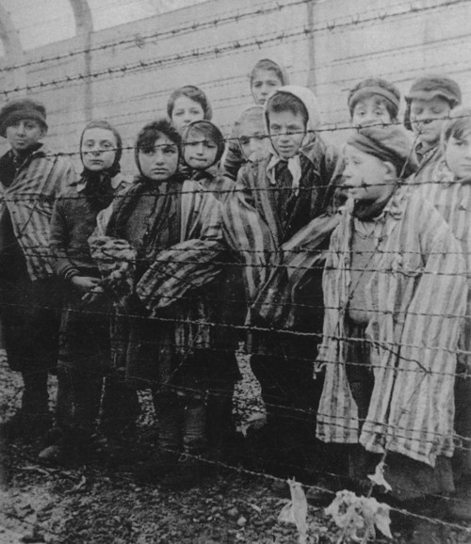

Slide 14
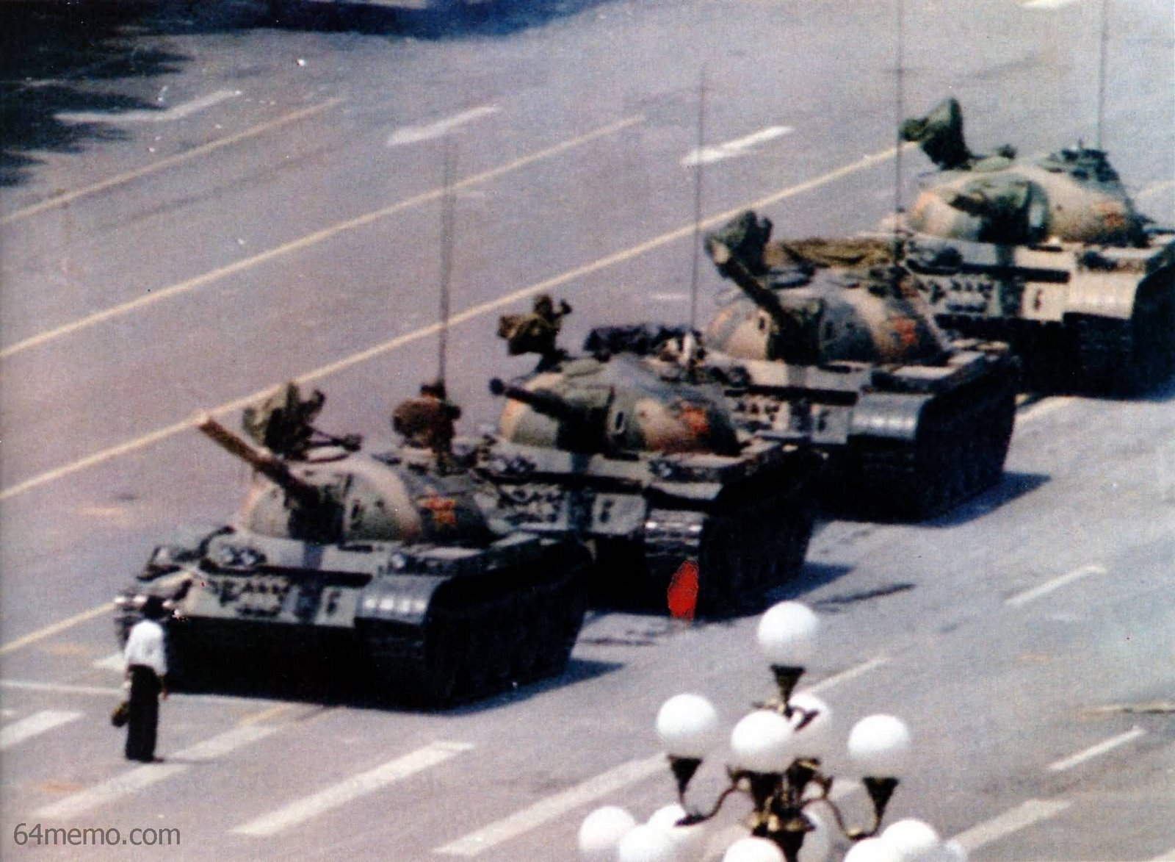

Slide 15
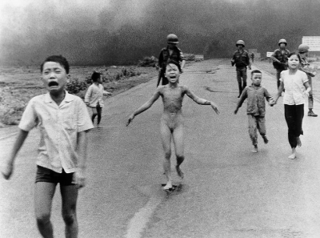

Slide 16
Response to Visual Assignment
The visual reflection assignment is similar to any other written assignment in that you state your idea and then you defend your idea with details from the visual text

Slide 17
Wording
The assignment will be worded as follows:
WHAT IDEAS AND IMPRESSIONS DOES THE VISUAL TEXT SUGGEST TO YOU? CONSIDER THE CONTEXT AND DEVELOP YOUR RESPONSE BY REFERING TO THE VISUAL TEXT

Slide 18
Response
Your response may be personal, critical, or creative
You MUST:
    Select a prose form that is appropriate to the ideas that you will express and enable you to communicate effectively to the reader (NO POETRY)
    Consider how you can create a strong unifying effect

Slide 19
Assignment
You will be given a visual text (photograph, advertisement, poster) Your task is to communicate to the reader the ideas and impressions that you get when you look at and analyze the visual.

Slide 20
Hints
Do not just look at the visual…THINK
Take in all the details, look for the 6 visual elements
What is the BIG IDEA? THEME?
There are multiple ways to interpret the visual there is no “one right answer”
Make sure your ideas are appropriate, clear and incorporate details from the visual

Slide 21
Personal Response
Connect the “big idea” and details in the photo to your own life
    Your friends, your family, your job, your schools, your experiences, places you have travelled to etc.

Slide 22
Critical
This format is like a mini-essay. Analyse the details of the visual and prove the “big idea”
    Subject, level, focus, body language, composition, symbols, facial expressions, any words etc.

Slide 23
Creative
This format is wide-open. Here you can choose a creative style to represent the “big idea”
    Short story, news article, script, letter, diary entry, you can be one of the people or objects in the visual etc.

Slide 24
Planning
1. What is the “big idea/ theme”?
2. What details from the visual support that theme?
3. What prose format will you use?
NO POETRY!

