Slide 1
Figures of Speech

Slide 2
Imagism
Abstract
General
Specific
Detailed Specific
Concrete
Absolutely Concrete

Slide 3
Courage
I was filled with courage
I was filled with courage at the sight
I was filled with courage at the sight of the reinforcements
My heart was filled with courage at the sight of the reinforcements coming over the hill
My heart was filled with courage at the sight of the reinforcements coming over the hill and launching into battle
My heart was filled with courage at the sight of the 500 reinforcements coming over the hill and launching into battle against the British forces

Slide 4
David By Earle Birney
Tough assignment
Q1) When a question asks for contrast, that gives you a huge clue that there are two sides, and you need to provide evidence of both
Q2) The Robin and David
Q3) The irony is not just that David was the better climber, it has to be related to the bird and the freedom David feels

Slide 5
4) Metaphors are not similes, but a direct naming of something to compare it
He was quiet as a mouse – simile
He was a mouse – metaphor
He looks like a god - simile
He is a god – metaphor

Slide 6
‘Pines thrusting at the stars’
This isn’t a metaphor about stars, it’s a metaphor about the pines. If they are thrusting at the stars, they aren’t pines, they are swords. This could also be personification, even more than metaphor.

Slide 7
6) Need to pay attention to the criteria – it will tell you exactly what you need to do.
You HAD to explain why you lied to the men in the camp, it wasn’t a hint, it was the point
The writing style had to be similar. You can’t change it to, “Hello, what’s up, haven’t written in a while, here’s the deal, I killed my best friend. Feel really bad about it tho.”

Slide 8

Writing a Movie Review
You are writing a critical piece, and you are writing it for an audience of many, not just for your teacher.

Slide 9
Think and write about many different things. You have to provide information about:
Actors and characters
Directors
Music
Plot summary
An evaluation of the movie
The good, the bad, how it holds up
Who should see it.

Slide 10
The Ending…
YOU CAN SPOIL THE MOVIE, AS LONG AS YOU WARN PEOPLE.
You can leave the twists out, tell of the plot, say “great ending” but not give away the ending if you do it well. Don’t say “You’ll have to see it to know the ending”
Warm Bodies
Transformers: Age of Extinction

Slide 11
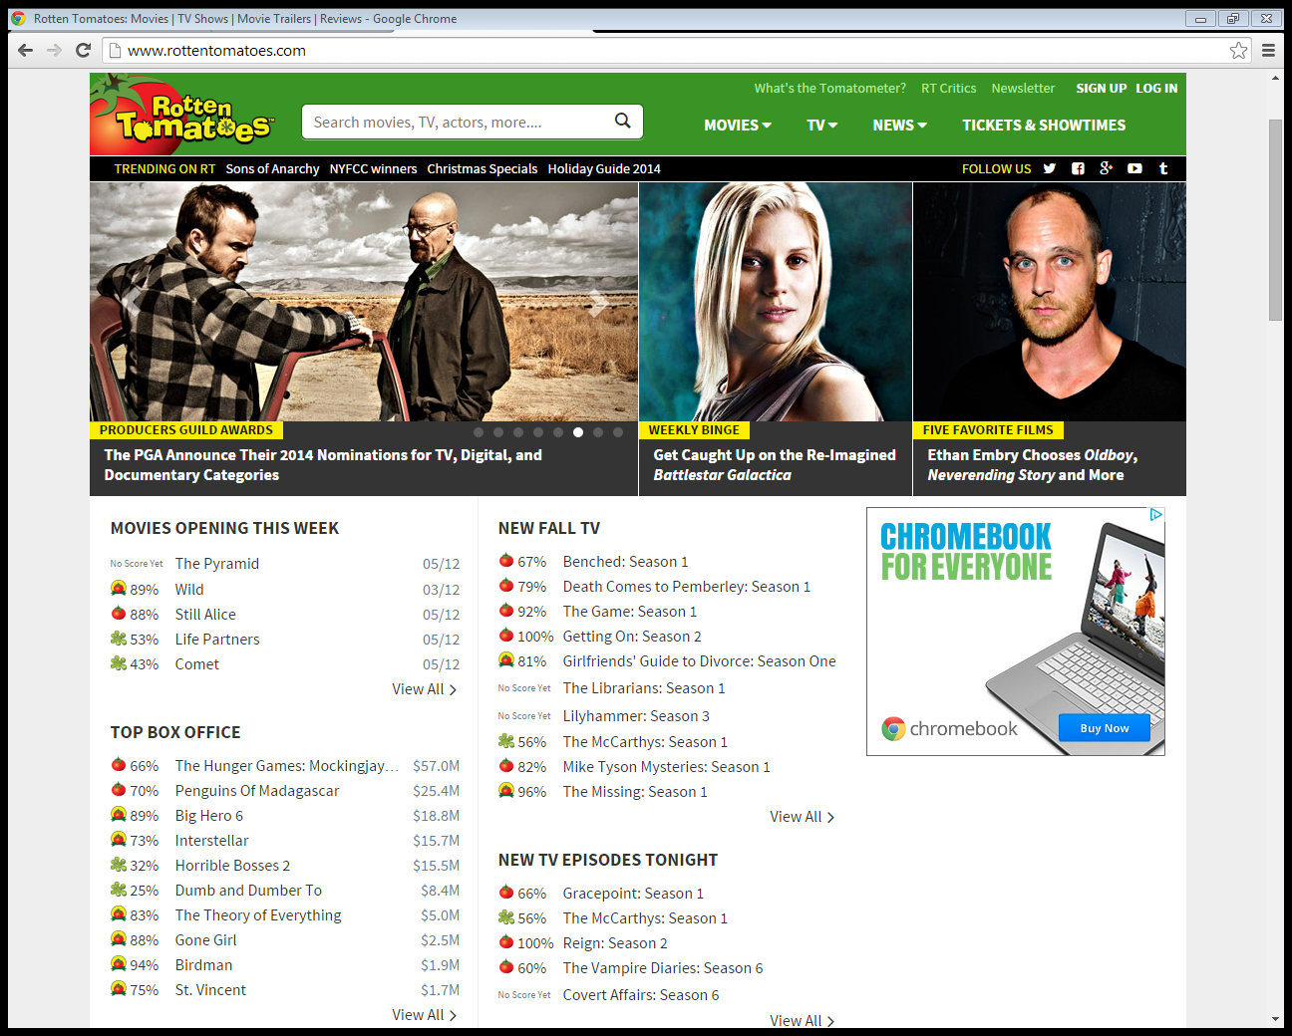
Rotten Tomatoes

Slide 12
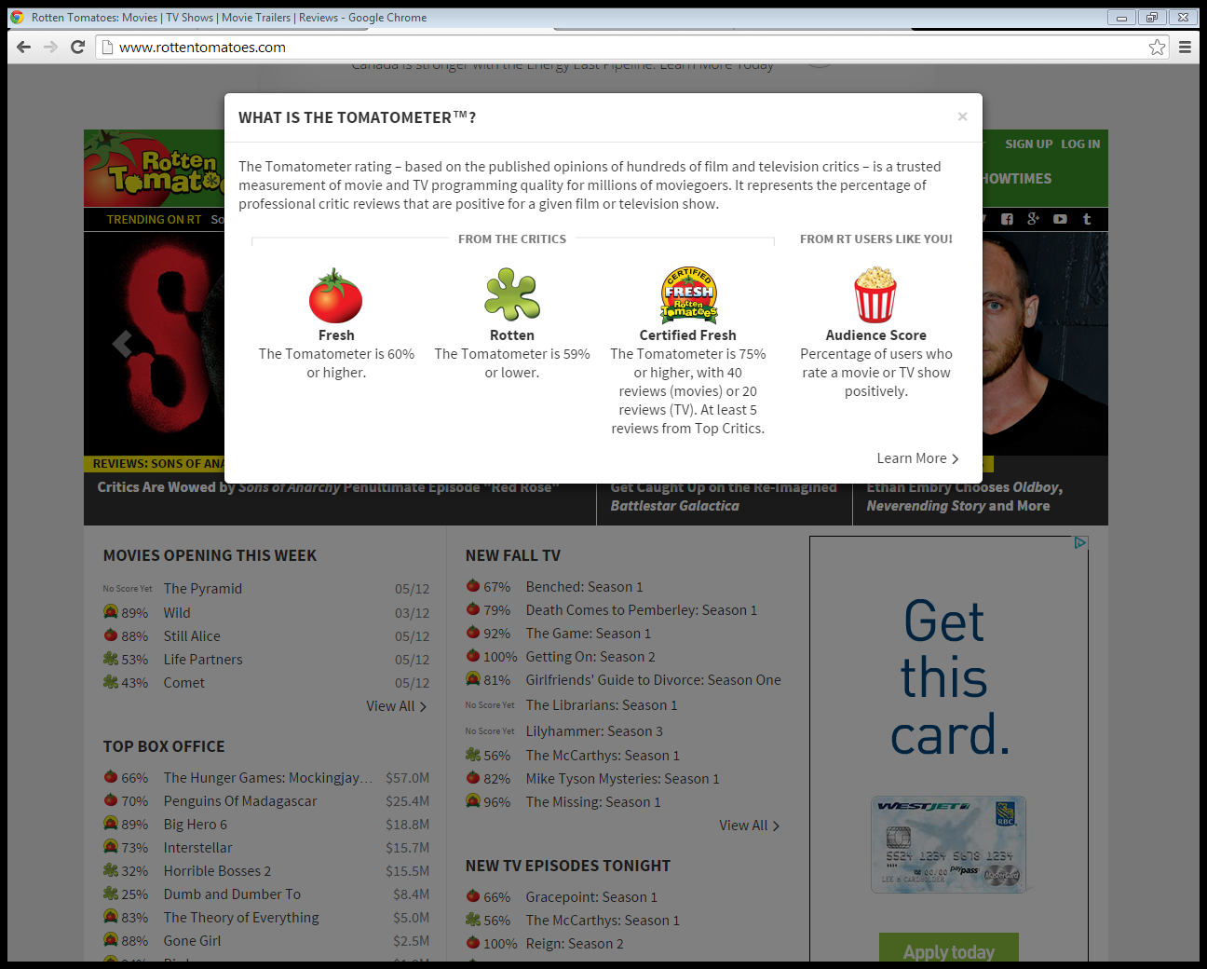
Has viewers and critics opinions
Gives a ‘Fresh’ or ‘Rotten’ score and the percentages

Slide 13
The Lion King 2: Simba’s Pride
What did you think of it?
What did you honestly think of it?

Slide 14
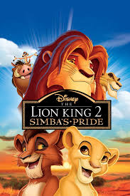
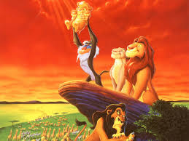
The Lion King 2: Simba’s Pride
The Lion King (90%) The Lion King 2 – Simba’s Pride (33%)
>

Slide 15
The Lion King 2: Simba’s Pride

