Slide 1
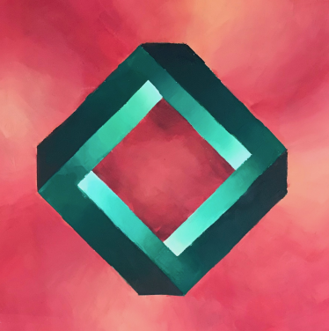
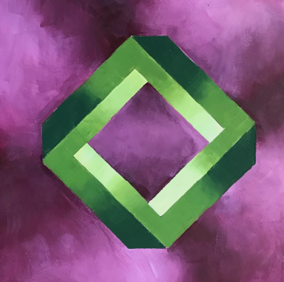
The Impossible Shape
An Acrylic Painting Project

Slide 2

Supplies
For this assignment use only 4 colours – the 3 primary colours (red, blue and yellow) and white.
All colours in your project will be made by mixing those colours.
You will need brushes, water, a pallatte (styro trays work great!) a pencil and a ruler.
You will need a substrate – your own or one provided by your teacher.

Slide 3
Process:
Print large version of impossible shape (found in the moodle lesson).
Copy this shape onto your substrate. Either cut it out and trace, trace the lines in pencil and do a rubbing to transfer, use carbon paper or draw freehand using careful observation.
Choose a secondary or tertiary complementary color scheme (two colors directly across from each other on the color wheel).
Paint your Impossible Shape and background following the style of the samples. This is a blending assignment, so focus on blending your paint and painting smooth transitions.

Slide 4
Process Continued
5. Paint the entire background first, painting into the shape edges slightly so that when you paint the shape you an achieve a nice crisp edge. If you paint the shape first you can easily mess up the edges when painting the background around it. Edges of the shape need to be crisp in order for the shape to look 3-Dimensional and to create the optical illusion seen in the samples.
6. Use a wet-into-wet approach for all soft value transitions and a wet-onto-dry approach for establishing crisp edges. You will require patience, as sometimes one part will need to dry before you proceed.

Slide 5
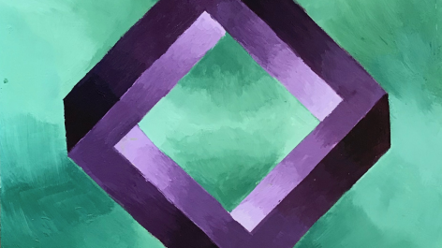

Slide 6


Slide 8
