Slide 1
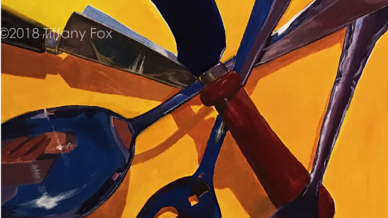
Sensational Silverware
An Acrylic Painting Project

Slide 2
Create your Source Photo
Choose 4 or 5 pieces of silverware (all pieces must be different). These can be serving utensils or any kitchen utensil.
Use your phone to take photos of these, creating your source photo. Remember our lesson on composition? That will be key here. Taking photos outside in the sunlight on white paper yields beautiful shadows and gorgeous reflections. If this is not possible, taking photos on a counter with a desk light and overhead lights off works well also. You want lots of reflections and shadows.
3) Put your best photo into a photo editor or into a word document and crop for good composition. Include overlapping, interesting negative space and dynamic angles.

Slide 3
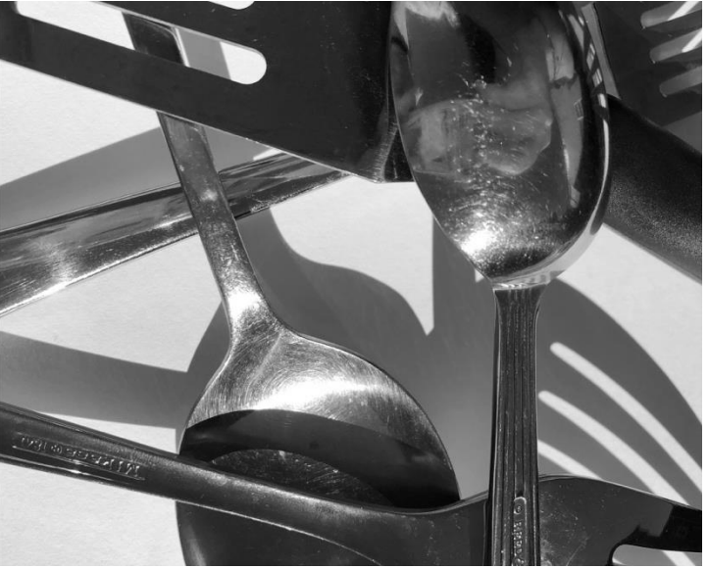
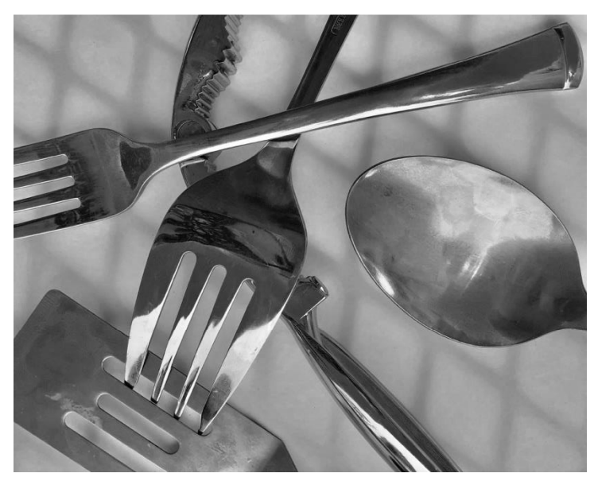
Sample Source Photos

Slide 4
Process
Begin by
Begin by lightly sketching your chosen composition on your substrate. Layout contour line of silverware in a very light color (very light blue or violet works well).
Choose
Choose a colour scheme for your painting – think about warm and cool, primary and tertiary, complimentary colours. There are no rules, but your colour choices should not be accidental.
Paint
Paint background first around silverware. Next paint silverware that is underneath any other silverware, then paint silverware on top last (I call this, “painting from the back outward.”) This will ensure clean edges.

Slide 5
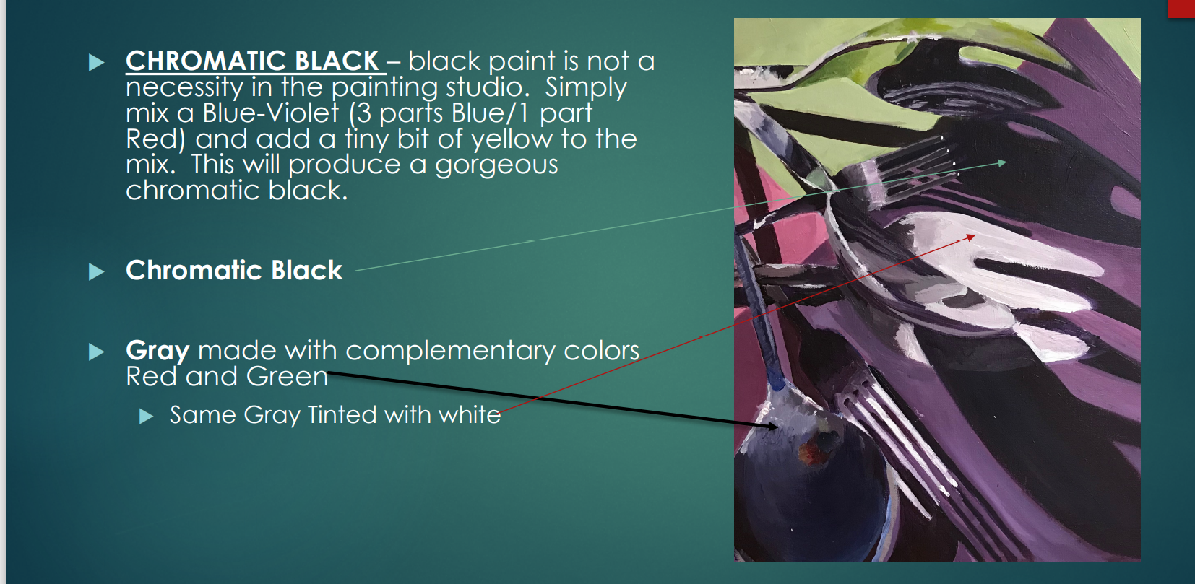

Slide 6
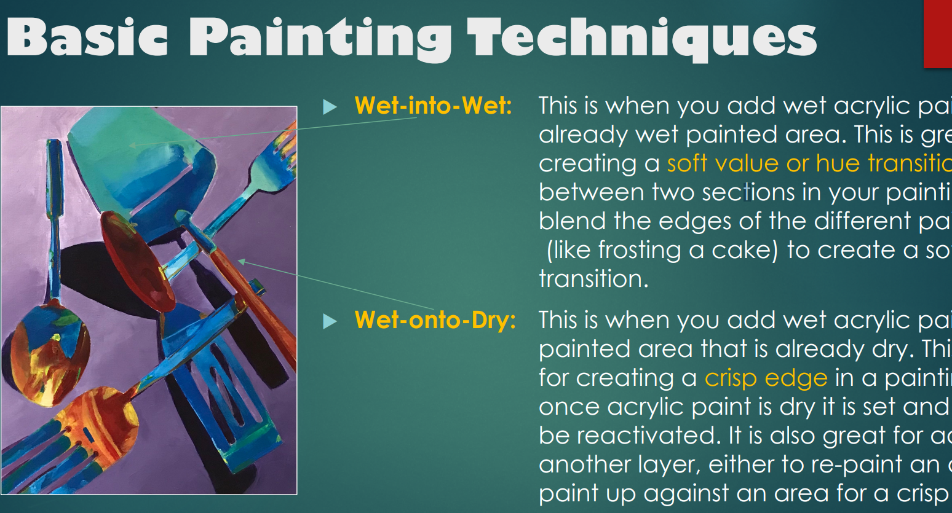

Slide 7
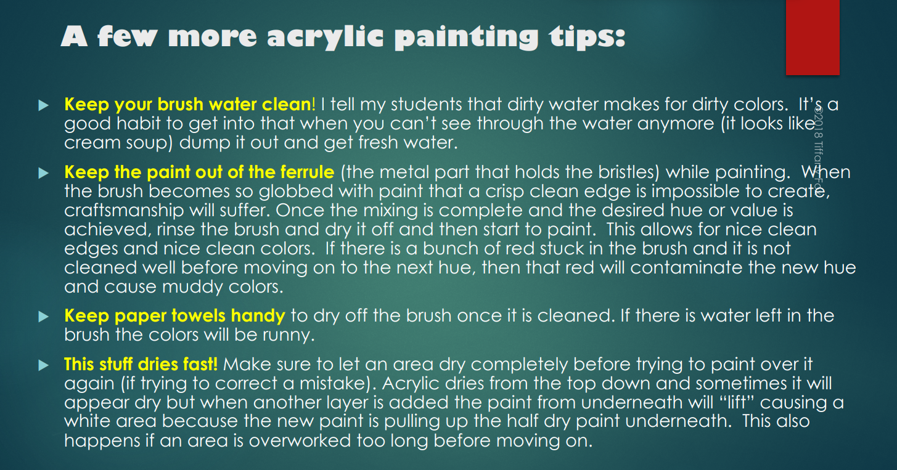

Slide 8
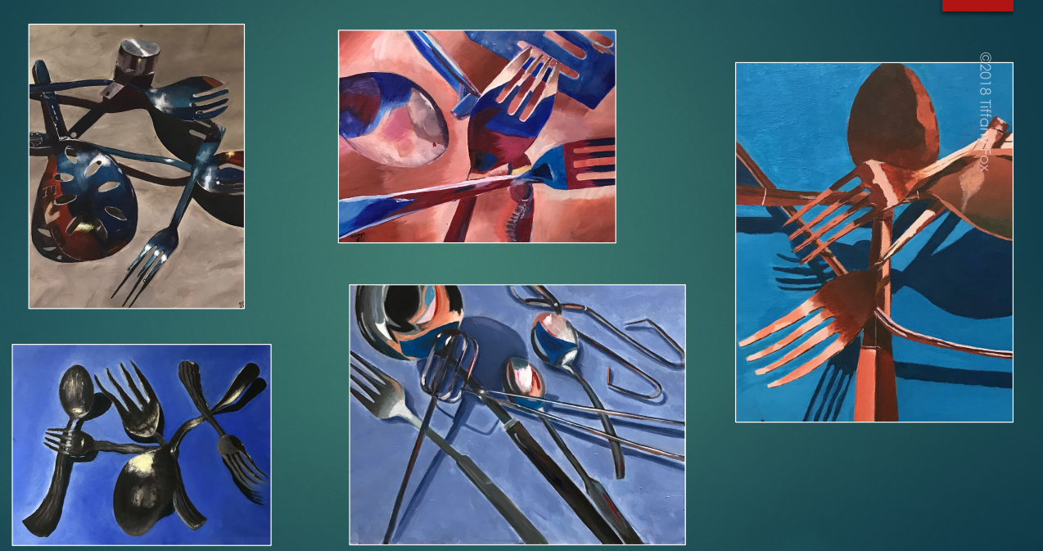

Slide 9
