Slide 1
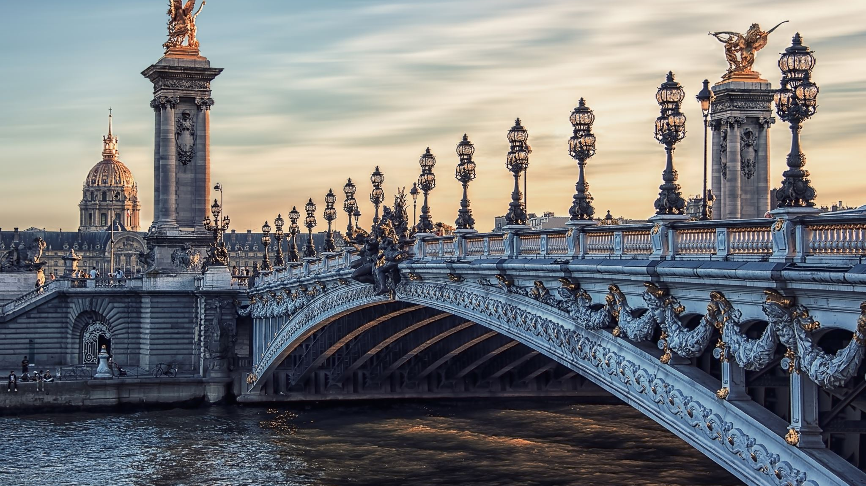
The Art Of Henry Moore
A Sketching, Art History, Intro to Sculpture Assignment

Slide 2
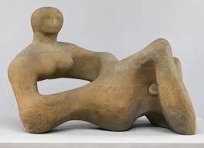

Slide 3
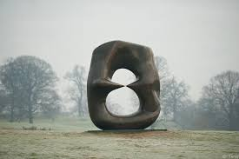

Slide 4
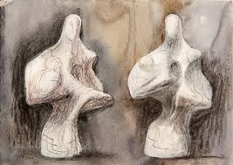

Slide 5

Please watch this video about English Sculptor Henry Moore
Henry Moore’s Vision

Slide 6

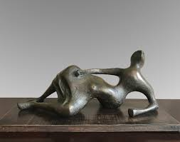

Slide 7

Your Assignment
1) Choose an image (or a few) of a Henry Moore Sculpture. You may choose from this slide show, or find some through an image search on line.
2) Create a drawing of that sculpture(s) in your sketch-book or on a separate piece of paper.
Use any drawing medium you like – pencil, pen, charcoal, watercolour paint, combined/mixed media…

Slide 8
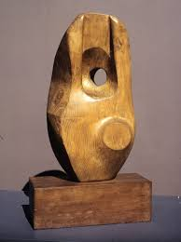

Slide 9
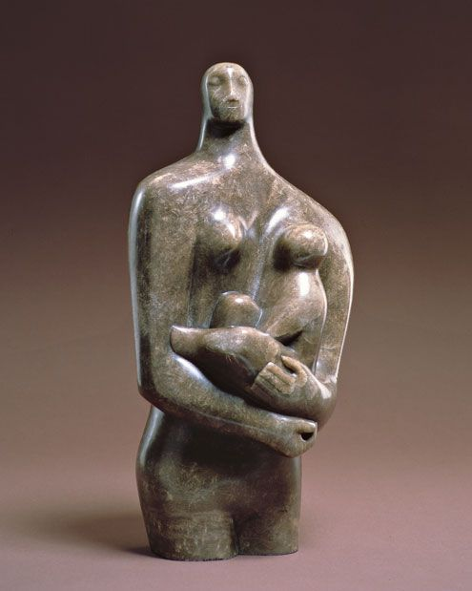

Slide 10
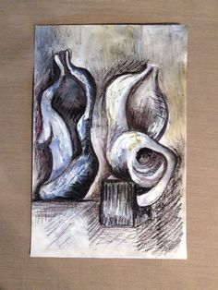
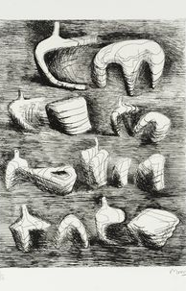
Sample Drawings:

Slide 11
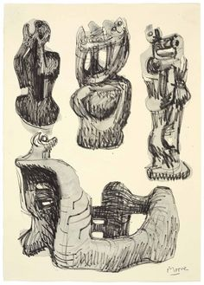
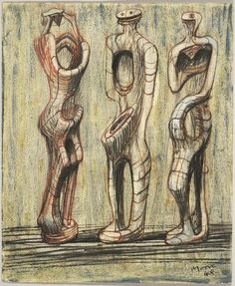

Slide 12
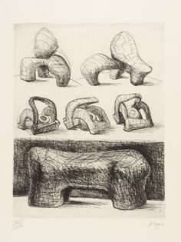

Slide 13
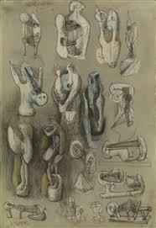

Slide 14
