Slide 1
Sculpture
An Anything Goes Assignment

Slide 2
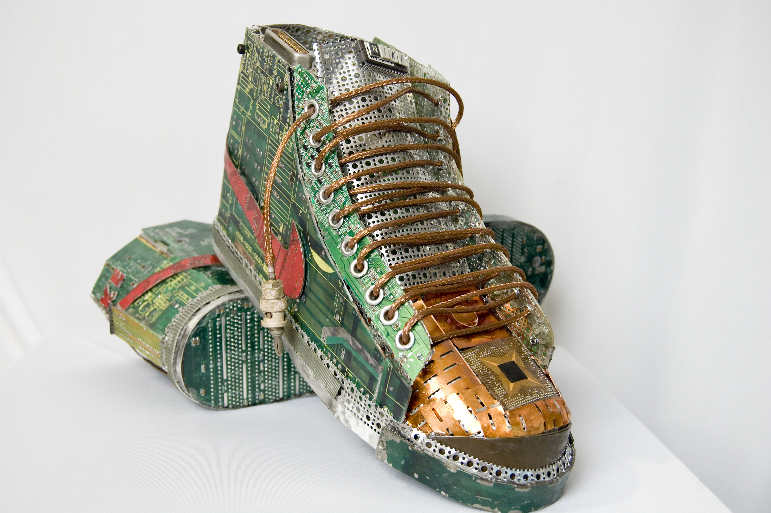

Slide 3
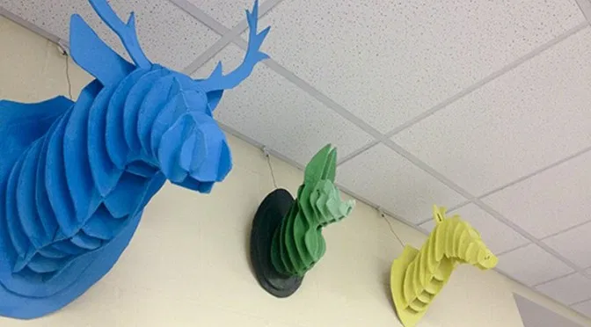

Slide 4
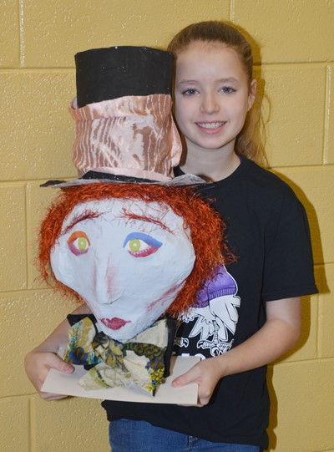

Slide 5
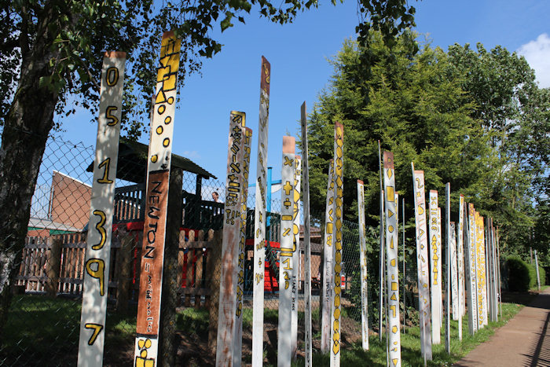
This student had some old boards and housepaint in the garage…

Slide 6
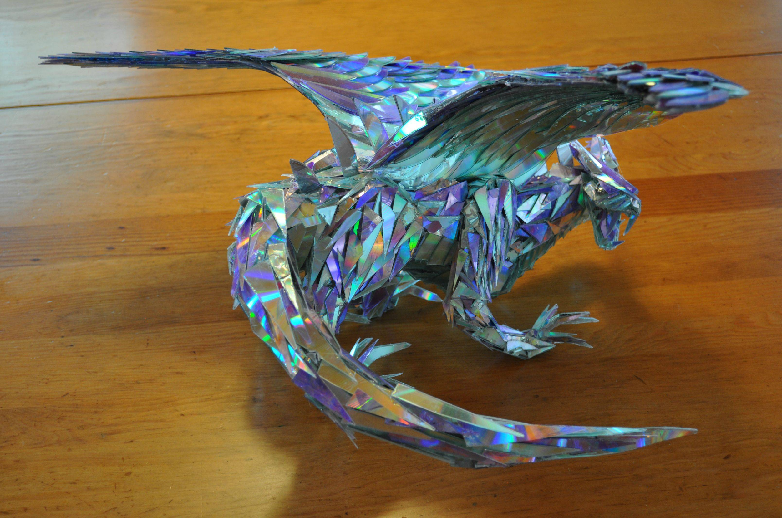

Slide 7
Smash up some old CDs, build a frame/skeleton out of paper, wire and masking tape, and glue CD shards on with a hot glue gun…

Slide 8
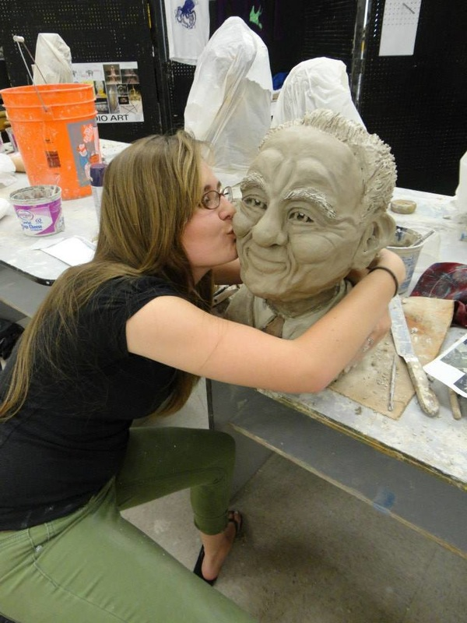
Ceramics
We don’t have a kiln at the school, but some students have access to a kiln through family. If that’s you, clay is another option.

Slide 9
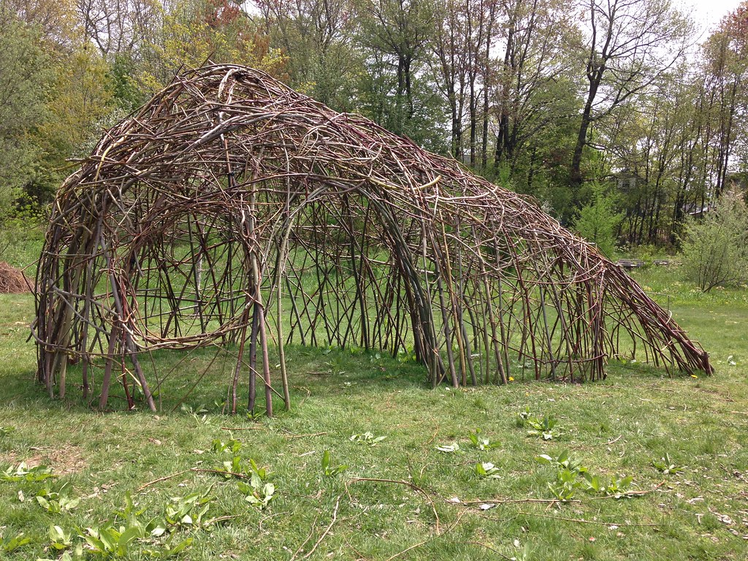
If your Sculpture is an on-site installation, take lots of photos!

Slide 10
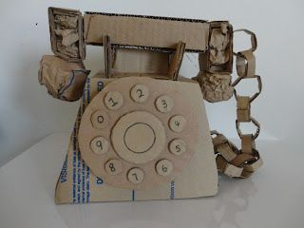
Cardboard is a great material. It can be painted, or not. Your sculpture can be abstract, realistic, humourous, larger than scale, smaller than scale…..

Slide 11
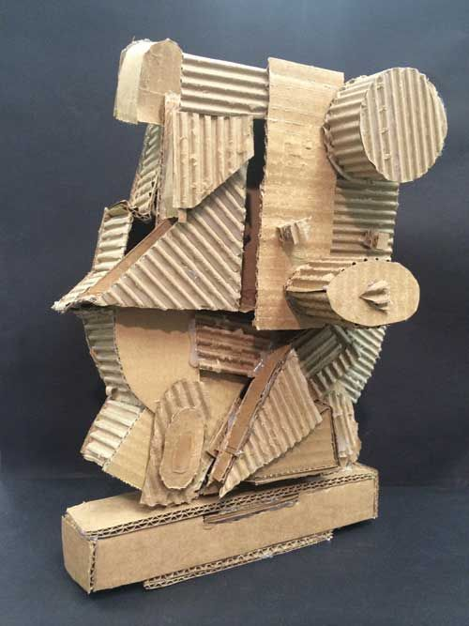
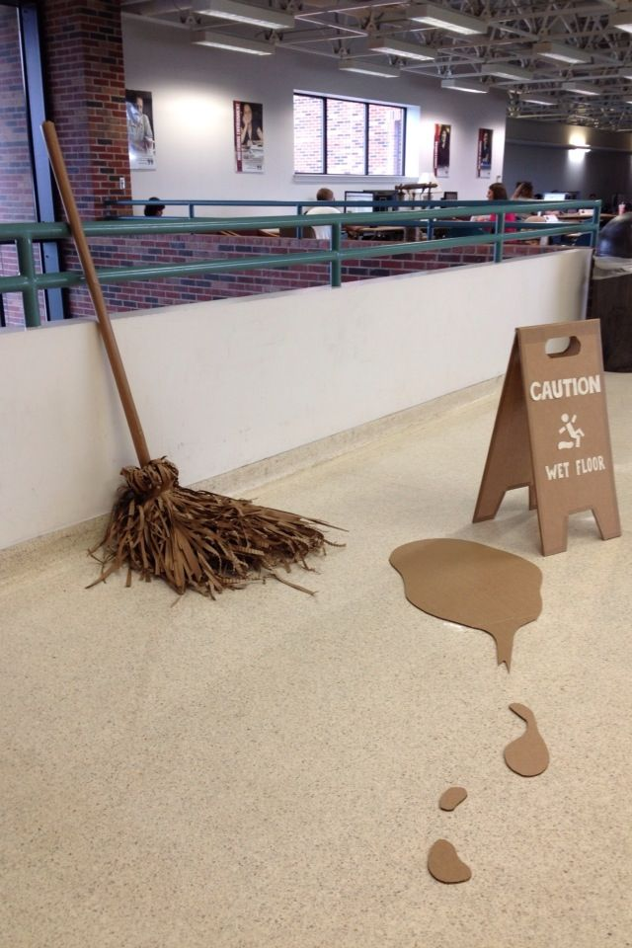

Slide 12
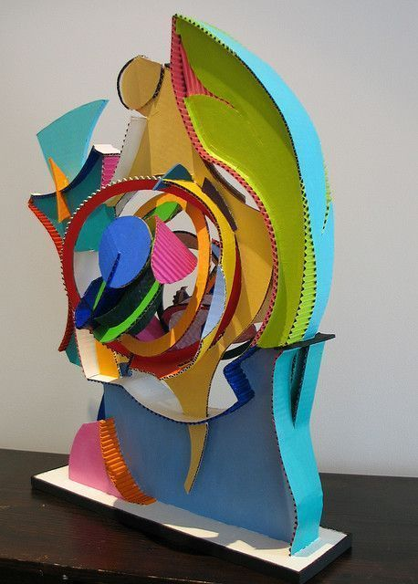
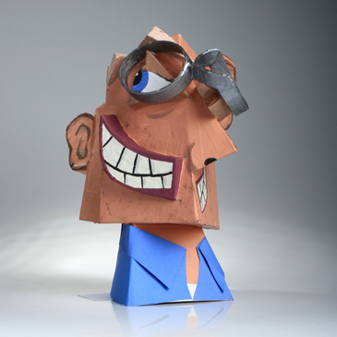

Slide 13
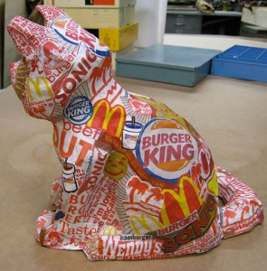
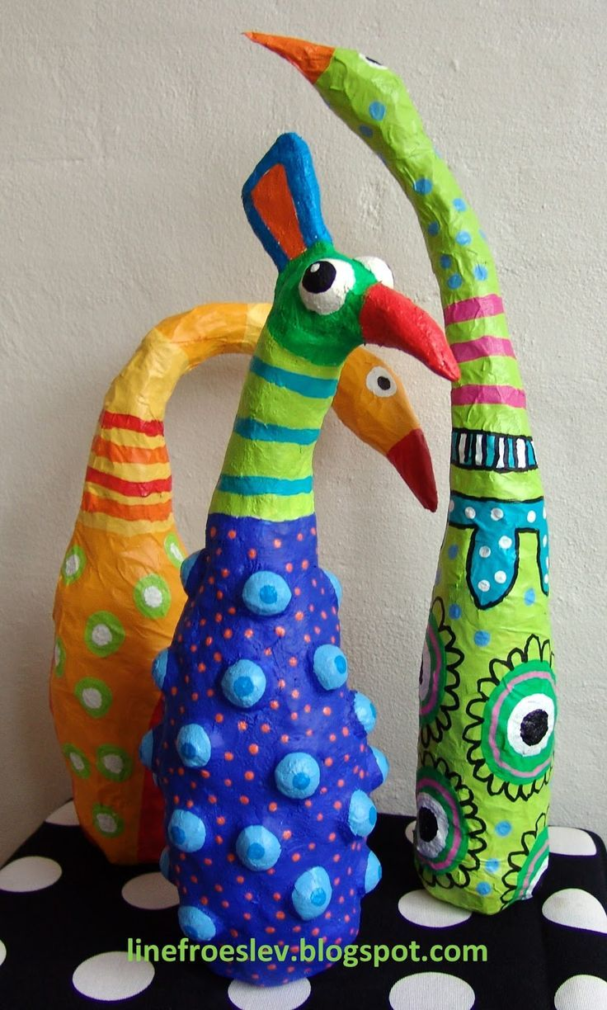
You can use paper mache:

Slide 14
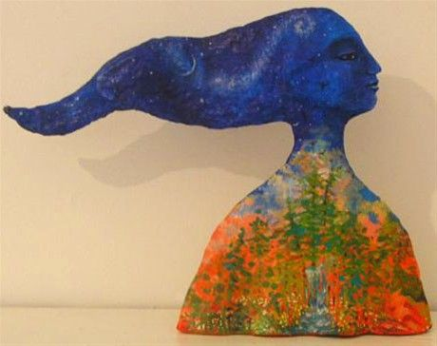

Slide 15
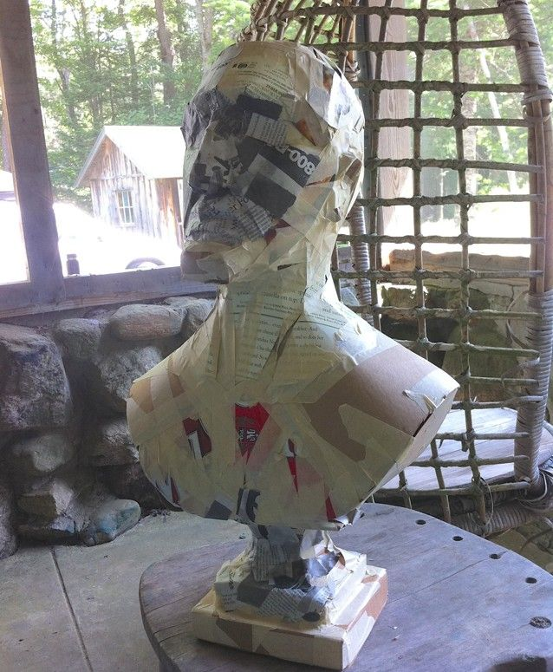
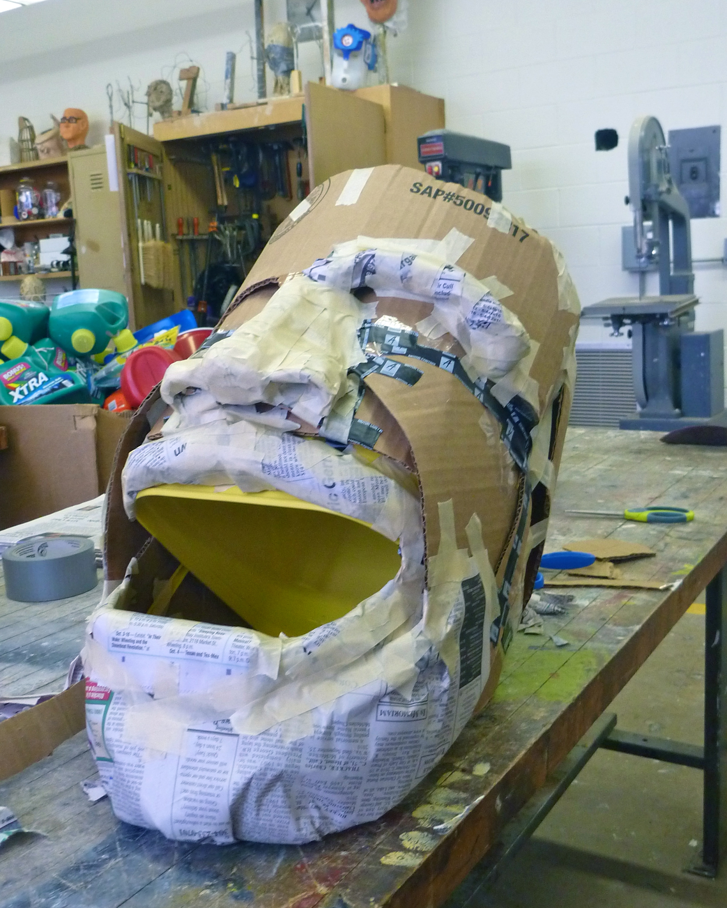

Slide 16
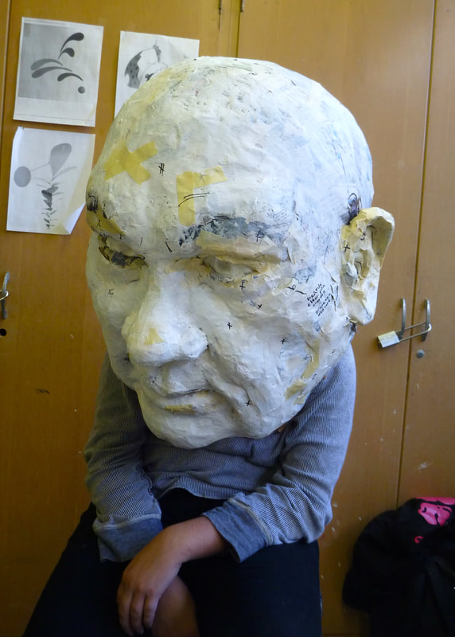
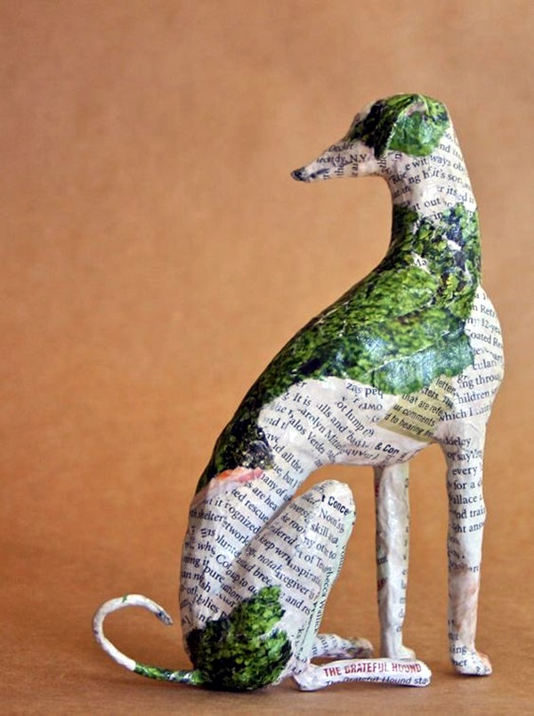

Slide 17
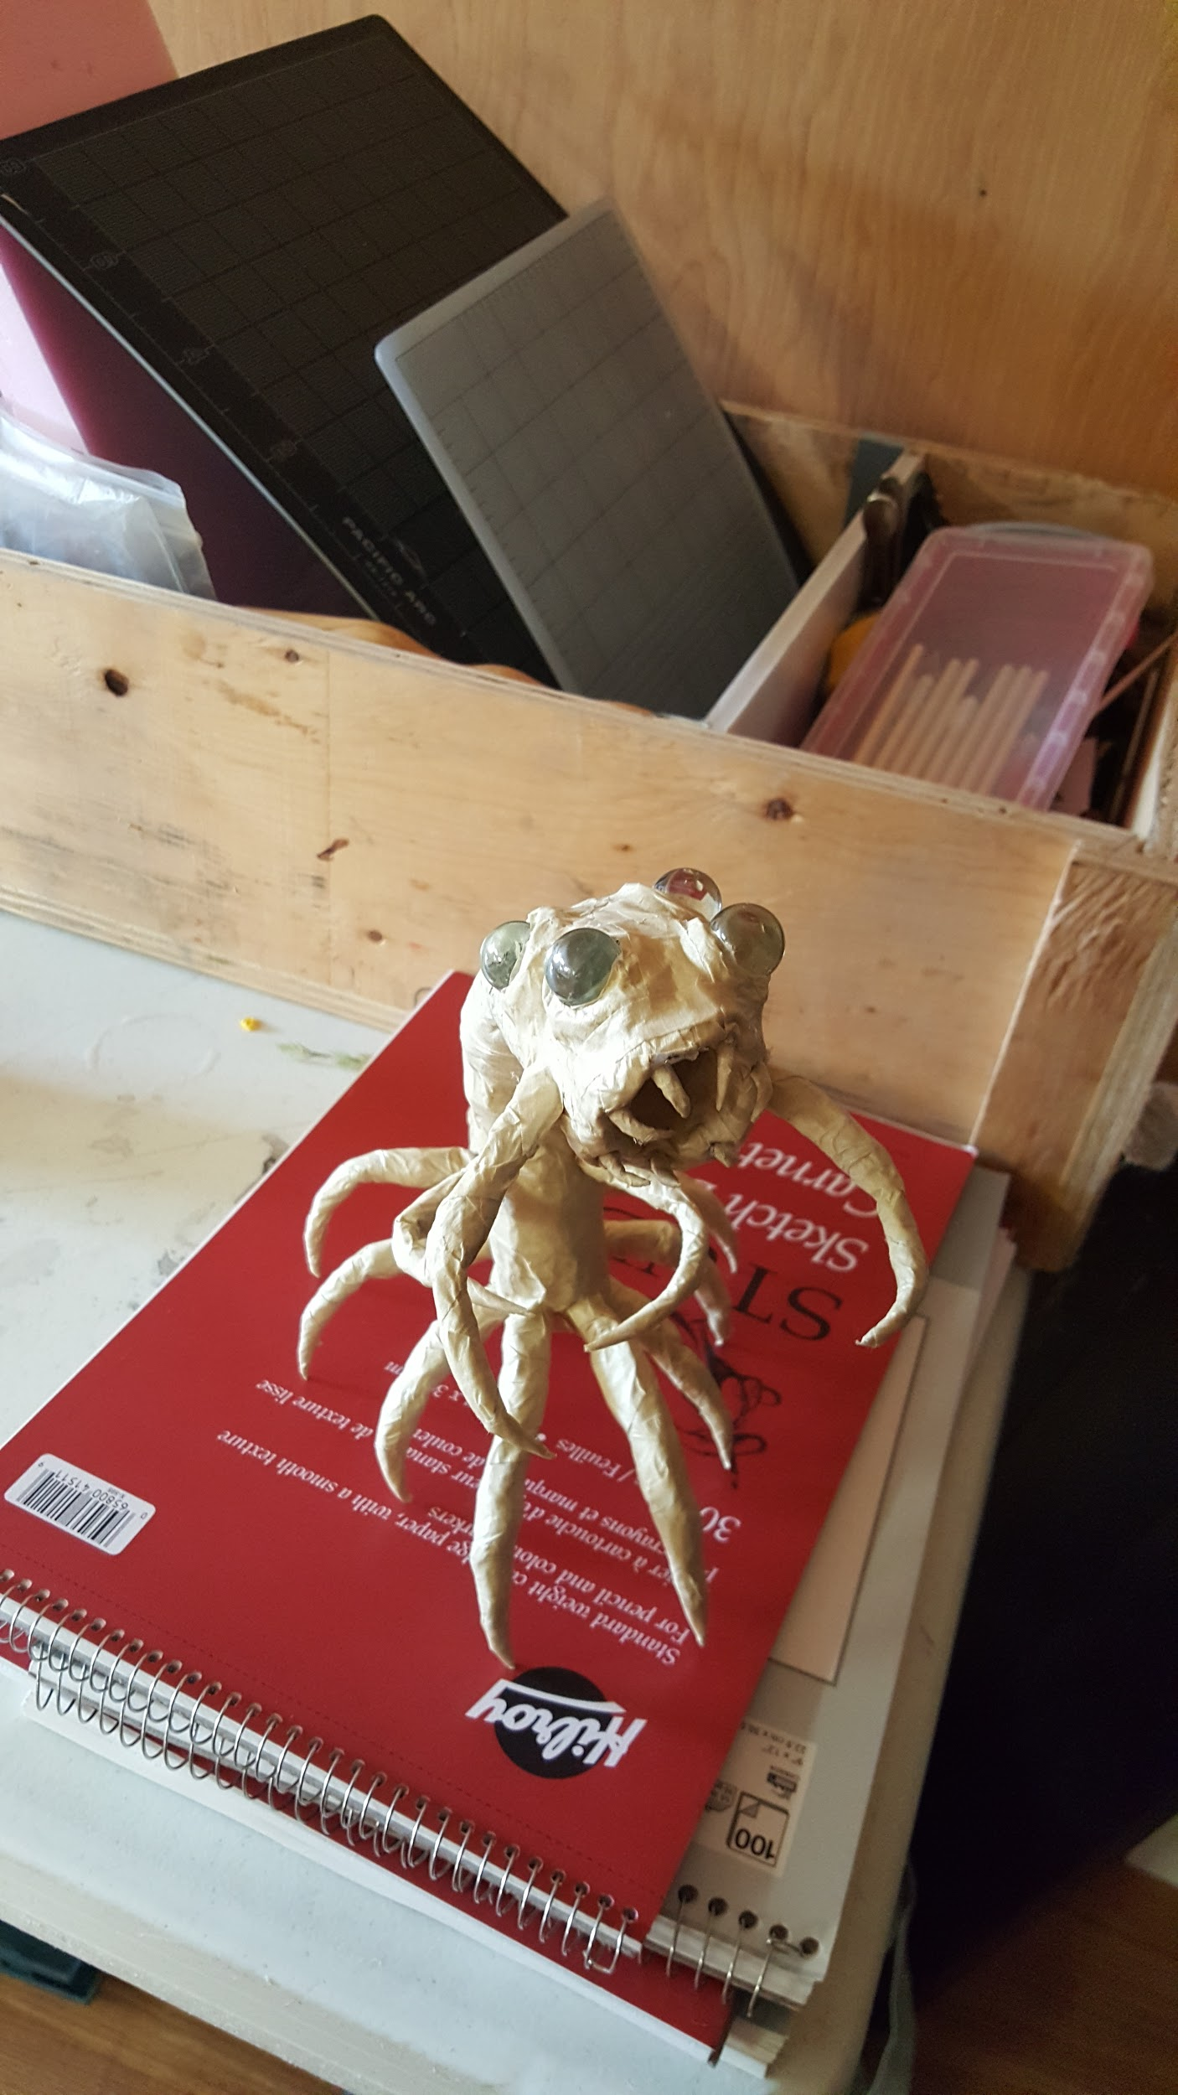
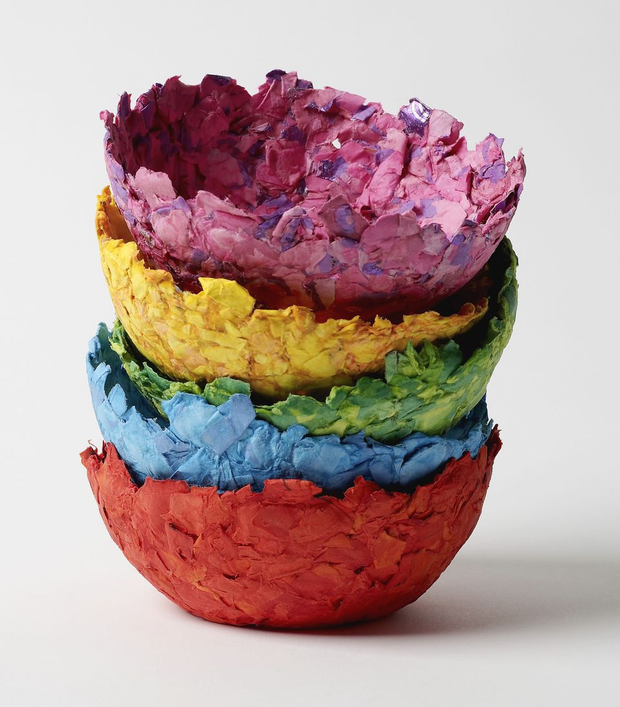

Slide 18
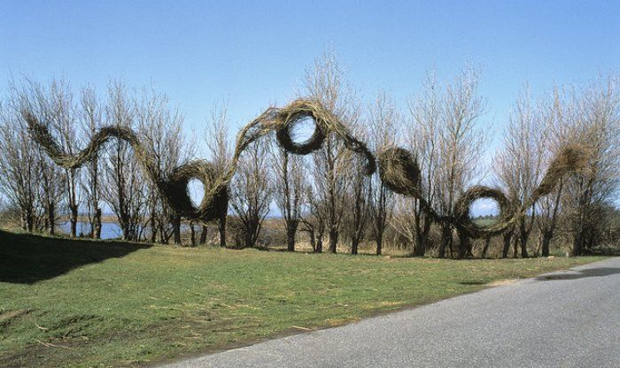

Slide 19
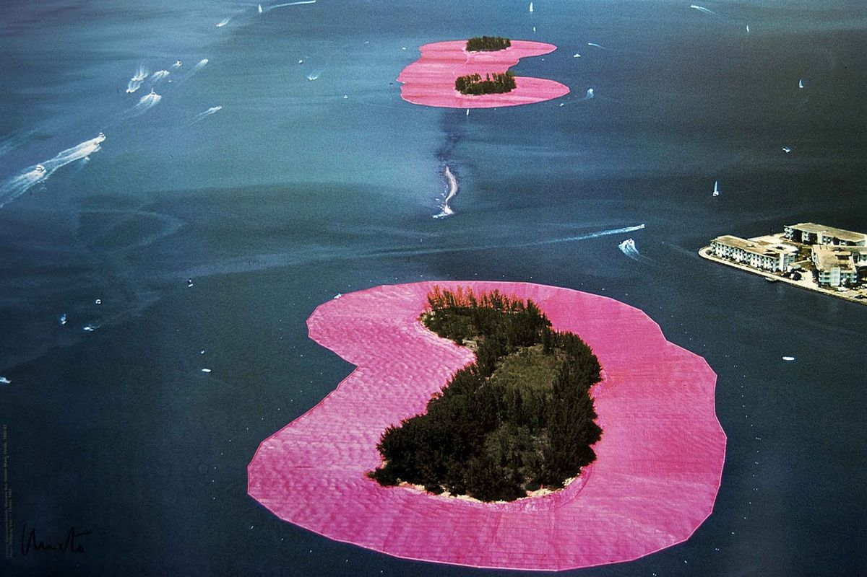

Slide 20
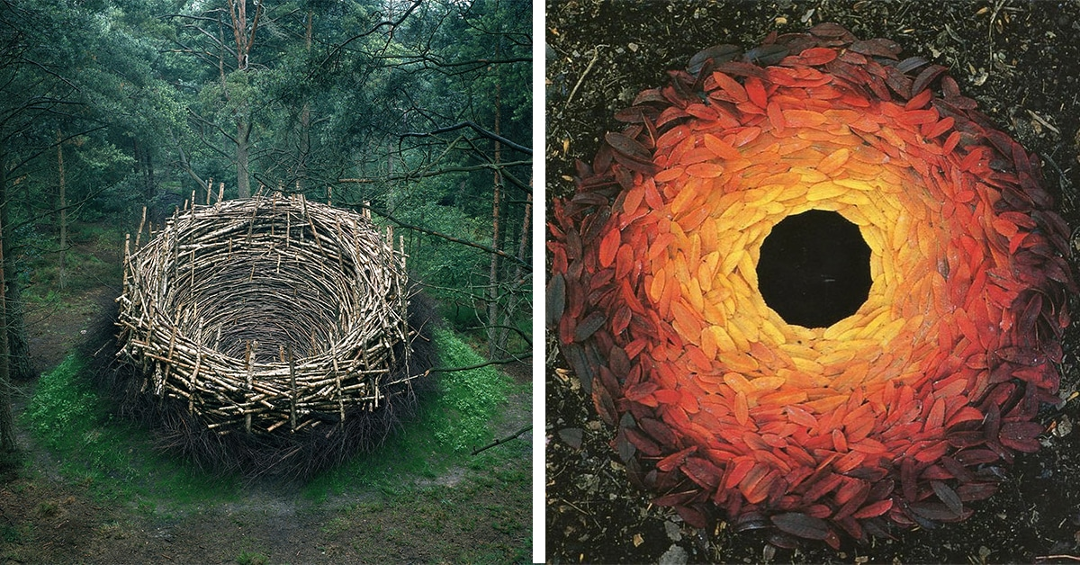

Slide 21
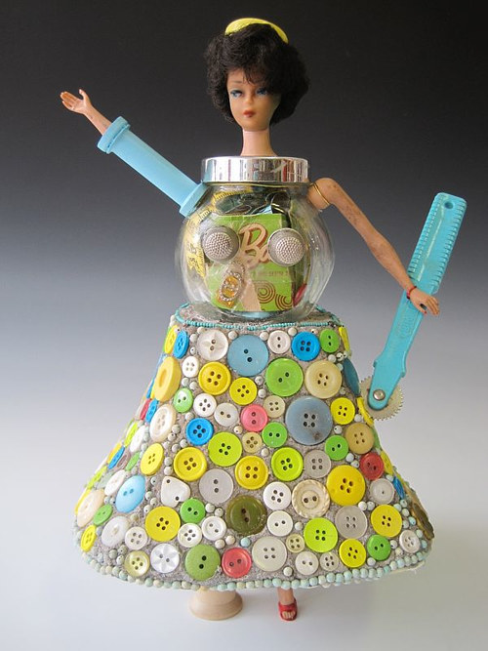
Assemblage/Found object sculpture
These sculptures are made by combining found objects to create new meanings

Slide 22
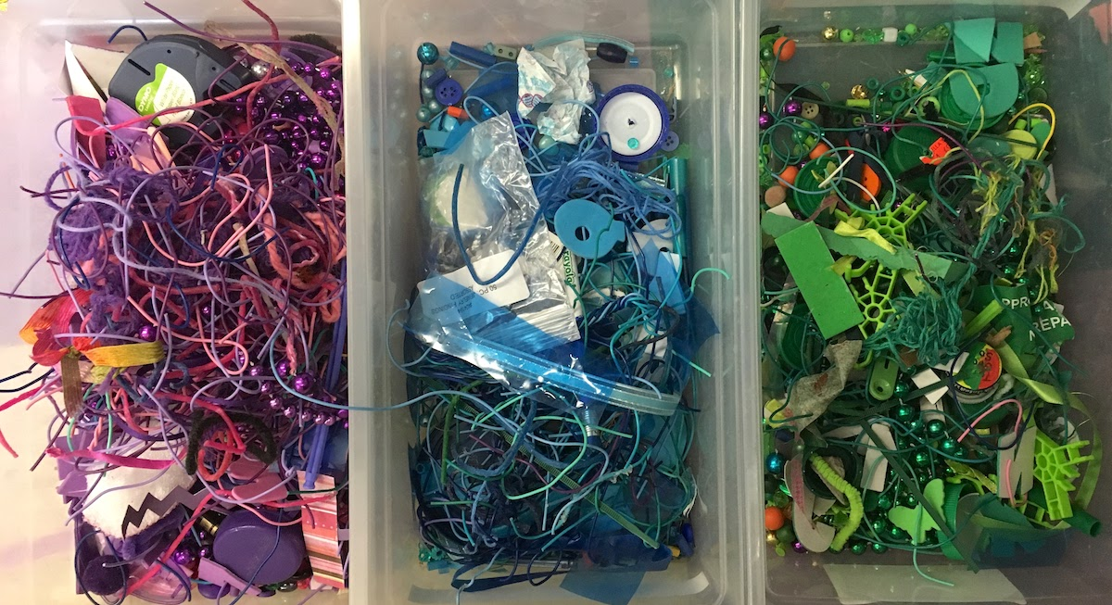

Slide 23
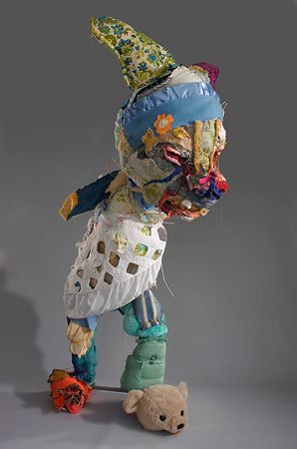
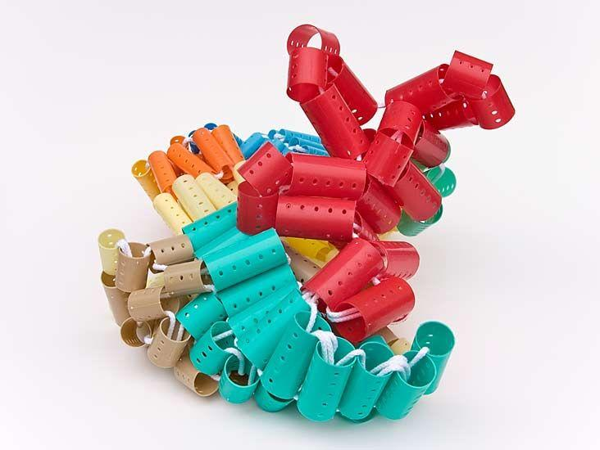

Slide 24
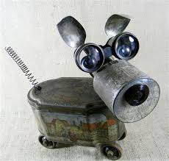

Slide 25
Your Assignment
This is a wide open, flexible assignment. You may create any sculpture you like, using any materials you like. It may be temporary (for example a sculpture made of rocks on a riverbank) in which case you will have to send me a few photos for assessment. Your sculpture may be large or small, carved, assembled, formed by hand, sewn, glued...
Please do not submit a craft that has come in a kit, or that follows step-by-step instructions. This sculpture must be original art; it can be inspired or influenced by another artist but should be your own, unique creation.
Your sculpture must be 3D – able to be viewed from all sides

