Slide 1

Module 4, Assignment 1:
Learn About Mixed Media & Fibre Arts
This is an assignment where you watch and Learn, but don’t submit anything.

Slide 2
Watch these Short Videos to start:
Fibre Art Video
The point here is to get you thinking about how and why some artists gravitate to alternative materials.
The History of Fibre Art
One Fibre Artist Tells her Story
Fibre Artists describe their inspiration
(One artist makes art of human bruises)

Slide 3
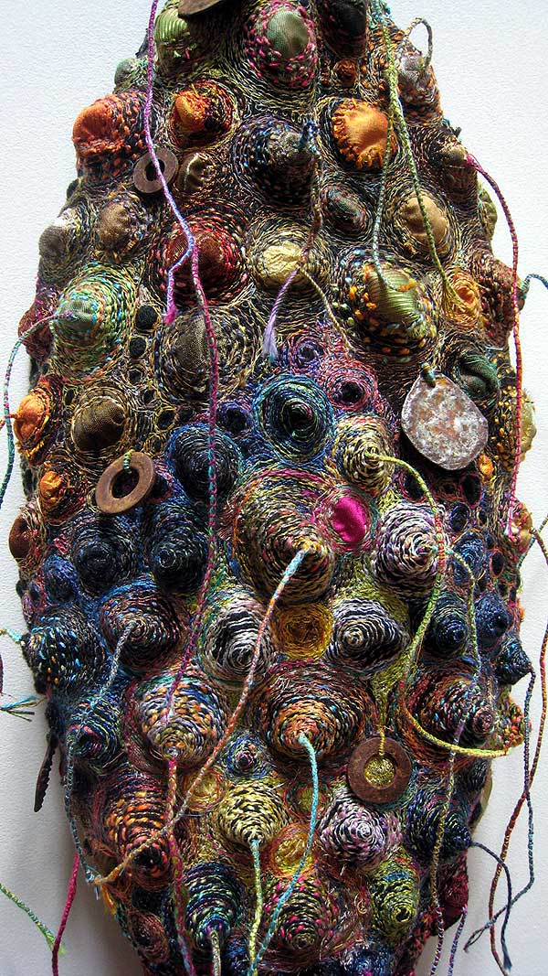
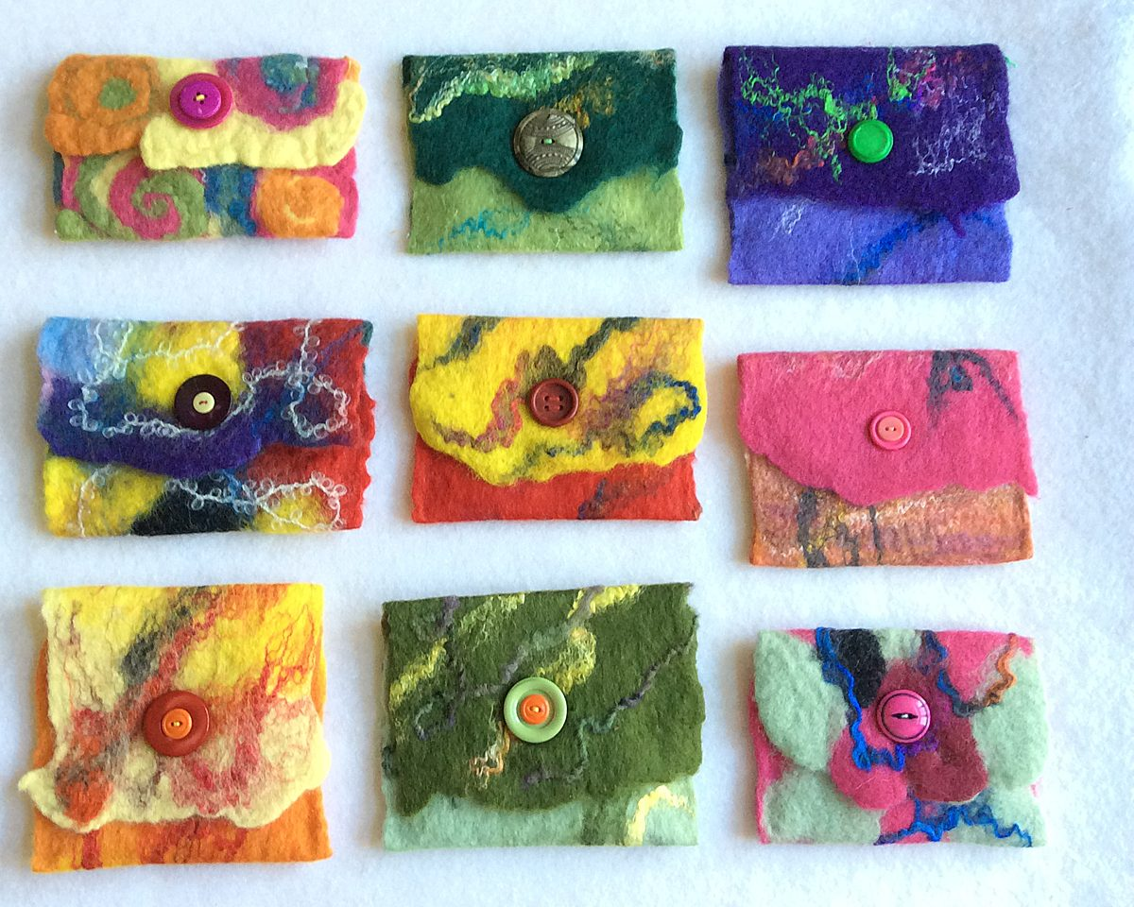

Slide 4
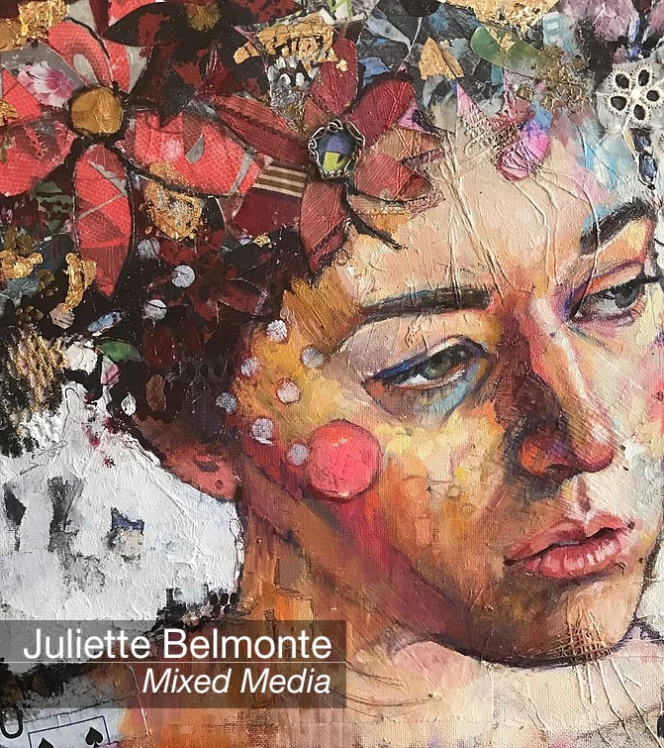
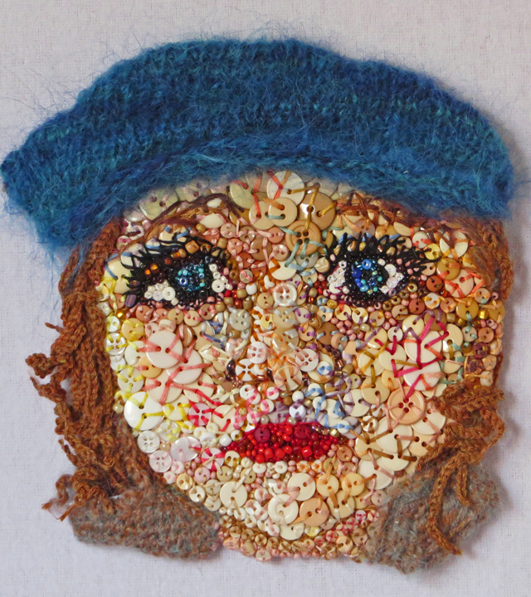

Slide 5
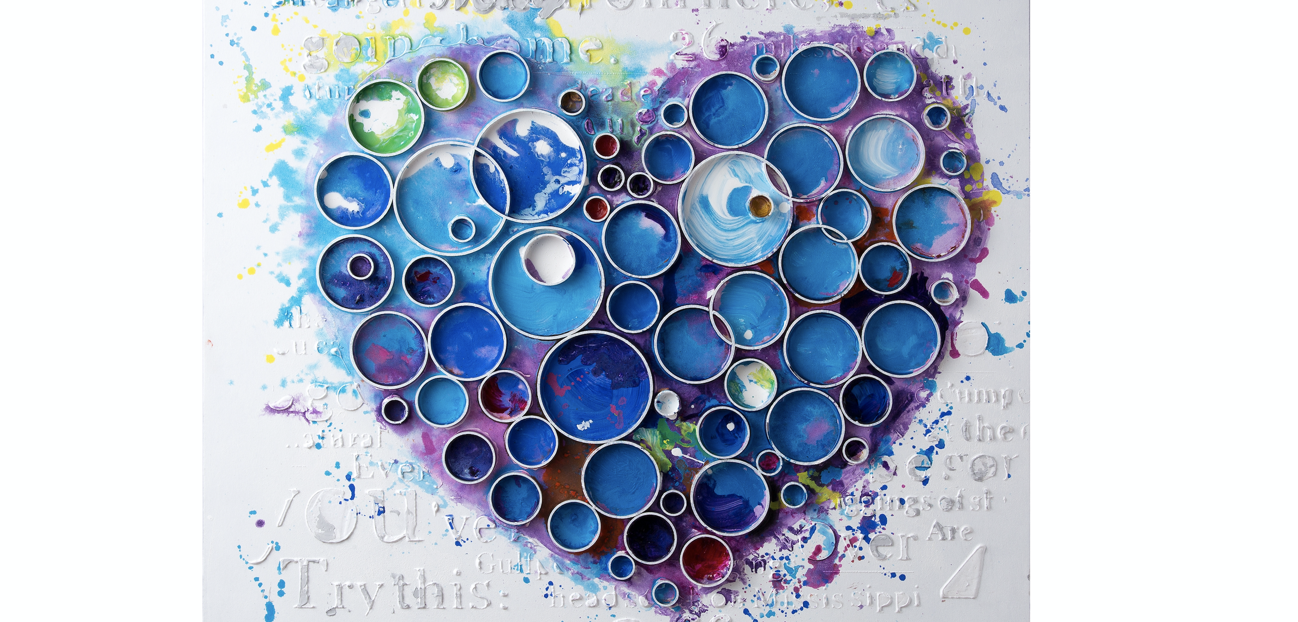

Slide 6
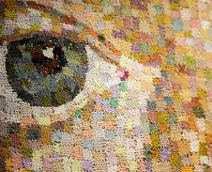
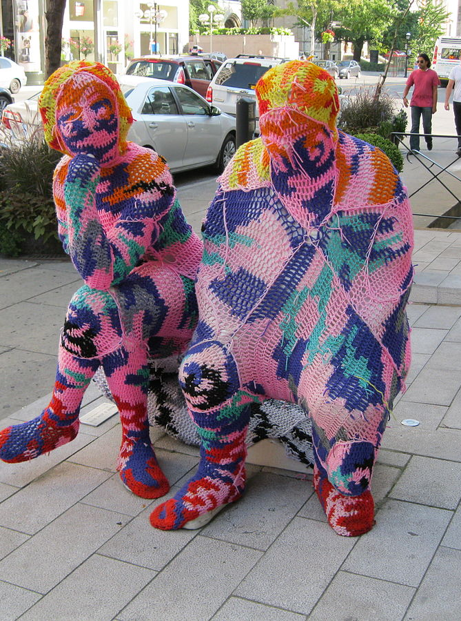

Slide 7
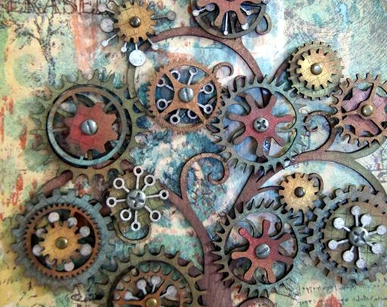
That’s it. Now go on to Complete Assignments 2 and 3
(When you view those Powerpoint lessons, they will be more beautiful and clear if you select view slideshow rather than watch in draft form. Just sayin’)

