Slide 1
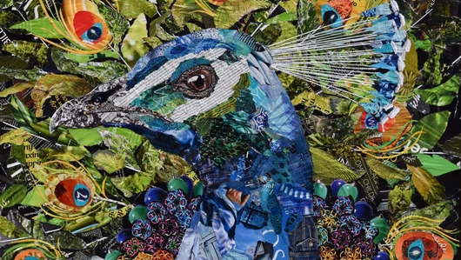
Module 4, Assignment 2:
Collage
A ‘drive you crazy” but satisfying assignment

Slide 2
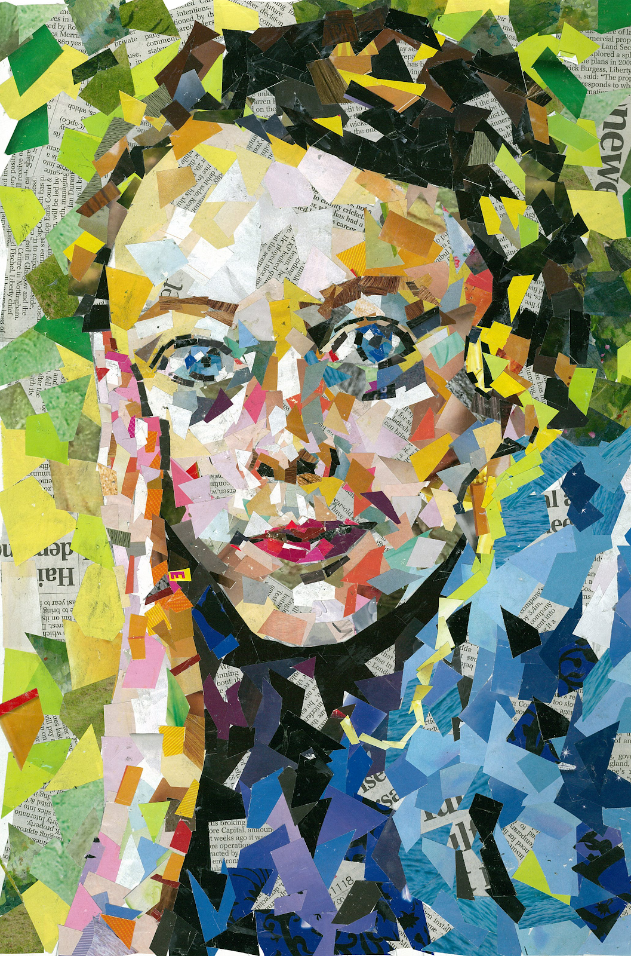
What you’ll need:
Substrate: Build your collage on a sketchbook page, a piece of sturdy paper, a canvas board, a piece of wood or an item of your choice. Collage works great on the lid of a box, the cover of a sketchbook or journal, a piece of furniture – whatever you like!
Collage Materials: Magazine pages work best, but any coloured paper will do. You can also use fabrics and strange items you find around the house. You can paint paper to make your own collage paper too.
Scissors
Glue: glue sticks work best, but any glue will do
Protection: If you happen to have a craft clearcoat, acrylic clear gel or any such material (white glue mixed with water works too), a clear coat at the end to protect is nice.

Slide 3
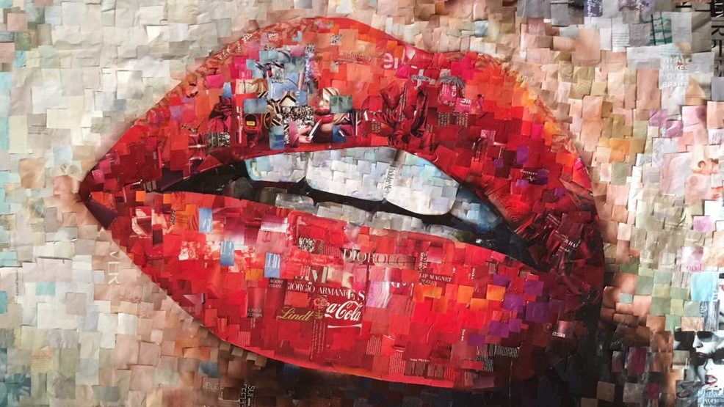
Use your Collage Materials like Paint. Cut pieces of colour to create your image

Slide 4
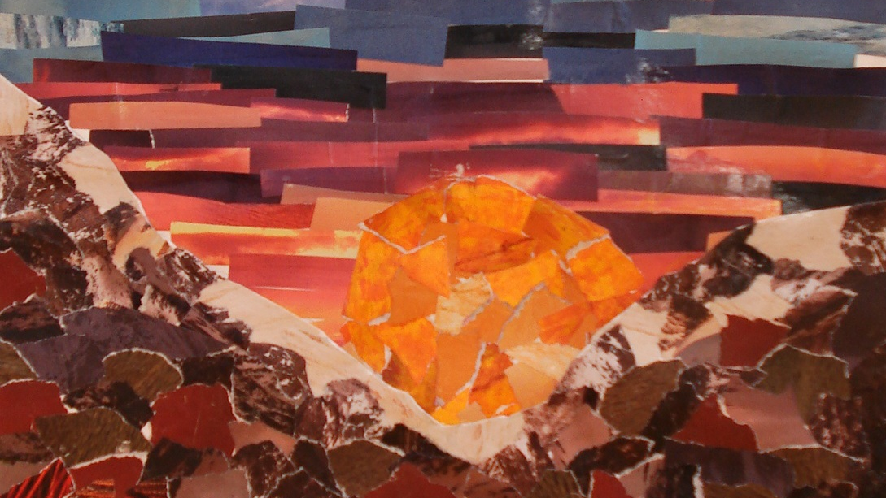
Complete and submit one collage, any size.

Slide 5
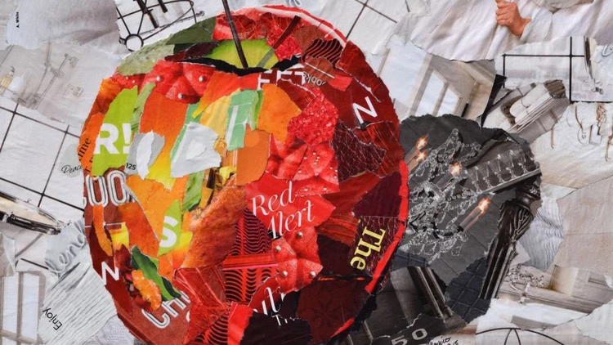

Slide 6
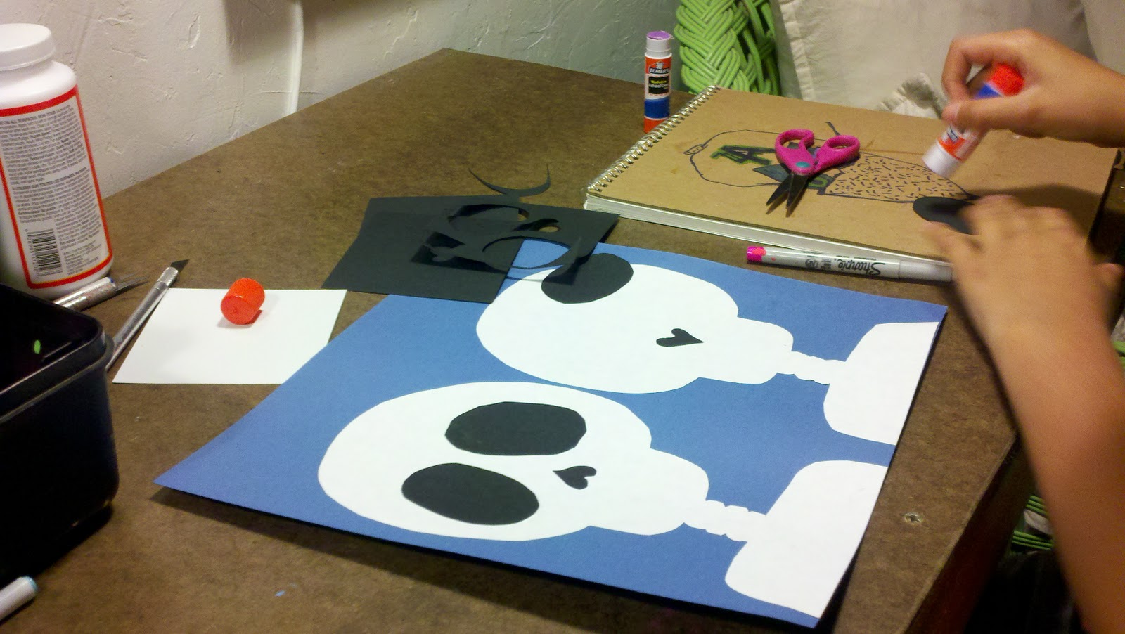
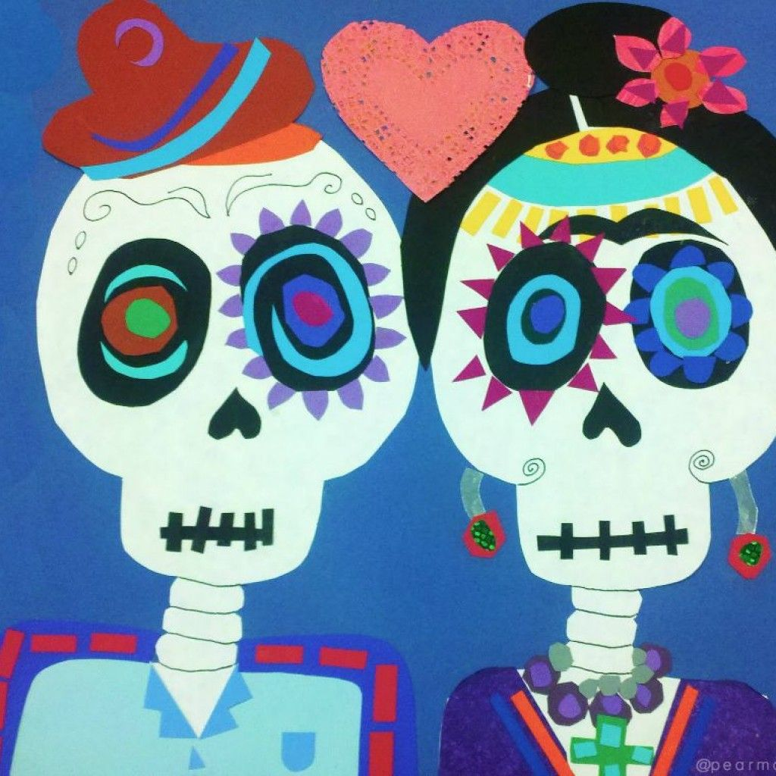
It doesn’t have to be too complex. Bigger, simple shapes will work too.

Slide 7
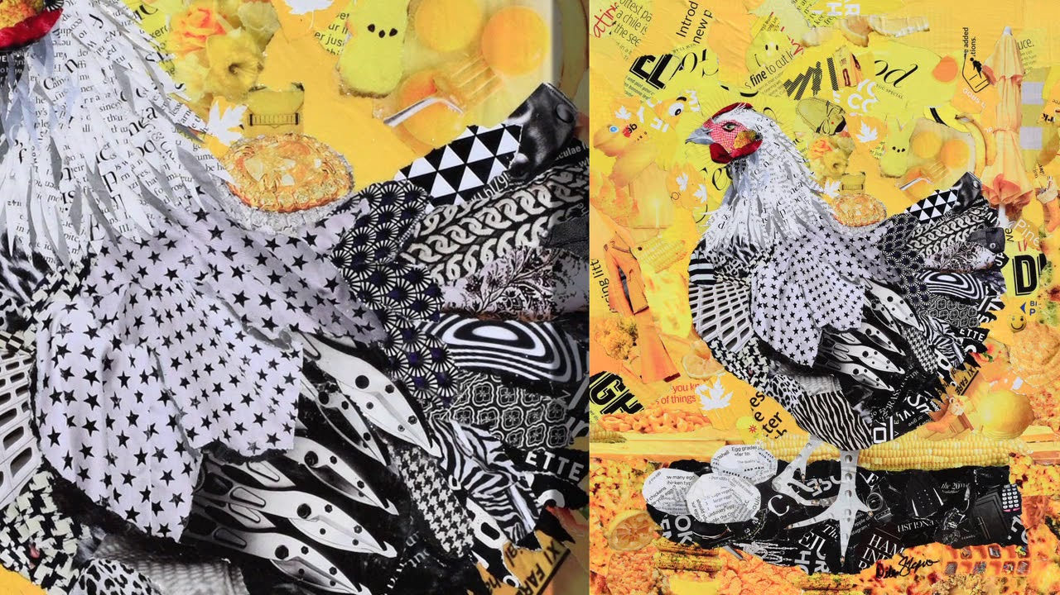
But the smaller pieces you use, the more intricate and amazing the image will be

Slide 8
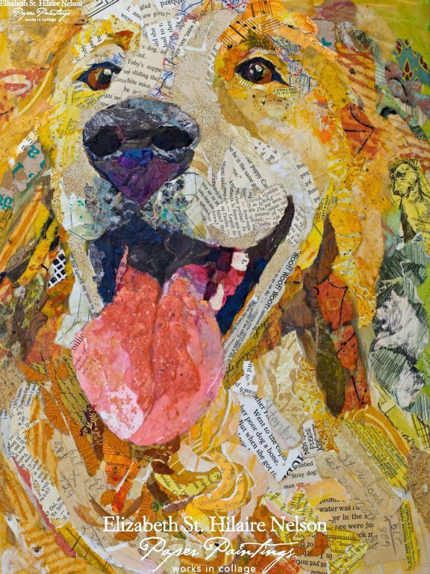

Slide 9
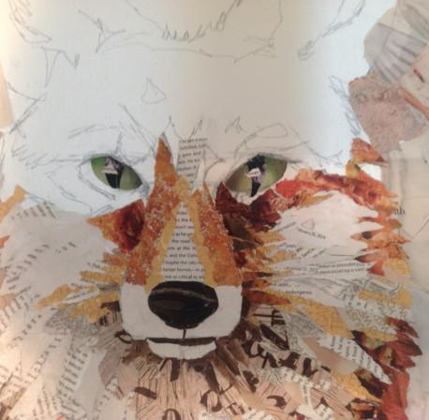
You can choose to start with a sketch, or paste an image down for a template and collage on top (a bit of a cheat – but this is a learning process so that’s OK here).

Slide 10
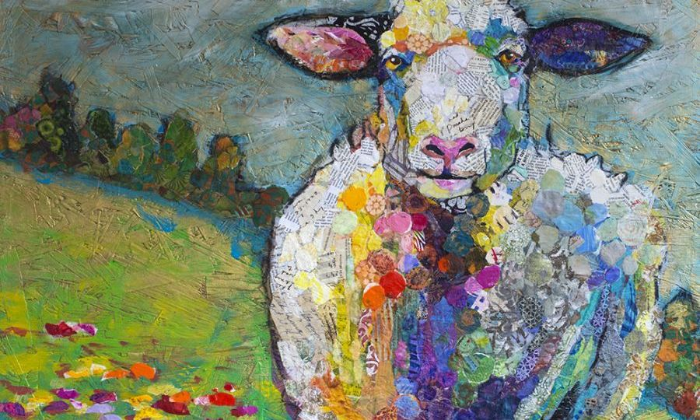
You can add paint to your collage if you like.

Slide 11
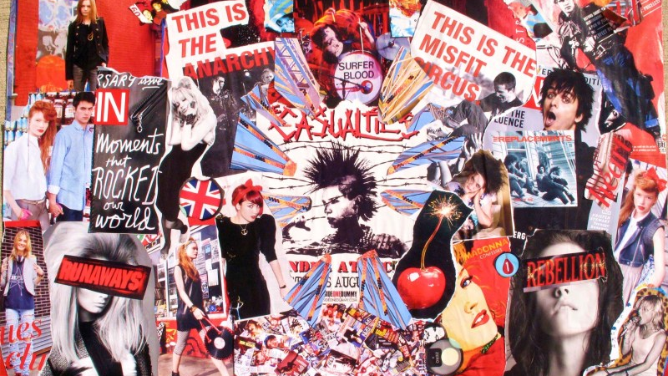
What not to do: We aren’t just finding images, and putting them together.

Slide 12
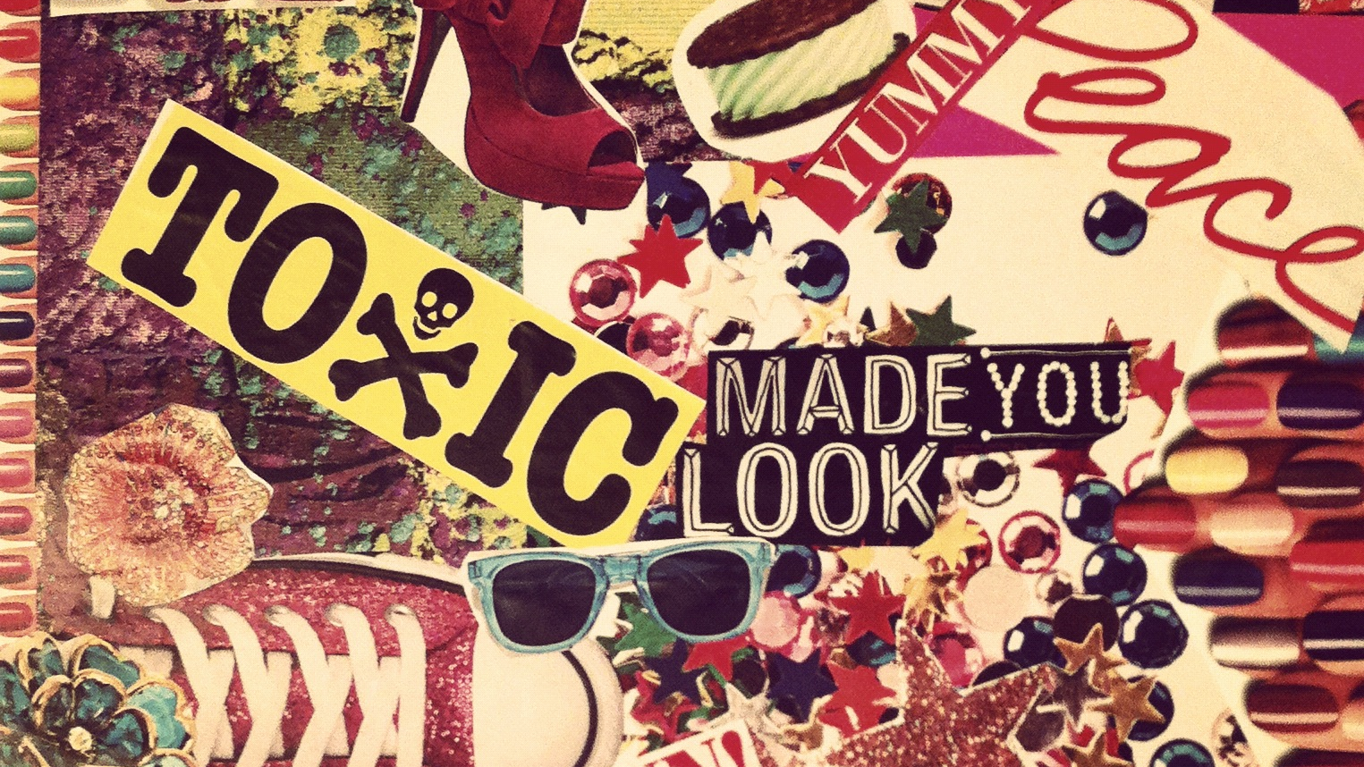
This kind of collage is fun, but won’t count in an ART class.

Slide 13
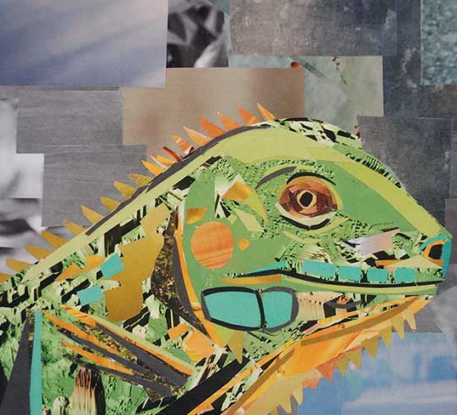
We’re looking for something more like this:

Slide 14
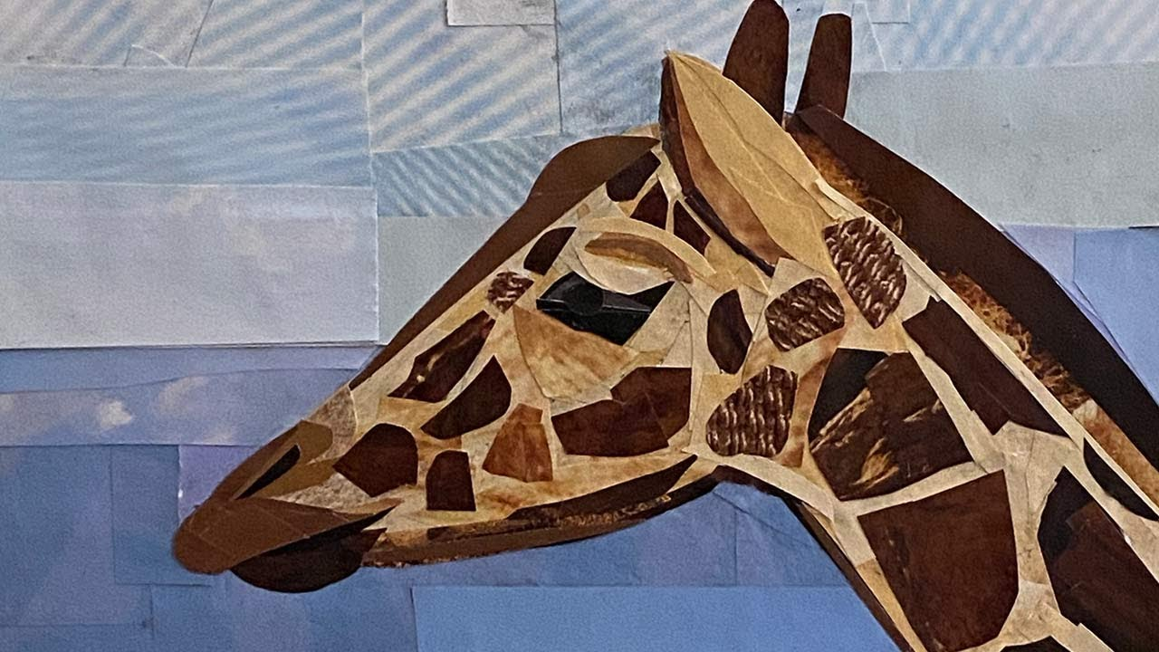
Or this:

Slide 15

Have Fun with it! Do an image search of “Magazine Collage” for more ideas…

