Slide 1
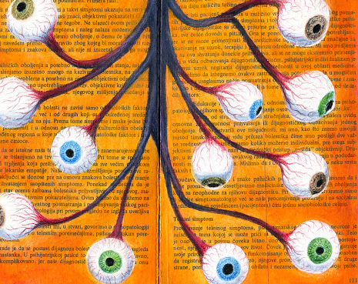
Module 4 Assignment 3:
Fibre Art/Mixed Media
This is an open, “your choice” assignment.

Slide 2
For this Assignment you will complete and submit one piece of Fibre Art or Mixed Media Art.
Your submission can be made from scratch, or it can be an item that you have found and altered.
You may have to do some research. The following slides will give you a list of words. Look them up on an image search, to see what inspires you.
Your project may be useful, functional, crafty, or purely decorative.

Slide 3
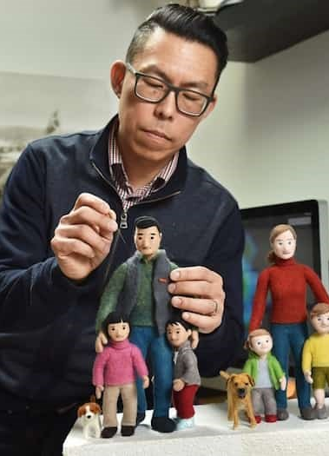
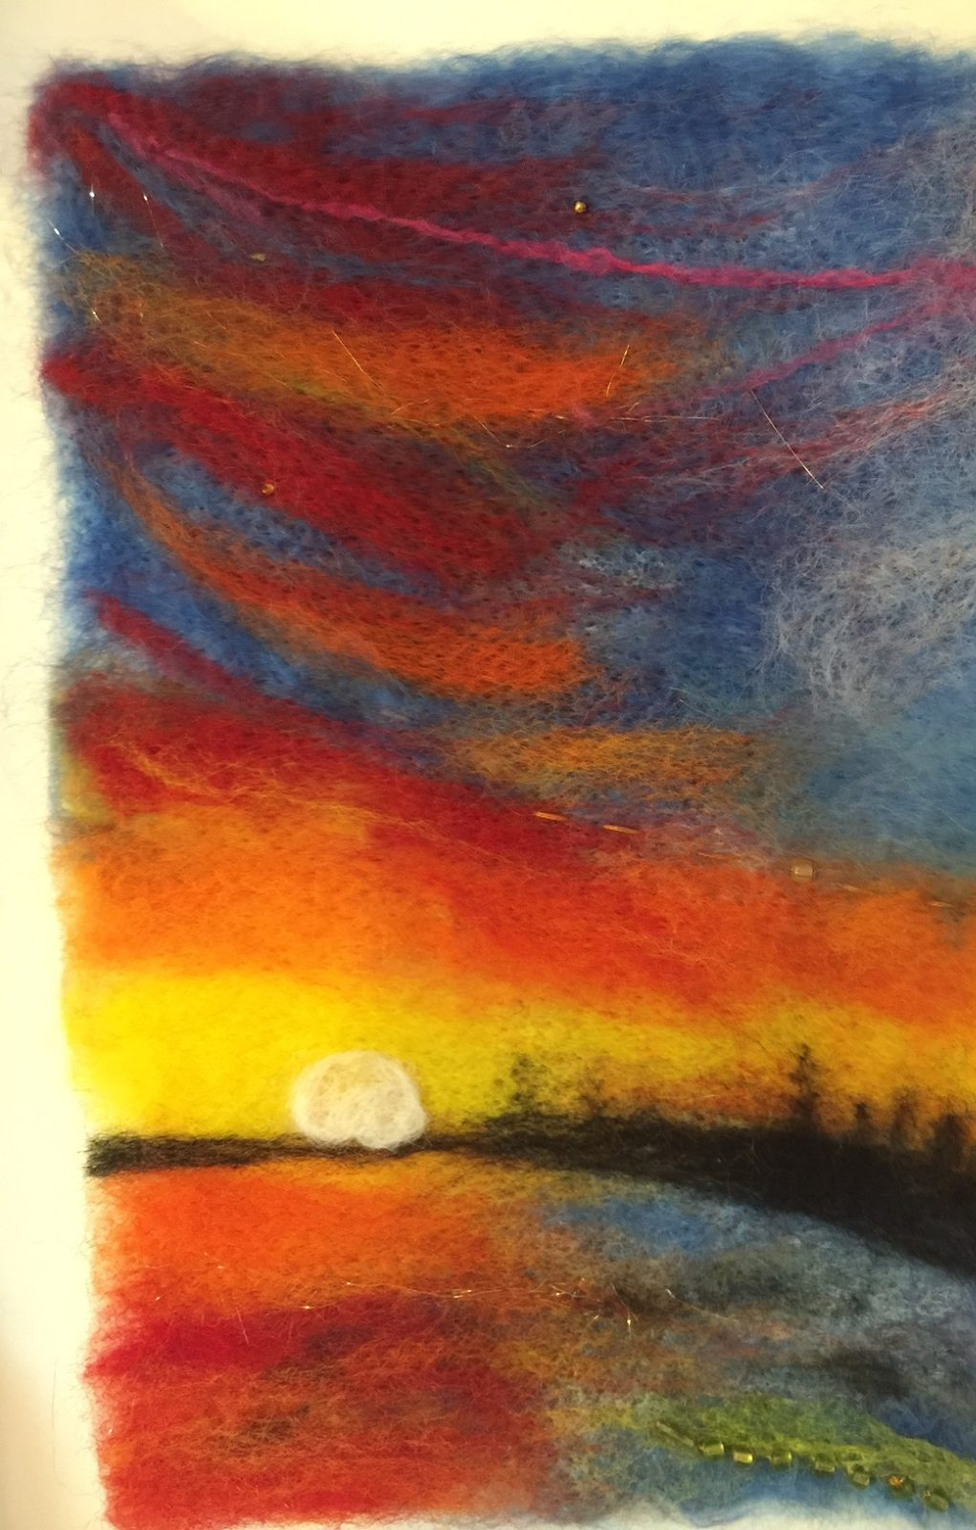
Needle Felting, Quilting

Slide 4
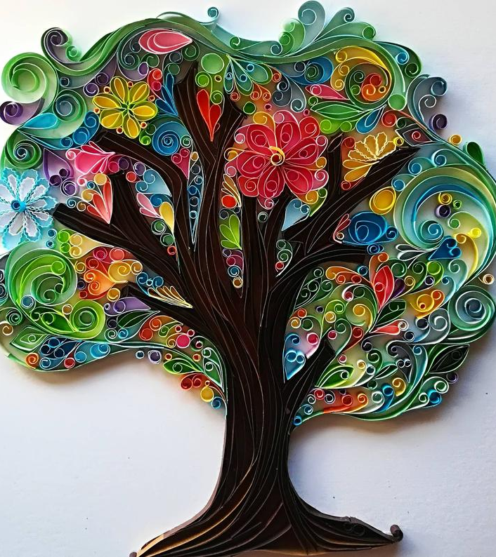
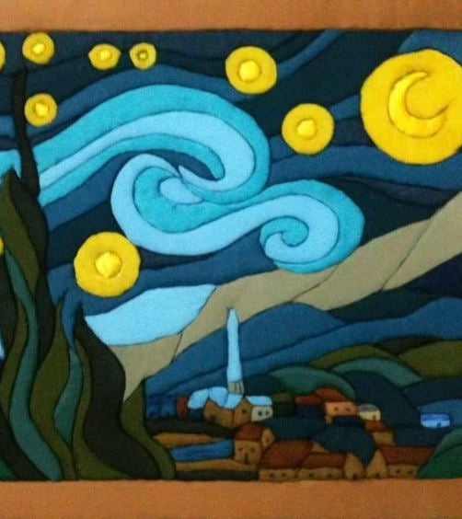

Slide 5
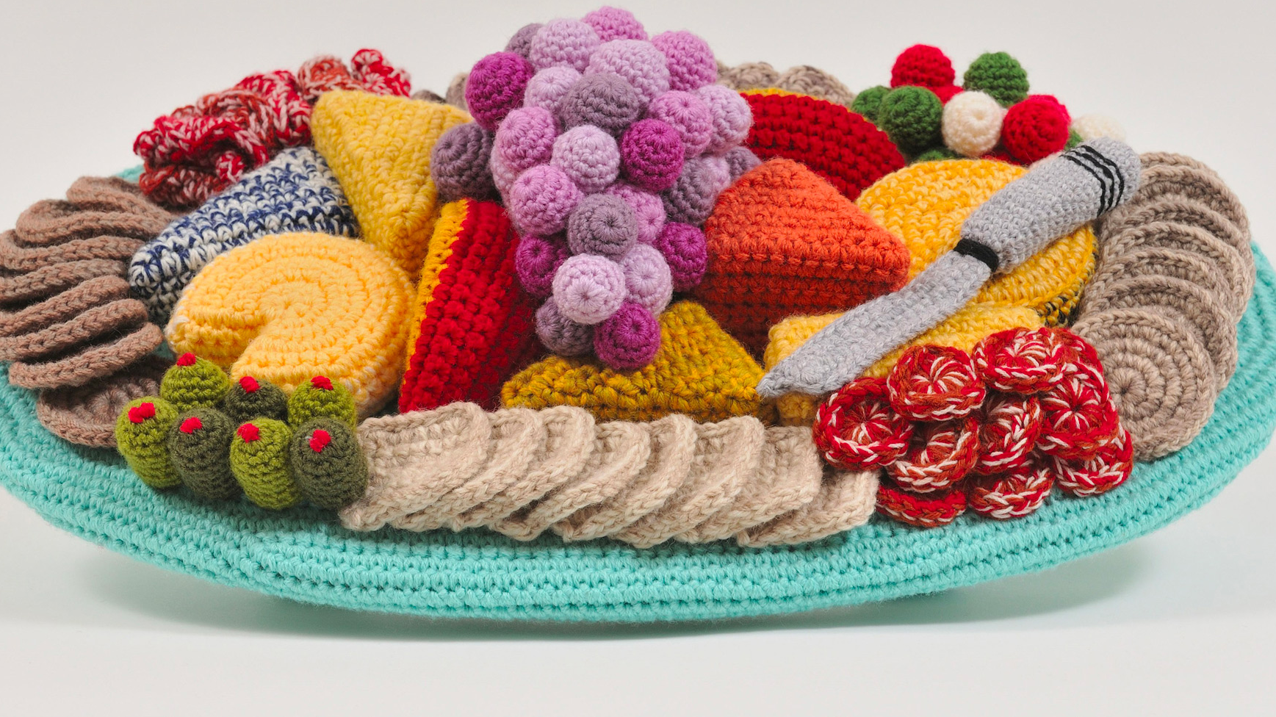
Crochet, Macreme, Knitting, Sewing

Slide 6
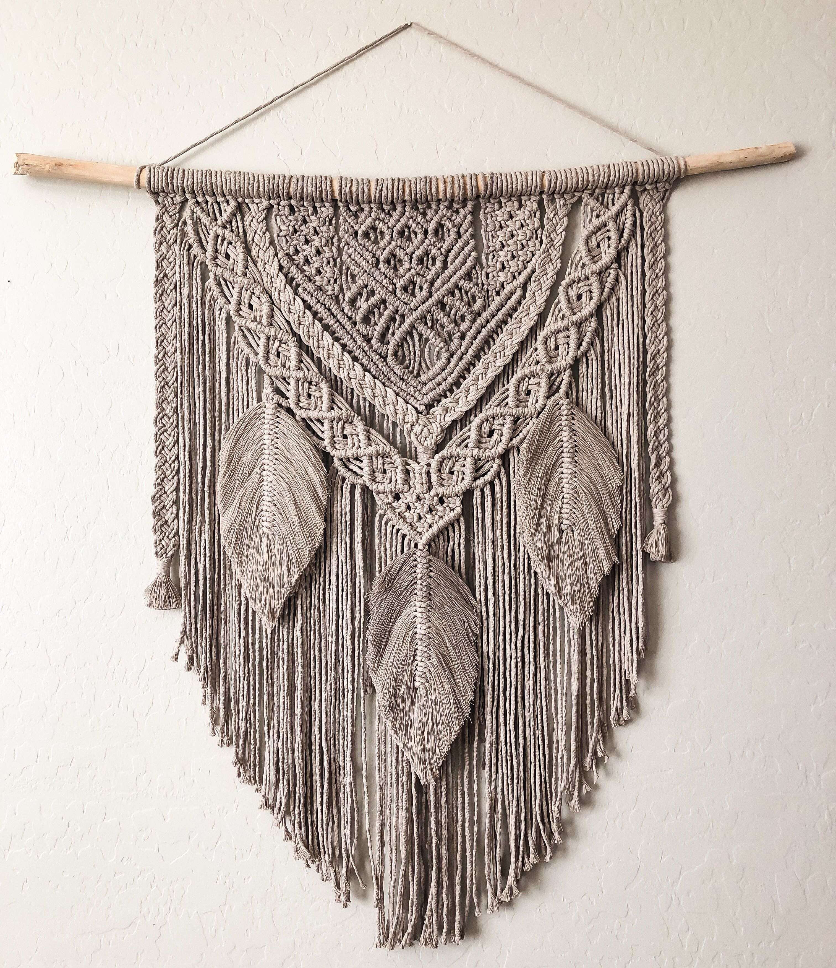
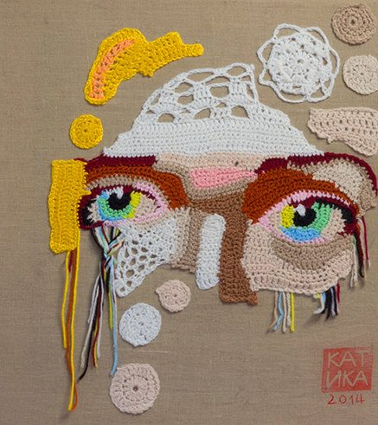

Slide 7
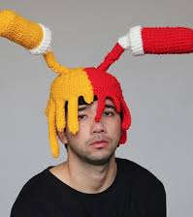
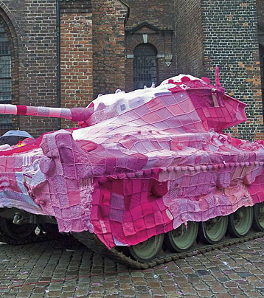

Slide 8
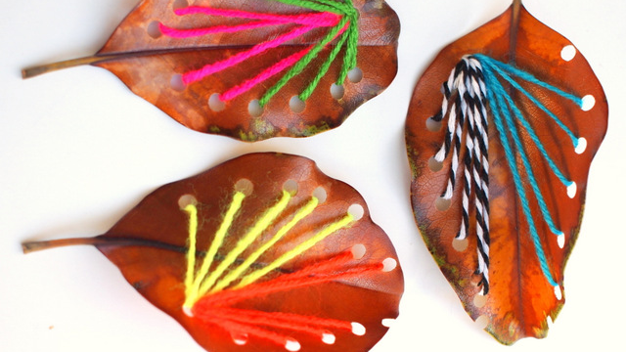

Slide 9

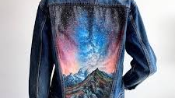
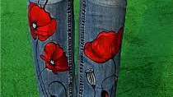
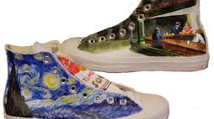
Painting on Fabric

Slide 10

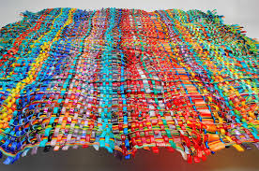
Weaving, Braiding

Slide 11
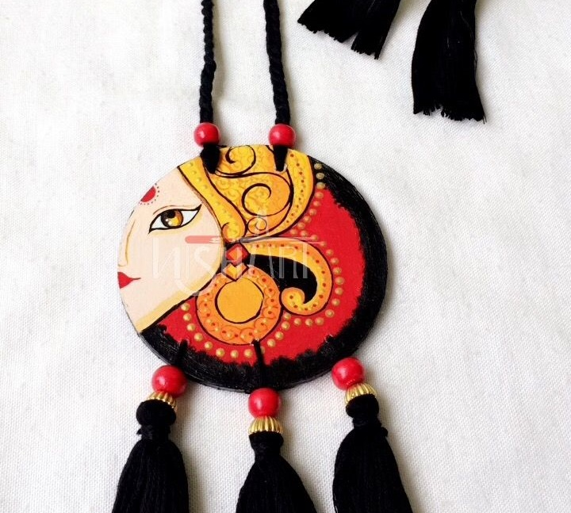
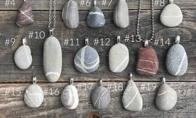
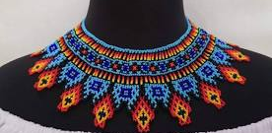
Jewellery

Slide 12
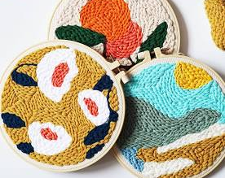
Cross-Stitching, NeedlePoint

Slide 13
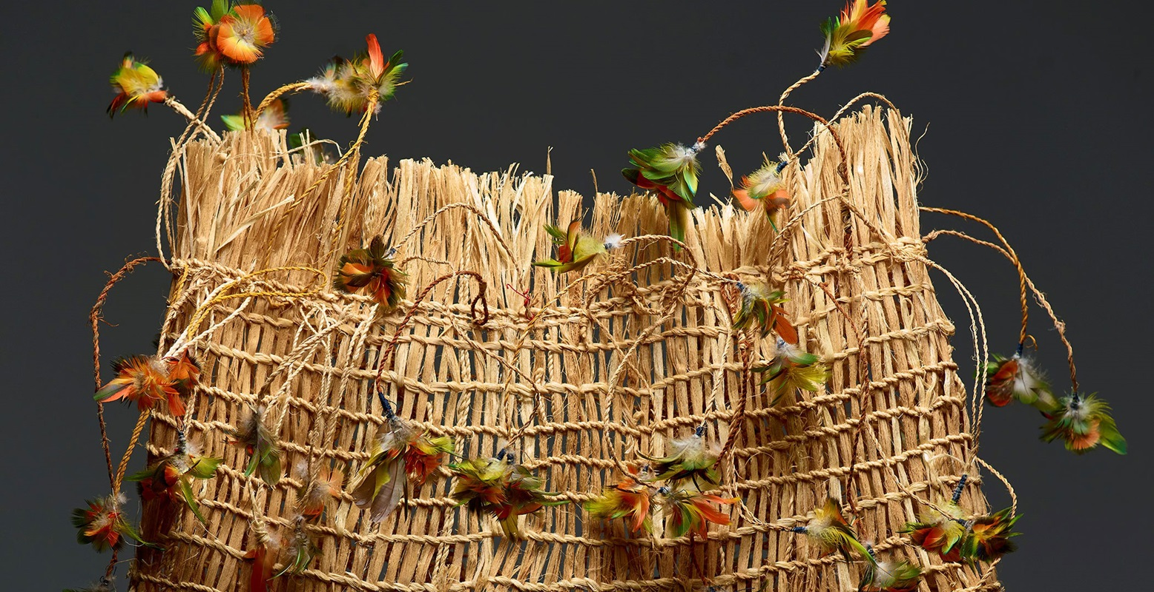
Your Own Idea of Fibre Art

Slide 14
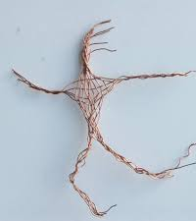
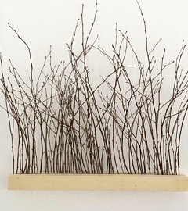

Slide 15
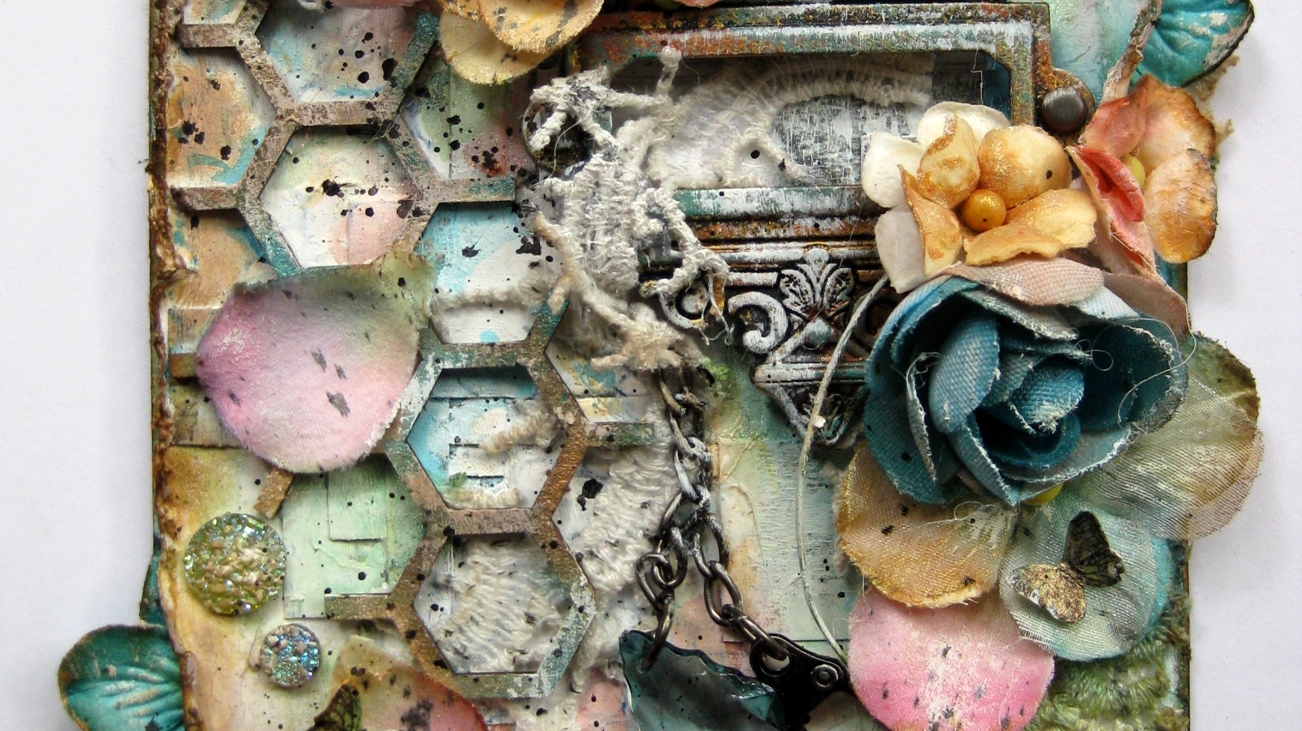
Your Own Idea of Mixed Media Art

Slide 16
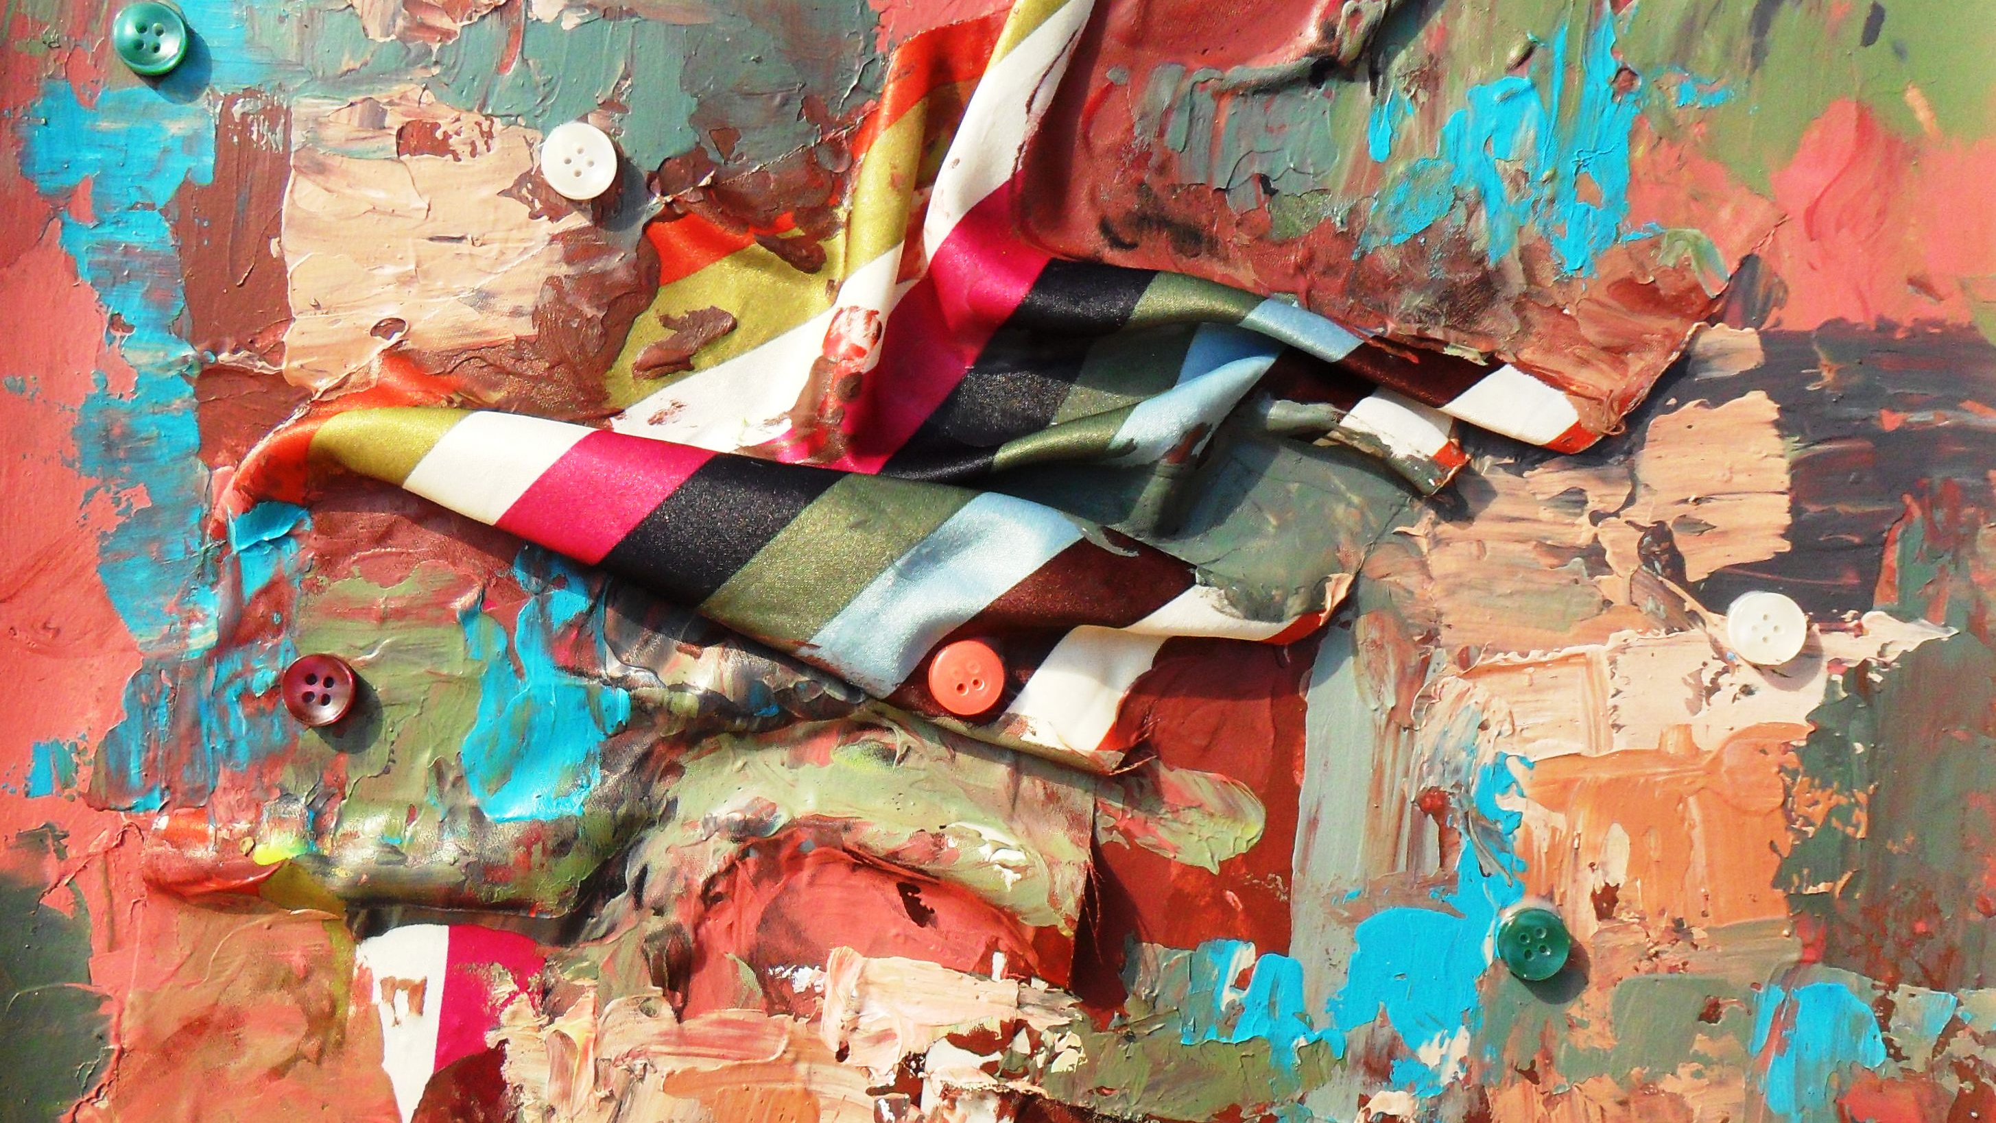
Your Submission can be any size, have fun and be creative!

Slide 17

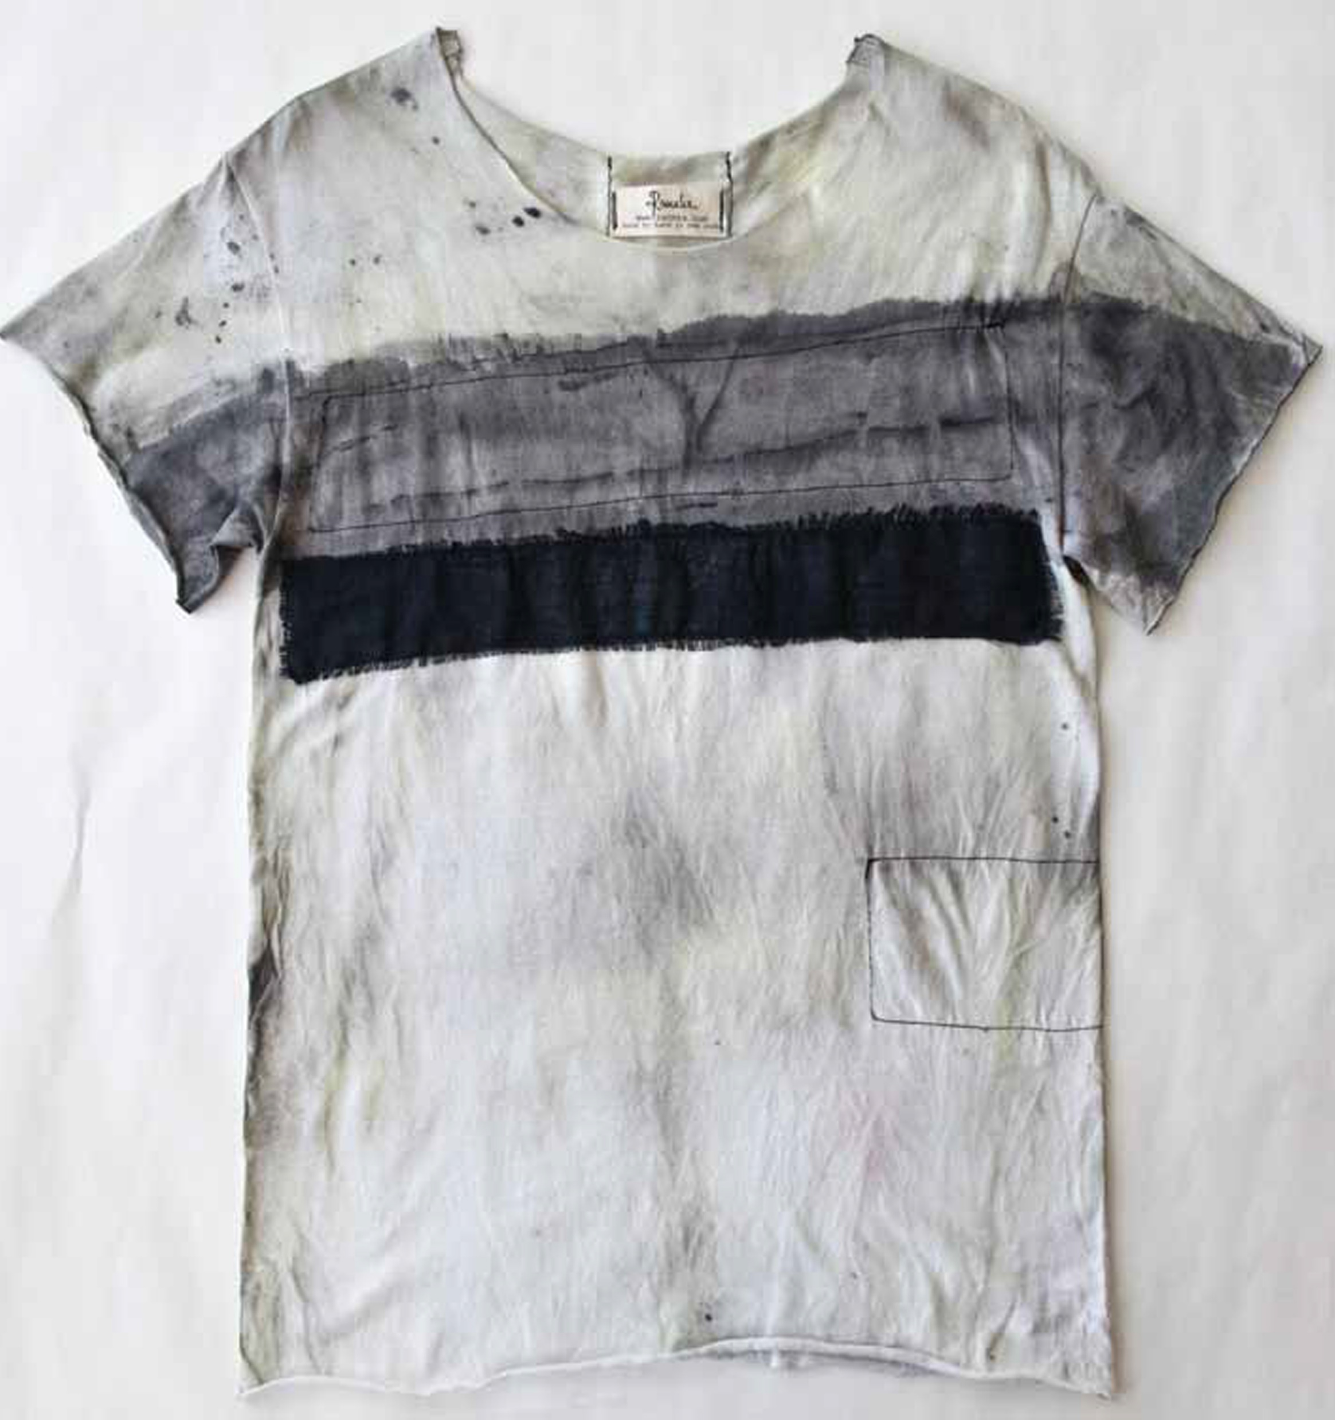
If this is tough, don’t start from scratch. Find something around your home and alter it.

