Slide 1
Printmaking
Art 10, 20, 30

Slide 2
In this unit we are going to learn about printmaking, and make a print at home

Slide 3
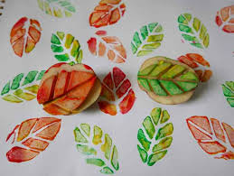

Slide 4
There are Many Types of Print
Tradition Methods include Serigraph (screen printing), Lithograph, Intalio and Relief Printing.
Monograph Printing is where there is only one print made (Mono), while typically prints are made in series or ‘editions’.
Some Methods are Traditional, while some are Non-Conventional/Alternative

Slide 5
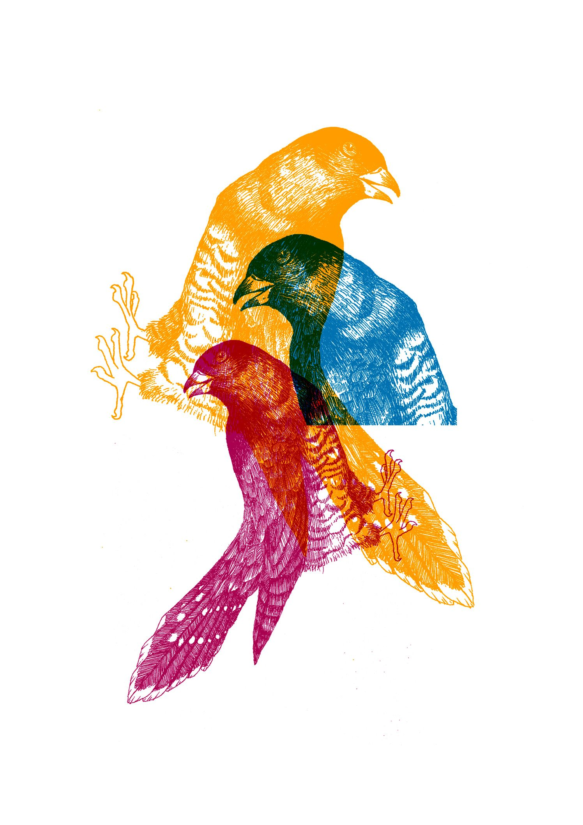
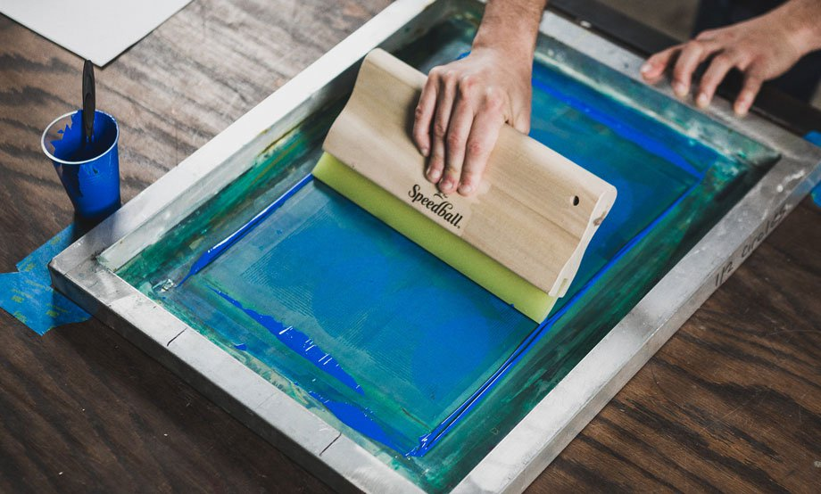
Screen Prints

Slide 6
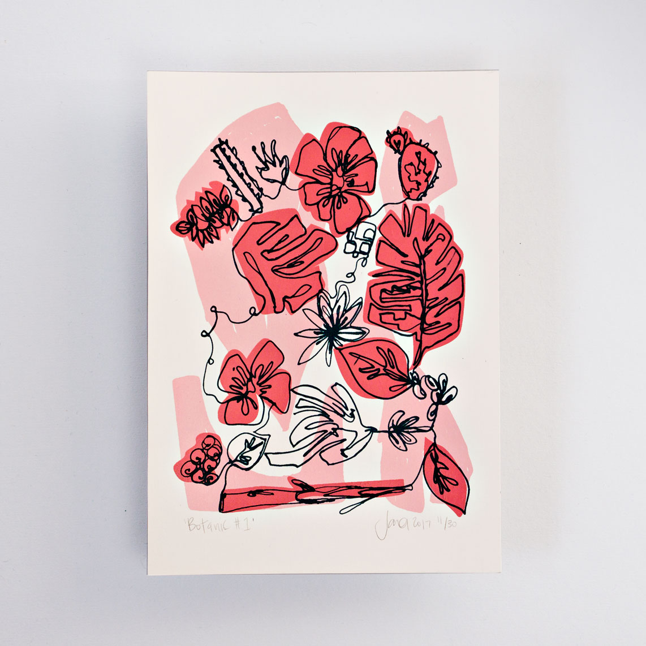
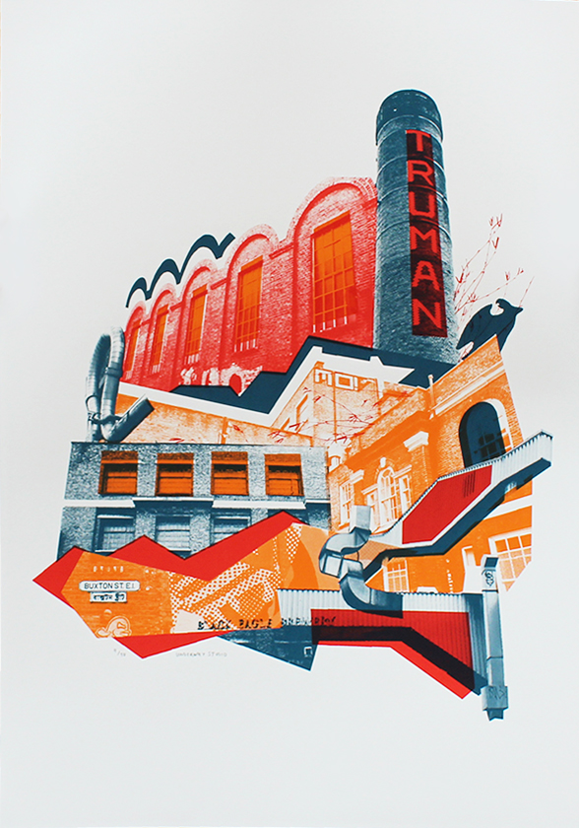

Slide 7
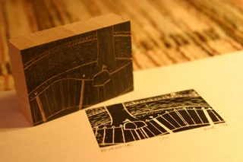
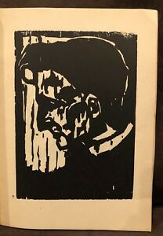
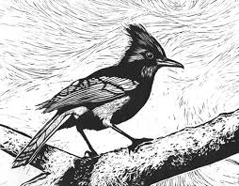
Woodcuts (relief prints)

Slide 8
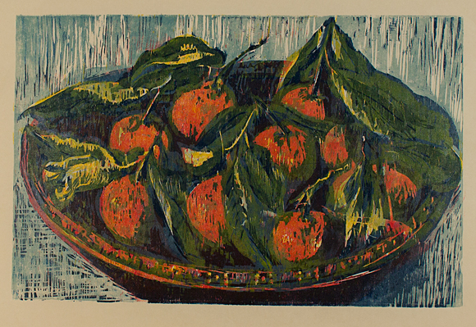

Slide 9
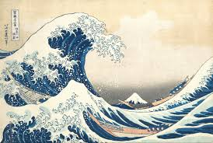

Slide 10
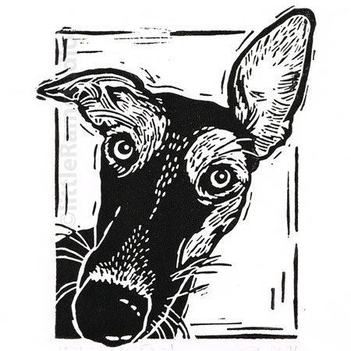
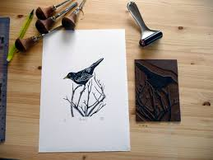
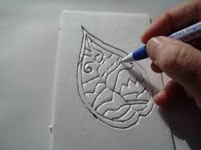
Lino-cuts ( also relief prints ) (Styro-Prints are a way to do this at home)

Slide 11
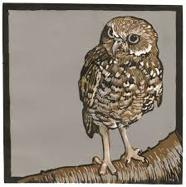
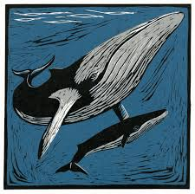

Slide 12
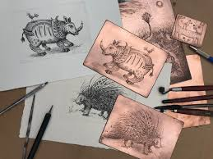
Intalio (etchings on Copper)

Slide 13
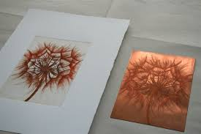
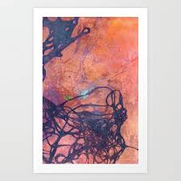
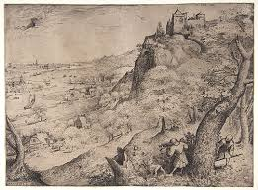

Slide 14
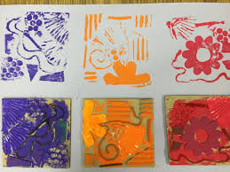
Collograph (build a collage, print it)

Slide 15
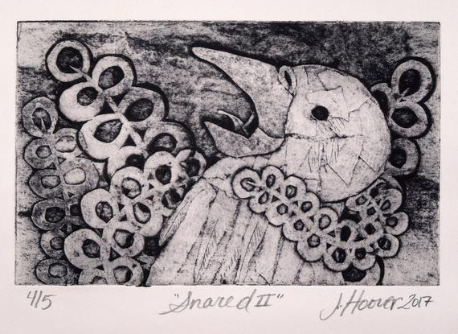

Slide 16
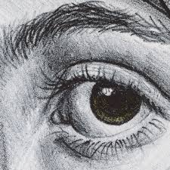
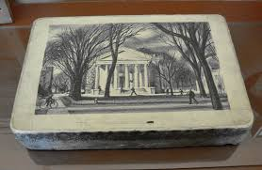
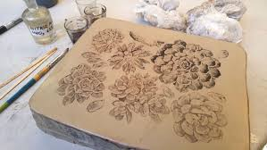
Lithography

Slide 17
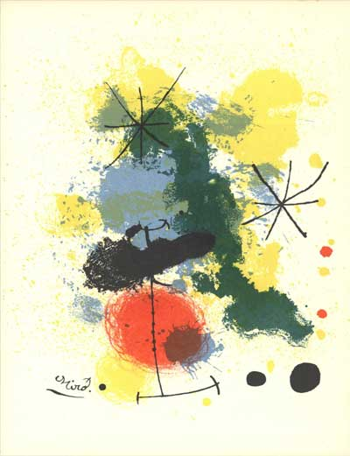
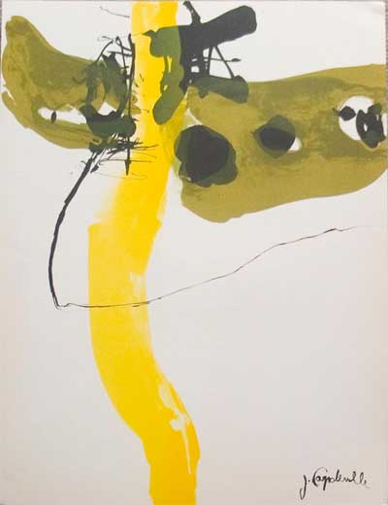

Slide 18
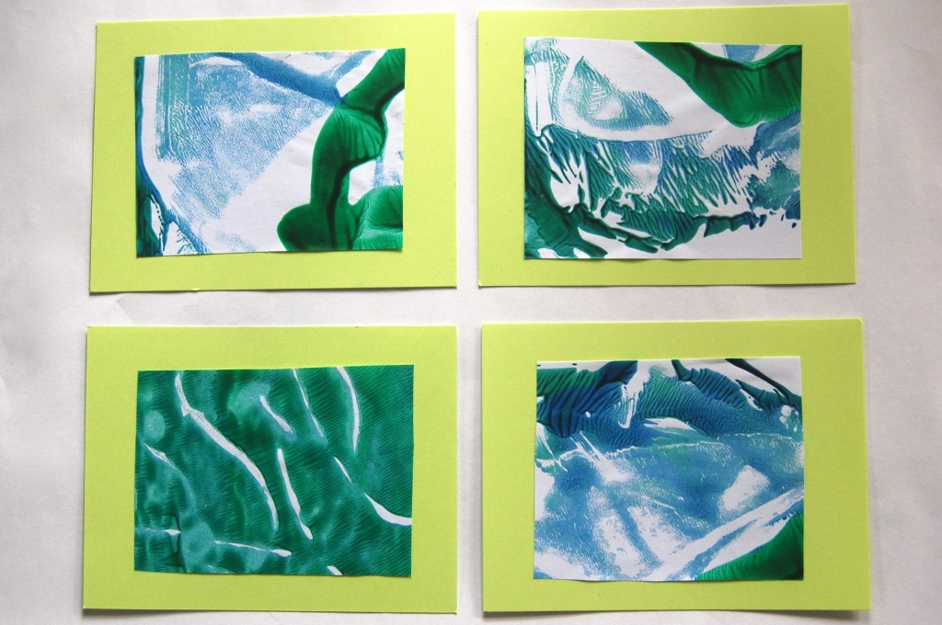
Monoprints

Slide 19
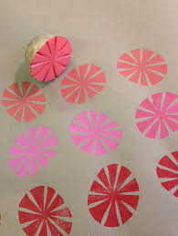
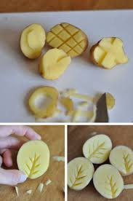
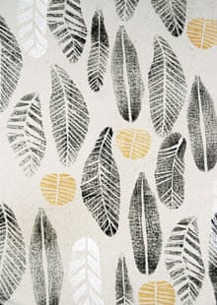
Potato Prints (mono)

Slide 20
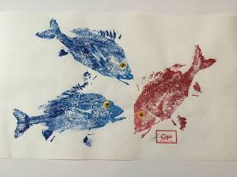
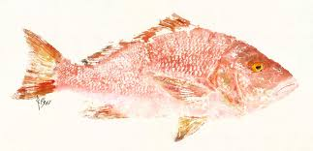
Fish Prints (mono) (works best on Frozen fish)

Slide 21
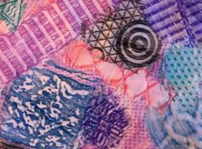
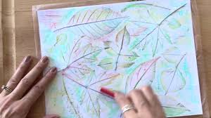
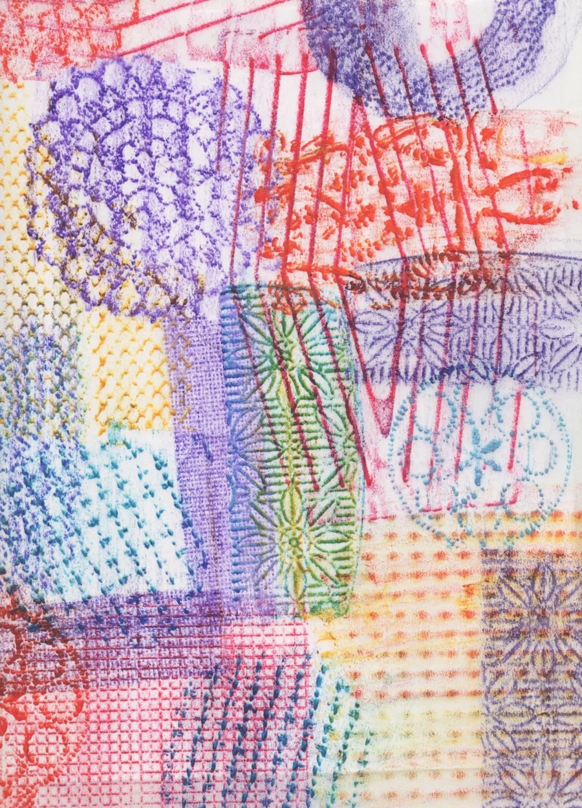
Rubbings (yes, that’s Printmaking)

Slide 22
Your Assignment:
Watch the Videos on the next Slide to Learn More
Research the topic “Printmaking at Home”
Create a series of 4 Prints. If you choose Monoprints, they will be similar but different. If you choose a method that allows reproduction, there should be 4 in your edition (all the same).

Slide 23
To Learn more...
https://www.youtube.com/watch?v=-BYHn5Vum_A&t=9s
https://www.youtube.com/watch?v=soVrto5reI0
https://www.youtube.com/watch?v=3RUsR3cXRos
https://www.youtube.com/results?search_query=how+to+screen+print+using+the+stencil+technique+
https://www.youtube.com/results?search_query=screen+printing+on+paper

