Slide 1
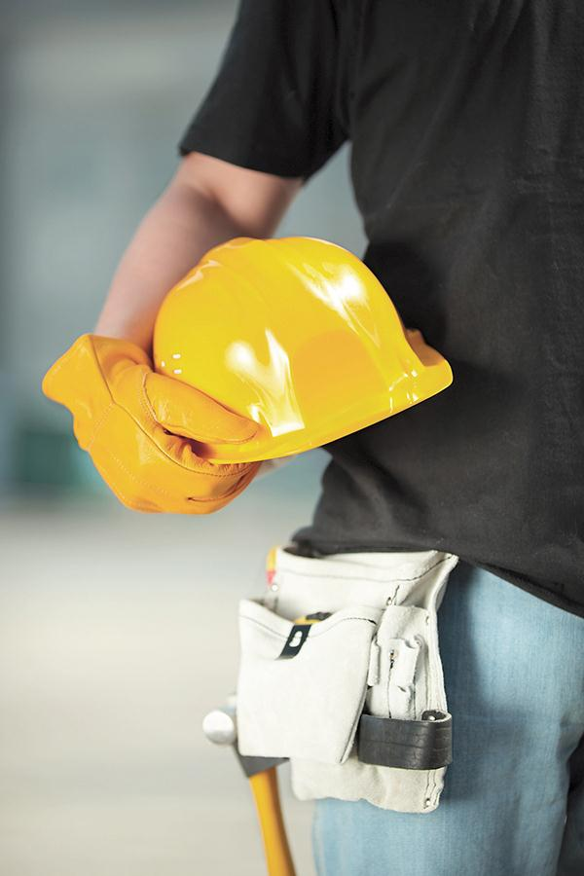
Defining Workplace Safety
Principles
and Practices
© 2012 Alberta Education

Slide 2
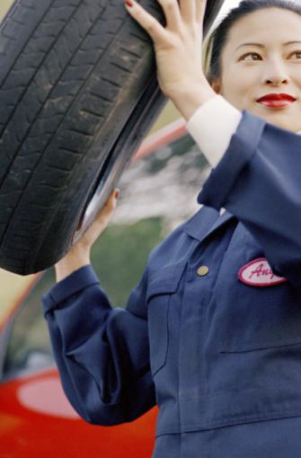
ergonomics
Examples : lifting can strain the back, bending arms or wrists very often can cause joint injuries, sitting all day can cause back problems
PPE: for example use a power lifting support belt device to protect the back
Administrative: for example give a safety course on how to lift properly
Engineering: for example use a properly designed chair
© 2012 Alberta Education

Slide 3
References:
Worker With Hat: Brand X Pictures/Thinkstock – Image #152154917 retrieved December 2012 from http://www.thinkstockphotos.ca
Mechanic Changing Tire: iStockphoto/Thinkstock – Image # 78405832 retrieved December 2012 from http://www.thinkstockphotos.ca
© 2012 Alberta Education

