Slide 1
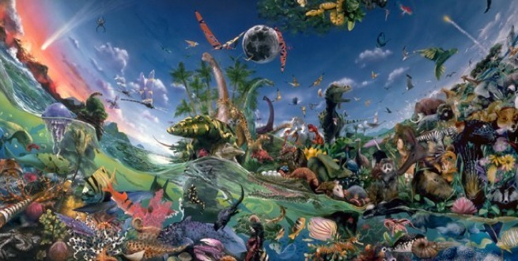
Cambrian Explosion 3.7.1

Slide 2
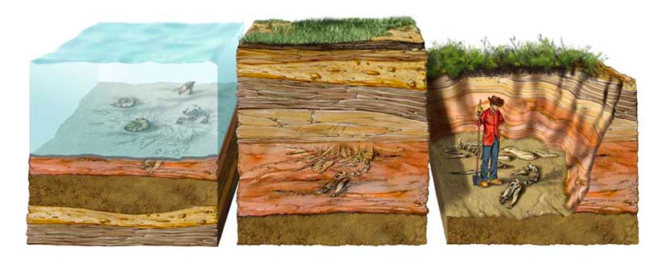
Fossilization
Fossilization : the process by which any trace of the existence of ancient life is preserved within rock.

Slide 3
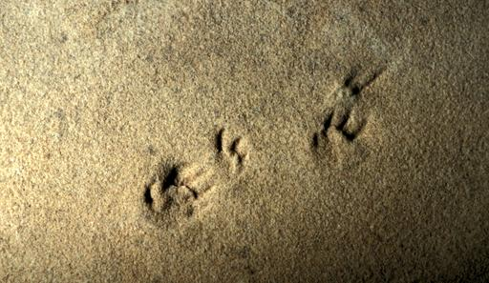
Types of Fossils
Trace Fossil : An imprint from a past organism where no remains of the actual organism is present.

Slide 4
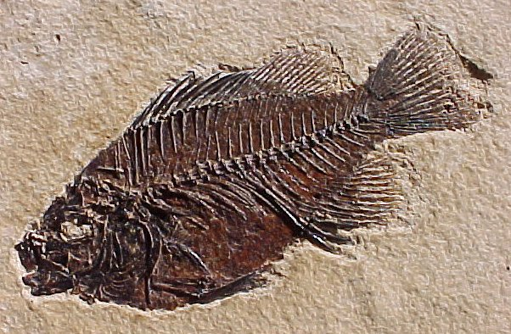
Types of Fossils
Mould Fossil : (Cast fossil)
A type of fossil formed by the encapsulation of remains that disintegrate and leave a 3 D mould of their structure.

Slide 5
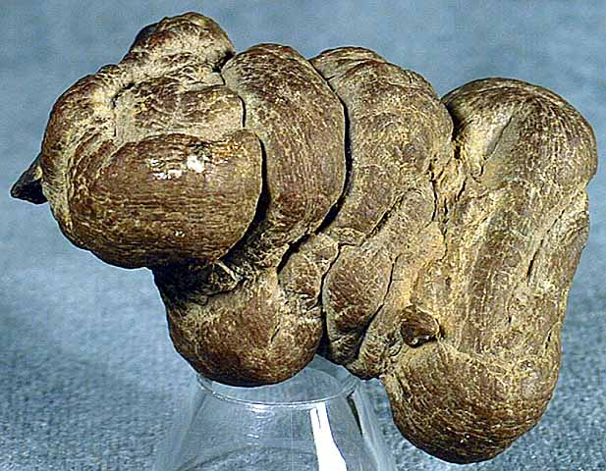
Types of Fossils
Cast fossil : a solid mineral deposit that filled a mold, leaving a copy of the living thing or organic material.
Petrification : plant or animal tissue replaced by minerals

Slide 6
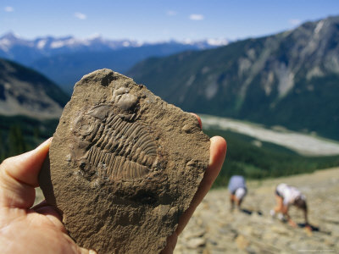
The Burgess Shale
Burgess Shale : a Cambrian-age rock unit found on the side of Mount Wapta in the Canadian Rockies known for its well-preserved fossils.

Slide 7
The Burgess Shale
One thing that makes the Burgess shale unique is that the soft body parts of ancient animals were also preserved.

Slide 8
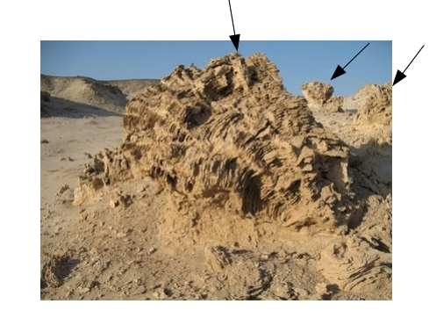
Ancient Ocean
Reef : a submerged ridge of rock, sand, or coral that rises to the water’s surface.

Slide 9
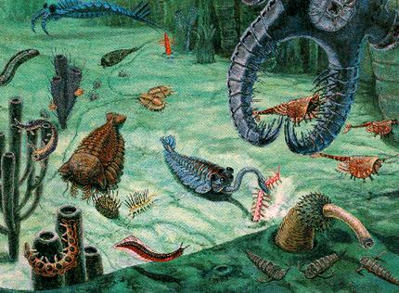
Cambrian Explosion
A relatively short period of time (approx 20 million years) approximately 545 to 525 million years ago where a vast diversity of life appeared in the fossil record.
It is remarkable that all life on Earth since then seems to involve variations on the basic design that first emerged from the Cambrian Explosion.

