Slide 1
7.1 Novel Character
PostSecret Postcard Template

Slide 2
For this option, you will create a series of 6 post-secret postcards for the main character in your chosen novel. Each postcard must reveal the secret that would relieve some of his or her pain if he or she got it off his or her chest. There should be a progression or development of character represented – how did the character change throughout the novel and how would the secrets change? Each postcard must also depict a visual that would be representative of the event or conflict taking place at that point in the novel.
Connect to the character not the plot events: Provide a written rationale which includes details and explanations which answer How? and Why? your postcards demonstrate the character’s development.

Slide 3

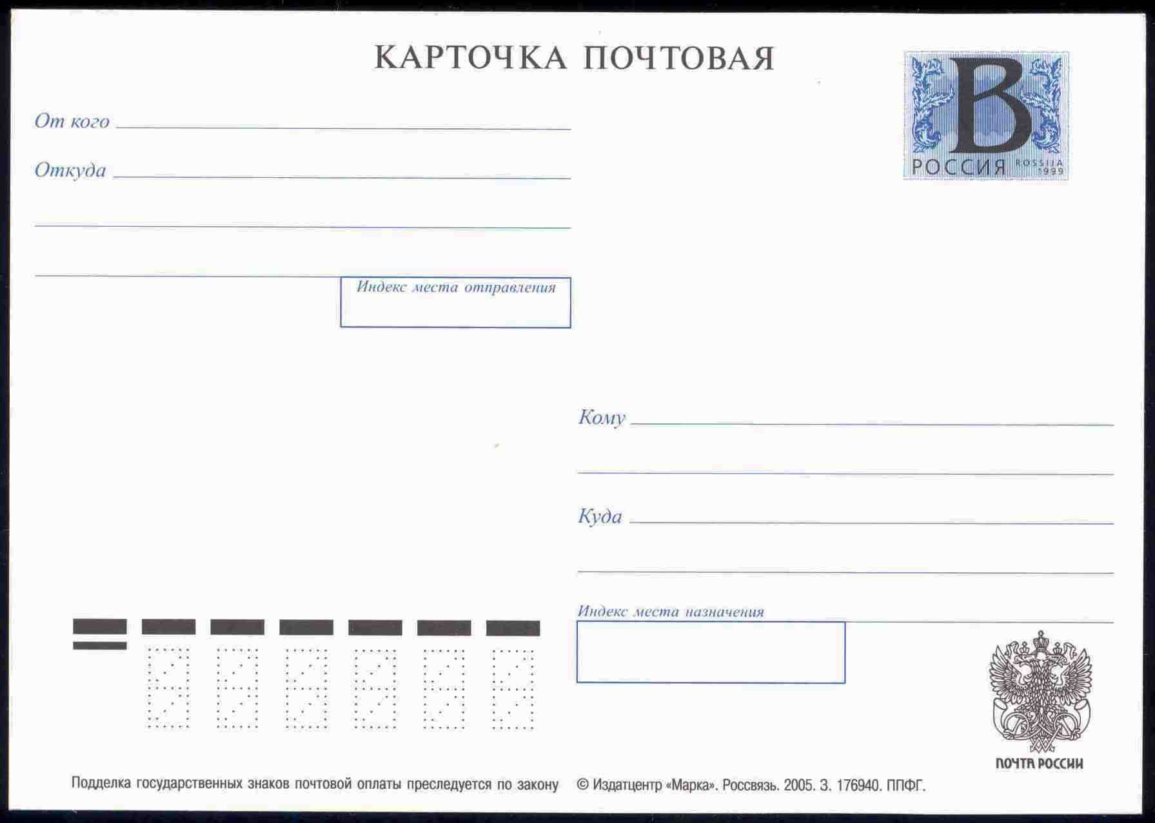
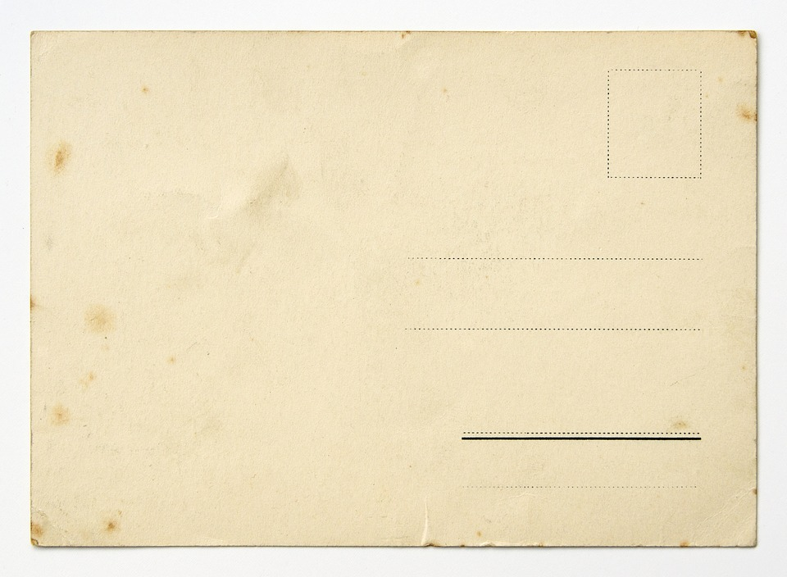
Resize the postcard as needed. Remember to add your own images to represent the front of hte card representing the event or conflict taking place at this point.

Slide 4
Resize the postcard as needed. Remember to add your own images to represent the front of hte card representing the event or conflict taking place at this point.

Slide 5
Resize (or replace) the postcard as needed. Remember to add your own images to represent the front of the card representing the event or conflict taking place at this point.
You need 3 more postcards! Duplicate these or create your own.

