Slide 1
Unit 2 Section 2
Study Notes
Complete the brief short notes to help you learn this material, and to provide you with some good study notes.

Slide 2
Viewing a Film
Films, like novels, tell stories using many of the techniques similar to photographs adding sound and motion. The same camera techniques used for breaking down a photograph apply to breaking down films. In addition, define these specific terms used to discuss scenes in a film.
Shot:
Cut:
Scene:
Sequence:

Slide 3
Studying Film tutorial
Fill in the blanks or record definitions in the space provided.

Slide 4
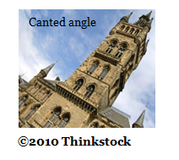
Studying Film tutorial continued...
1. Camera angle: refers to the position of the camera with respect to what’s being viewed (the subject).
a. _____ angle: the camera is above the subject. This angle can make the subject look smaller or powerless
b. _____ angle: the camera is below the subject. This angle can make the subject look strong and powerful.
c. _______ ____: the camera is at a neutral level. This shot is most comfortable for viewers, as it mirrors how we typically look at our world.
d. _______ angle: the camera is tilted at an angle. The subject appears slanted in the frame of the shot. This can create uncertainty or uneasiness in the viewer, as if something is ‘not quite right’.

Slide 5
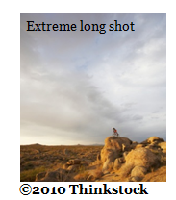
Studying Film tutorial continued...
2. Focus: what the camera centers on
a. Close Up: _______________
b. Extreme Close Up: _____________
c. Medium: You don’t see the subject’s entire body, but you don’t need to either.
d. _______ Shot: You see the subject’s entire body, including the surroundings.
e. _______ ______ Shot: These shots are used to show a sense of vastness of surroundings.

Slide 6
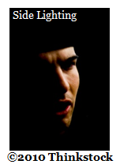
Studying Film tutorial continued...
3. Lighting: How might the following lighting choices contribute to the mood of a shot.
a. Natural: | e. Top:
b. Artificial: | f. Back:
c. Bright: | g. Side: can show a character who feels divided or torn between two choices
d. Soft: can show tenderness | h. Under: can be spooky

Slide 7
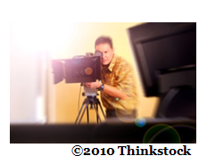
Studying Film tutorial continued...
4. Sequence:
a. ________: action filmed in one continuous take, with no disruptions
b. ________: the conclusion of the shot

Slide 8
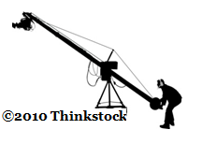
Studying Film tutorial continued...
5. Camera Movement:
a. ________: the visual elements around the actor
b. ________: how the actor is positioned in relation to the camera and his surroundings
c. ________: the camera follows the actor
d. ________: the camera scans horizontally, from left to right
e. ________: the camera tilts up or down

Slide 9
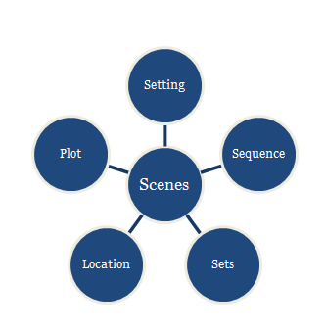
Studying Film tutorial continued...
6. Scene:
a. _________: the time, place, shooting location
b. _________: a progression of related scenes
c. _________: arrangement or display of scenery,
backdrop, or landscape
d. _________: the narrative or sequences of events that make up the story

Slide 10
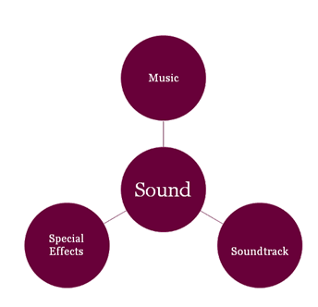
Studying Film tutorial continued...
7. Sound:
a. _______________: can set the mood for the scene
b. ________: popular music embedded within the film
c. _________ _________: using technology to bring sound into the film.

Slide 11
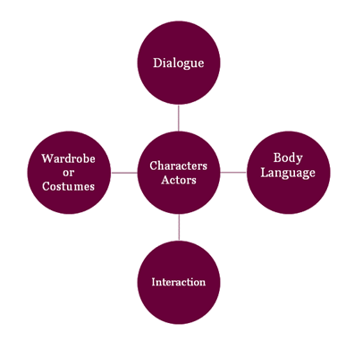
Studying Film tutorial continued...
8. Characters and Actors
a. ___________: words spoken by the actors
b. _____ _________: nonverbal cues (facial expressions, eye contact, posture)
c. ___________: how the characters work together or conflict with one another
d. ___________: what characters wear, carefully chosen to reveal more about the character

Slide 12
Answers to the Film Study Notes: The End
1. a. High
b. Low
c. Straight On (Medium)
d. Canted
2. a. the subject occupies most of the frame
b. the subject occupies the entire frame
d. Long
e. Extreme long
3. a. warm glow, emphasize reality, usually the sunlight
b. sets a scene, has lighting that exists outside of nature, emphasizes something
in particular
c. reveals vivid or intense details, cheerful, happy
e. showcases or highlights the object or subject like they are on stage or under
a spotlight; all eyes are on them
f. emphasizes the shape or silhouette rather than the individual person
4. a. shot
b. cut
5. a. framing
b. blocking
c. tracking
d. panning
e. booming
6. a. Setting
b. Sequence
c. Sets
d. Plot
7. a. Music
b. Soundtrack
c. Special effects
8. a. Dialogue
b. Body language
c. Interaction
d. Wardrobe

