Slide 1
Written Response I
The Terminology Question

Slide 2
Your mission:
Demonstrate your knowledge and understanding of social studies
  Terminology
  Theoretical concepts
  Historical events
  Current events
These videos will help with terminology and theory
  Collectivism: https://youtu.be/GjOqfDMyxkc
  Individualism: https://youtu.be/TW_hLMnVpO8
  Economic Spectrum/Continuum: https://youtu.be/ahUwvh5F_sQ
  Political Spectrum/Continuum: https://youtu.be/hnAFfl3nFxE
  Combined: https://youtu.be/nDSyTqtDlHQ

Slide 3

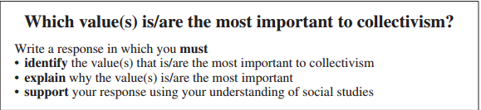

Slide 4

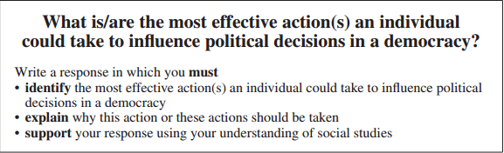

Slide 5

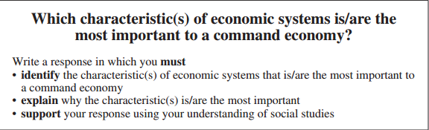

Slide 6

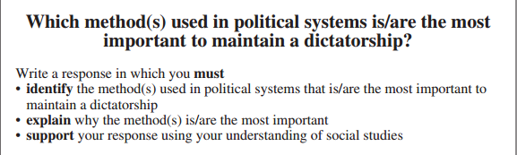

Slide 7
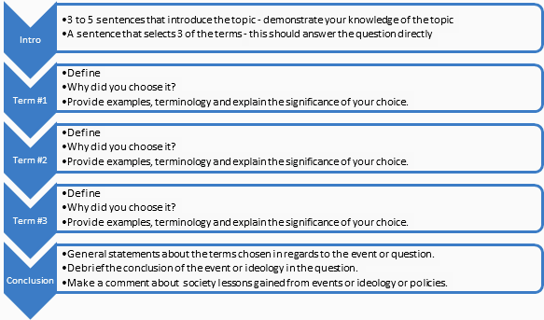
FORMAT - 5 Paragraphs

Slide 8
Paragraph 1: Introduction
3 to 5 sentences that introduce the topic - demonstrate your knowledge of the topic
A sentence that selects 3 of the terms - this should answer the question directly

Slide 9
Paragraph 2: Term #1
Define
  What does the term mean?
Why did you choose it?
  Why is it an important characteristic/term/element?
Provide examples, terminology and explain the significance of your choice.
  Elaborate with specific examples - if the question is about the Canadian economy, you’d better explain how that term/characteristic functions in the Canadian economy.

Slide 10
Paragraph 3: Term #2
Define
  What does the term mean?
Why did you choose it?
  Why is it an important characteristic/term/element?
Provide examples, terminology and explain the significance of your choice.
  Elaborate with specific examples - if the question is about the Canadian economy, you’d better explain how that term/characteristic functions in the Canadian economy.

Slide 11
Paragraph 4: Term #3
Define
  What does the term mean?
Why did you choose it?
  Why is it an important characteristic/term/element?
Provide examples, terminology and explain the significance of your choice.
  Elaborate with specific examples - if the question is about the Canadian economy, you’d better explain how that term/characteristic functions in the Canadian economy.

Slide 12
Paragraph 5: Conclusion
General statements about the terms chosen in regards to the event or question.
Debrief the conclusion of the event or ideology in the question.
Make a comment about society or lessons gained from events or ideology or policies.

Slide 13
FORMAT - 5 Paragraphs

Slide 14
Here’s an example!

Slide 16
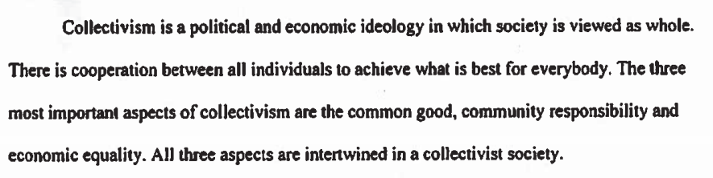
Here, the topic - collectivism - is defined. Then the student lists the three terms they have selected and has provided context for the selection.

Slide 17

Common good is defined in the first two sentences. Why it is essential to collectivism is answered. An example (highlighted) is provided.

Slide 18
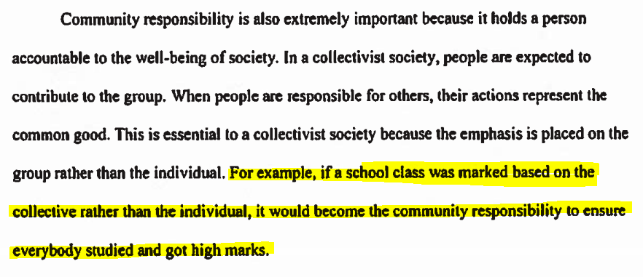
Community responsibility is defined in the first three sentences. Why it is essential to collectivism is answered. An example (highlighted) is provided.

Slide 19
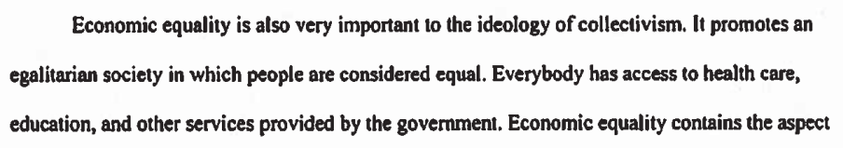
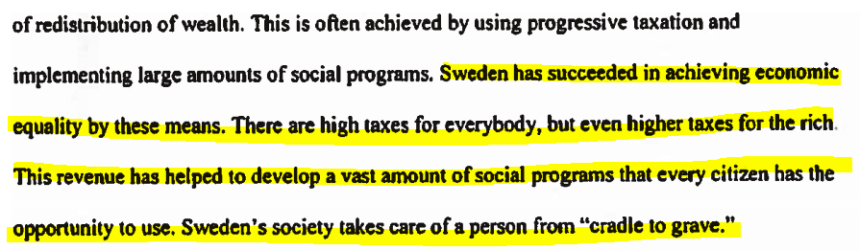
Economic equality is explained and elaborated upon.
An example (highlighted) is provided.

Slide 20

In the final paragraph, this student has written some historical information about the use of collectivist ideas. The student restates the three terms selected (highlighted) and provides context for the selection.

