Slide 1
Written Response II
Source Analysis

Slide 2
Your mission:
you will interpret three sources
  What ideological perspective is demonstrated in the source?
    How do you know? Make sure you explain and use the terminology from the course.
use the details from these sources and your knowledge and
understanding of social studies to defend a position
  Do you agree/disagree with the perspective demonstrated in the sources?
  What is your opinion?
    Use examples - historical or current events/theoretical concepts

Slide 3
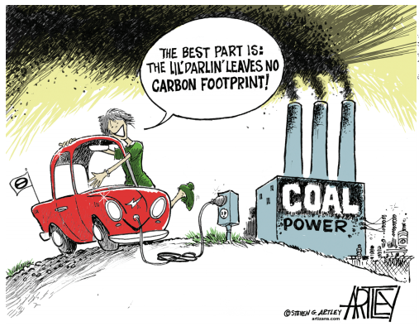
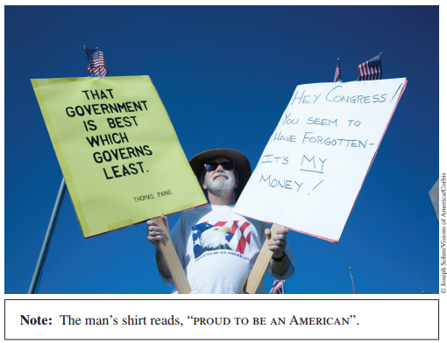


Slide 4
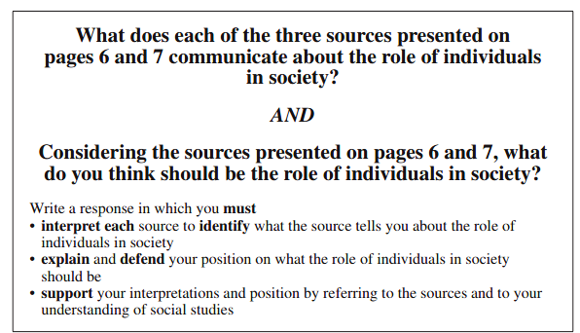

Slide 5

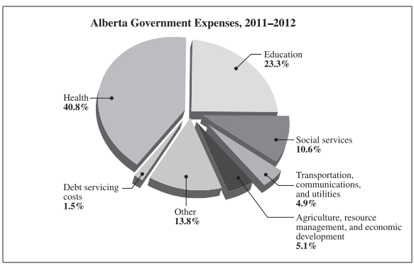
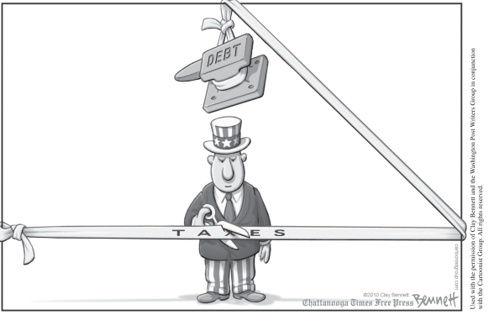

Slide 6
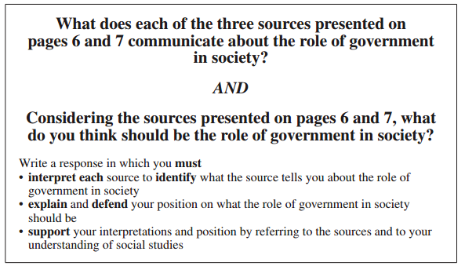

Slide 7
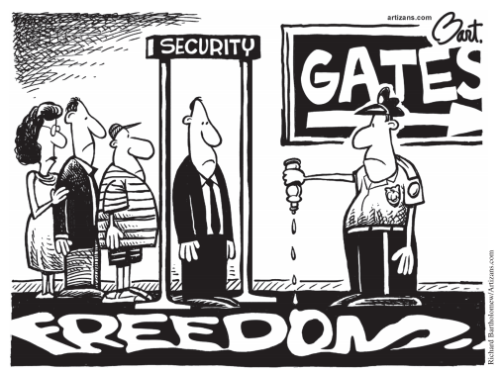
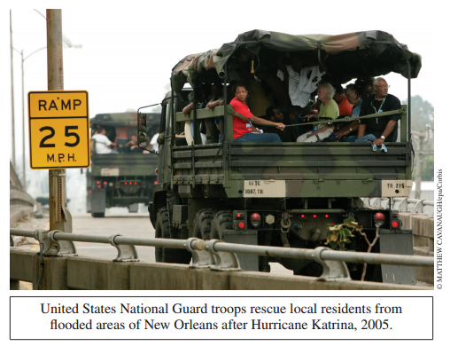
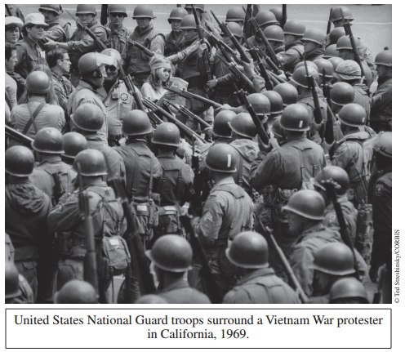

Slide 8
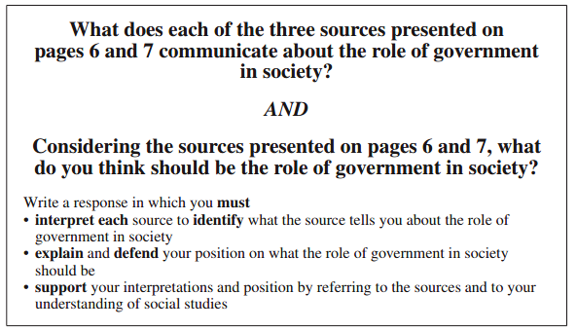

Slide 9
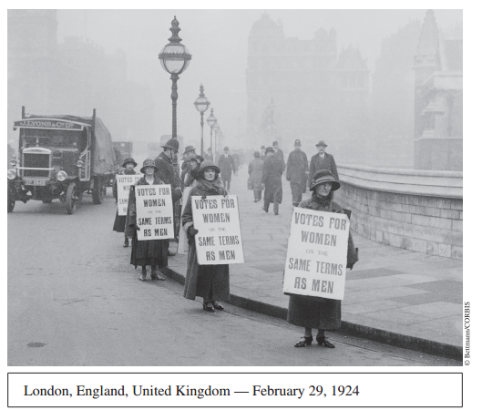

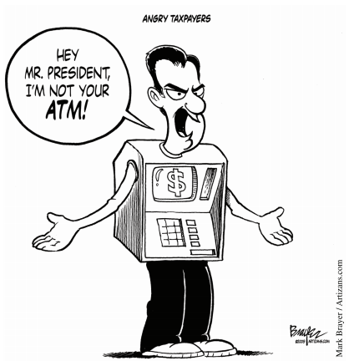

Slide 10
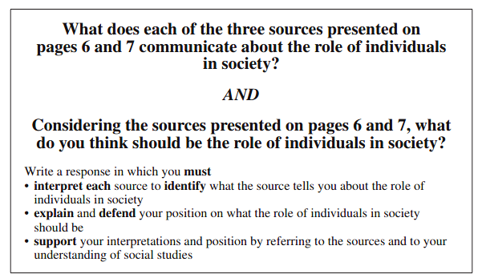

Slide 11
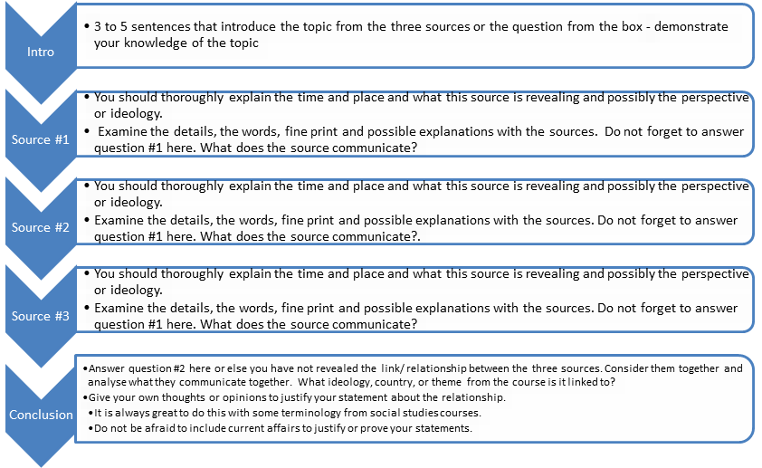
A format that works - You can always expand and be more creative in your writing.

Slide 12
An Example!!

Slide 15
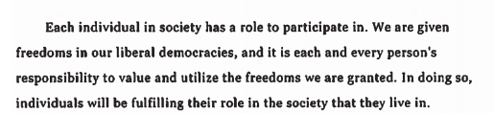
A brief introduction that demonstrates an understanding of the question/topic (role of the individual in society).

Slide 16
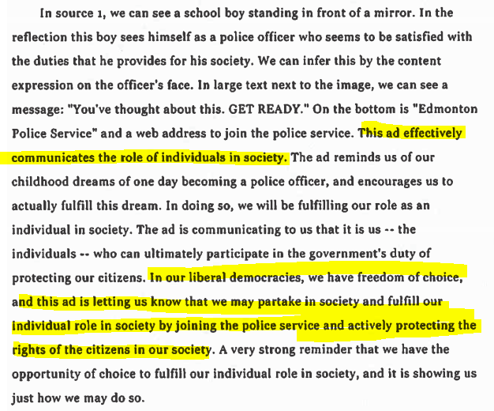
Source 1 Interpretation. Question #1 is clearly answered (highlighted) and explained.

Slide 17
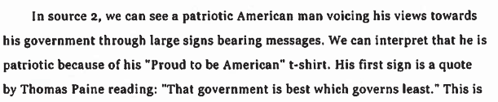
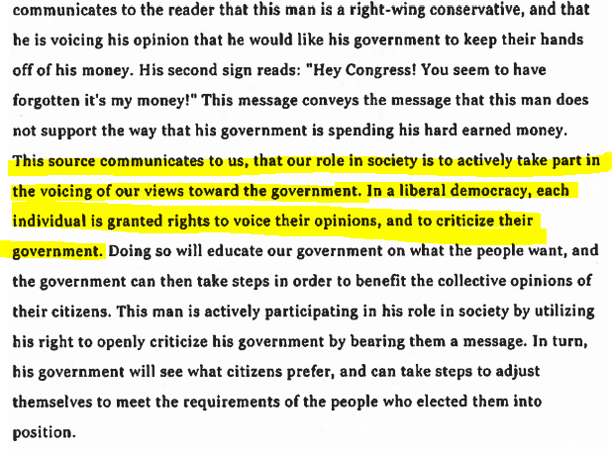
Source 2 Interpretation. Question #1 is clearly answered (highlighted) and explained.

Slide 18
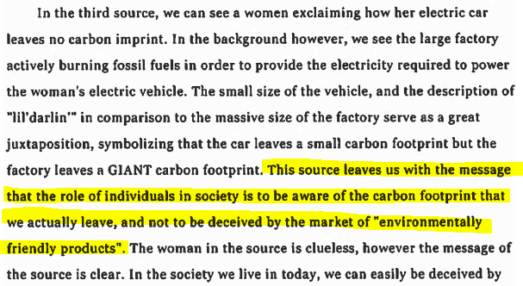
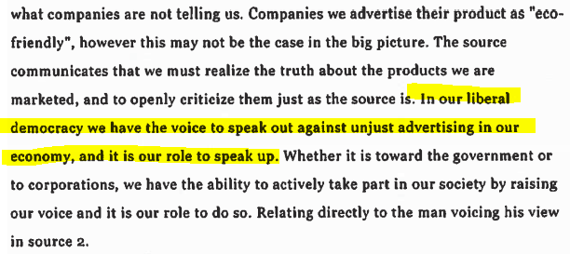
Source 2 Interpretation. Question #1 is clearly answered (highlighted) and explained.

Slide 19
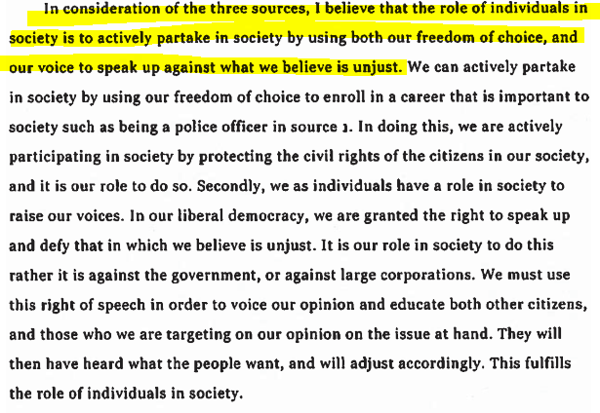
Question #2 is clearly answered (highlighted). References are made to the sources. Ideas are explained fully.

