Slide 1
Written Response III
The Citizens Question

Slide 2
Your mission:
explore an issue
  Why is it important?
  Why would people have differing opinions on the issue?
analyze various points of view on the issue.
  Each citizen will display a different opinion on the issue
    What ideological perspective is demonstrated? How do you know?
    Can you connect the perspective to a position on the spectrum/continuum?
      Check these out for help
        Economic Spectrum/Continuum: https://youtu.be/ahUwvh5F_sQ
        Political Spectrum/Continuum: https://youtu.be/hnAFfl3nFxE
        Combined: https://youtu.be/nDSyTqtDlHQ
explains and defends a position on the issue.
  Do you agree/disagree with the perspective demonstrated in the sources?
  What is your opinion?
    Use examples - historical or current events/theoretical concepts

Slide 3
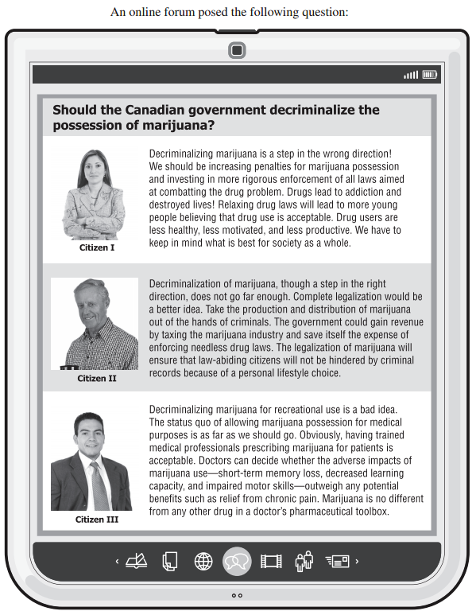
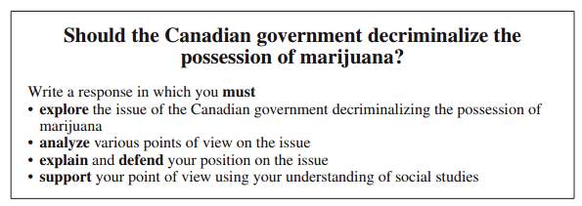

Slide 4
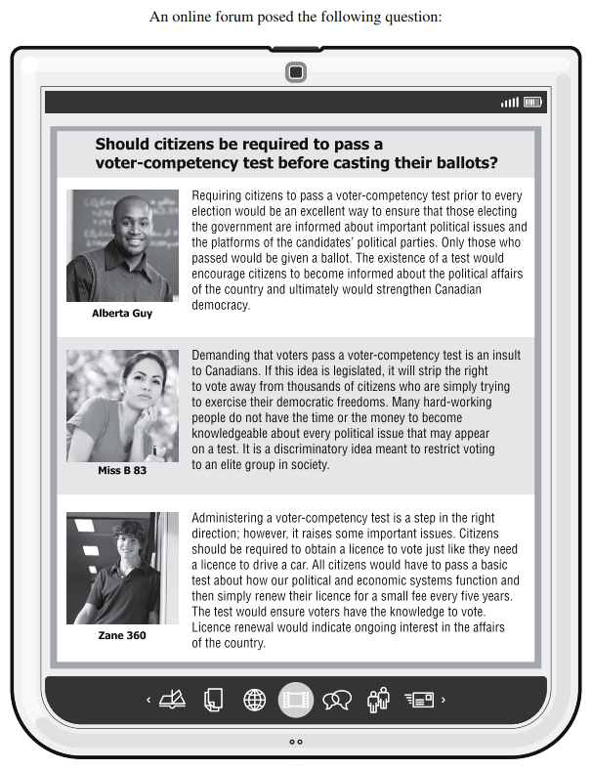
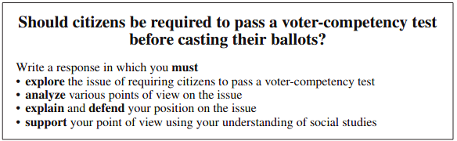

Slide 5

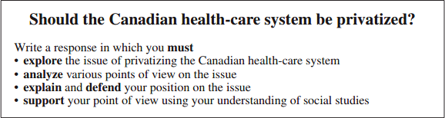

Slide 6
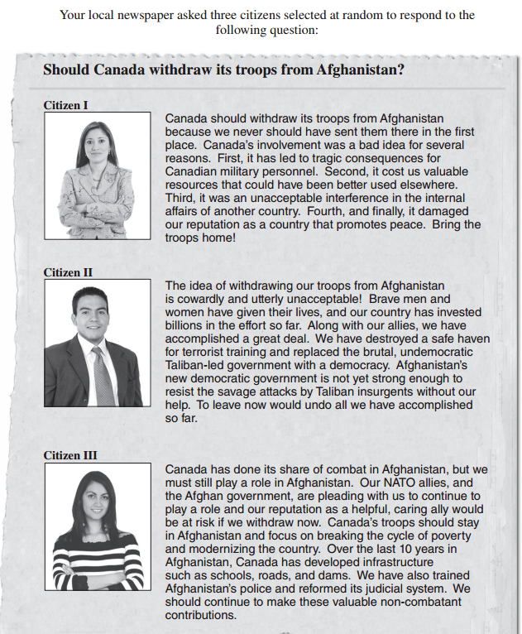
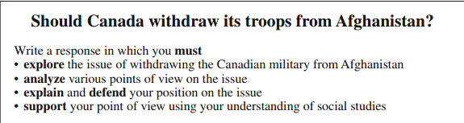

Slide 7
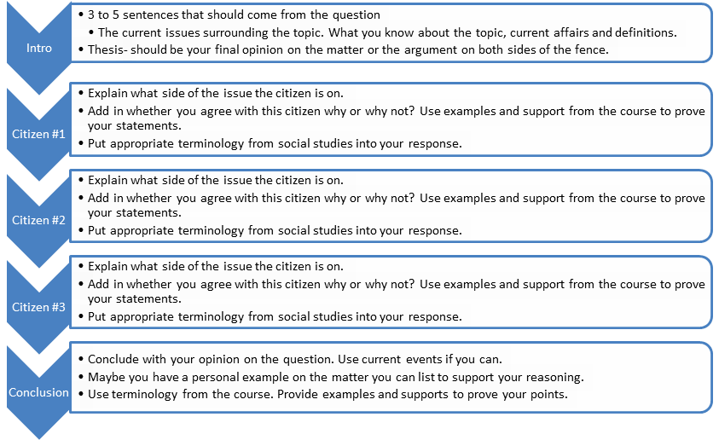
Format - 5 paragraphs

Slide 8
An Example!!

Slide 10
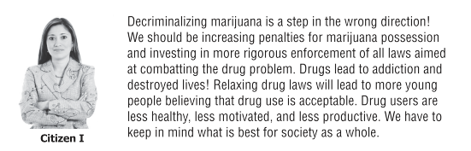
What is citizen 1 saying about the issue? Is her response more collectivist or individualist? Can you determine her position on the spectrum/continuum?

Slide 11
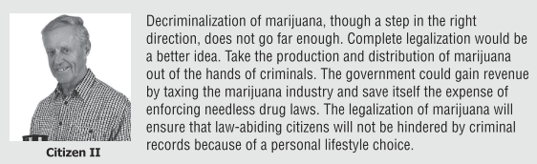
What is citizen 2 saying about the issue? Is his response more collectivist or individualist? Can you determine his position on the spectrum/continuum?

Slide 12
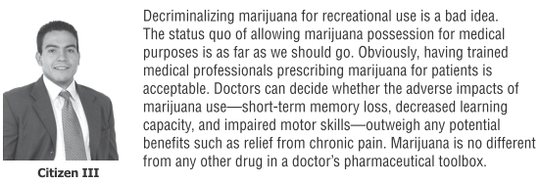
What is citizen 3 saying about the issue? Is his response more collectivist or individualist? Can you determine his position on the spectrum/continuum?

Slide 13
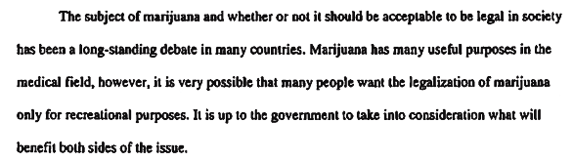
An introduction that introduces the issue and why individuals might have differing opinions.

Slide 14
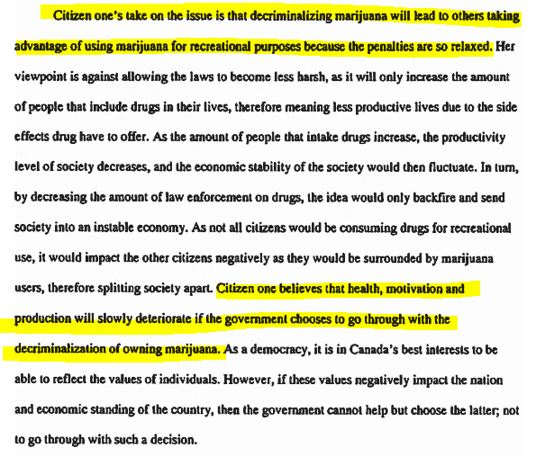
An analysis of citizen 1 - restates the position and elaborates upon it, using the terminology from the course.

Slide 15
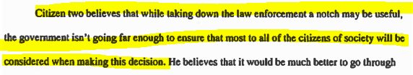
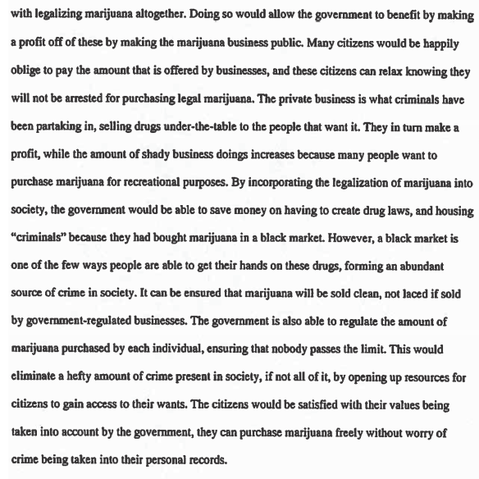
An analysis of citizen 2 - restates the position and elaborates upon it, using terminology from the course.

Slide 16
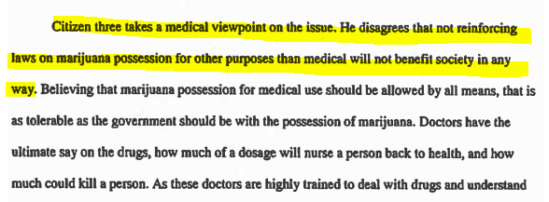
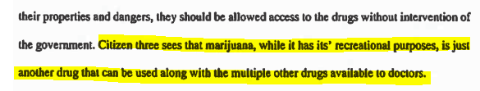
An analysis of citizen 3 - restates the position and elaborates upon it, using terminology from the course.

Slide 17
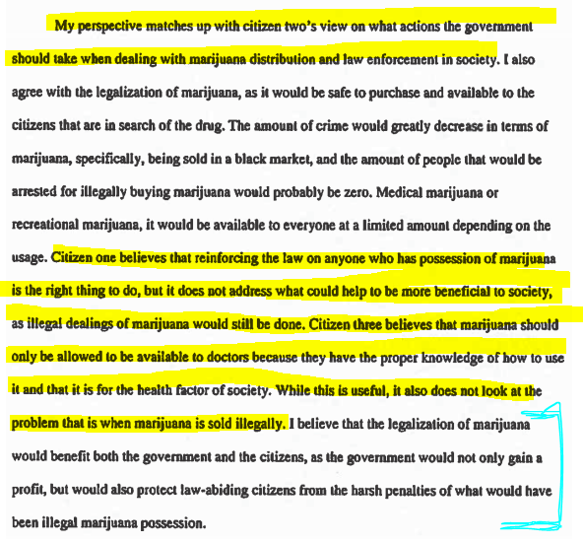
The student completes this assignment by stating and defending their opinion.
They also state what citizen they most agree with and why as well as why they do not agree with the other citizens.
The final sentence sums up their opinion and reasoning very clearly.

