Slide 1


Assignment 4.2.9
The Cold War
In your own words, answer the questions listed within each box on an individual slide. Completing this task will allow you to both understand and describe the impact and importance of the Cold War both on history and in respect to ideology.
Your answers for each question should fit on the slide(s) that have been indicated. The story components have been laid out for you, however, it is your responsibility to provide the appropriate depth and description to clearly communicate the key terms, explain important events and or concepts and to connect the events to each other. Make sure to support any claims you make with evidence from the course or history. It is vital you put this information in your own words to demonstrate your understanding and to avoid plagiarism.
Each page (where the photo is “paperclipped” to the powerpoint background) should have a APA cited image of your choosing, related to the concepts outlined on the slide. Remember, you will have to complete research, so resources will also need to be listed in your assignment bibliography, in APA format.
Student Name
___/110 =___%

Slide 2
Defining the Cold War
What is a “Cold War”? In what way(s) was the Cold War both safer and more dangerous than previous ideological conflicts (such as WWII?)
<>
What are superpowers? Who were they in the Cold War and what ideological beliefs did they hold by in large?
<>
How long did the Cold War last?
<>

Slide 3
2. Proxy Wars
What were the three major proxy wars of the Cold War? (List out their start and end date, and a 2-3 sentence description of the event itself)
1.
2.
3.
What is a proxy war and what are the advantages and disadvantages of using one?
<>

Slide 4
2.Proxy Wars
How do the proxy wars relate to the following terms: The Domino Theory, Containment and the Chinese Civil/Cultural War?

Slide 5
3. Berlin/Germany in the Cold War
What was the Berlin Blockade/Airlift (1948-1949)?
How was it ideologically motivated?
What were the justifications of the Soviet Union for the Berlin Wall?
What meeting decided Germany and Berlin would be divided and controlled by Allied Forces? How did this relate to Fascism?

Slide 6
3. Berlin/Germany in the Cold War
What was the significance of the Berlin Wall’s collapse? (Make sure to include the date it fell)
What years did the Berlin Wall exist?
<>

Slide 7
4. Cold War Economics
Bretton Woods Agreement-
The Marshall Plan-
The Truman Doctrine-
The Molotov Plan-
For the four following policies listed, define the purpose of each and explain how they would have threatened the opposite superpower.

Slide 8
5. Key terms of the Cold War
The Domino Effect
<>
2. The Iron Curtain
<>
3. Peaceful Co-Existence
<>
Define and describe the following Cold War phrases. Make sure to mention who is credited with each phrase:
1. The Domino Effect
2. The Iron Curtain
3. Peaceful Coexistence

Slide 9
5. Key terms of the Cold War
1. Containment-
2. Sphere of Influence-
3. Balance of Power-
4. Expansionism-
Define and provide an example of an event related to each of the following terms:
Containment
Sphere of Influence
Balance of Power
Expansionism

Slide 10
6. Cold War Alliances
1. NATO-
2. NORAD-
3. The Warsaw Pact-
4. Non-Alignment Movement-
Who was involved and what was its initial purpose?
(Make sure to identify the year it was established)
1.NATO (North Atlantic Treaty Organization)
2.NORAD (North American Aerospace Defense Command)
3.The Warsaw Pact
4.NAM(Non-Alignment Movement)
Apply one of the following terms; Sphere of Influence, Balance of Power, Containment or Expansionism to each alliance.

Slide 11
7. Cuba/The Cuban Missile Crisis
Why did conflict occur in Cuba? Who were the leaders of this movement?
How did JFK try to deal with this “problem”? Was it successful?
Define the following terms and consider the link to the Cuban Missile Crisis in the later questions on this topic:
Deterrence-
Brinkmanship-
Detente-

Slide 12
7. Cuba/The Cuban Missile Crisis
Summarize the Cuban Missile Crisis utilizing the three key terms on the left.
How was this situation resolved?
Deterrence
Brinkmanship
Detente

Slide 13
8. The Nuclear Age
What years did the USA/Soviet Union develop nuclear weapons?
How could someone argue that nuclear weapons were “bombs as a tool for peace”?
Define the following terms in relation to nuclear
Weapons:
Brinkmanship
Deterrence
MAD
Balance of Power

Slide 14
8. The Nuclear Age
How were ideologies imposed on others in respects to nuclear weapons? Select ONE only:
1)Nuclear testing in the South Pacific.
2)Usage of French nuclear weapons in Africa
3)Effects of Nuclear Weapons in
Pakistan,India or North Korea.

Slide 15
9. Detente
What did each of these agreements attempt to accomplish?
1) SALT I-
2) SALT II-
3) Non-Proliferation Treaty-
How does the structure of the UN Security Council support the concept of a Balance of Power?
Define Detente:
Which event started this period and which ended it?

Slide 16
10. Liberation Movements
1.
2.
What is a Liberation Movement?
Pick TWO of the three to create a brief summary:
1.Prague Spring
2.The Hungarian Revolution
3.Polish Solidarity

Slide 17
11. Decolonization
1.
2.
Explain how the process of decolonization created conflicts during/after the Cold War. Why did decolonization complicate this historical time period?
What is decolonization?
On the right side of this slide, provide TWO examples of how decolonization affected the Cold War (List them):

Slide 18
12. Canada and the Cold War
1.
2.
Pick 2 topics below and describe their importance within the Cold War.
1)The forced relocation of the Inuit
2)Canada/Soviet Summit Series (Hockey)
3)The Canadian Caper/Iranian Hostage Crisis
4)Tommy Douglas and the RCMP
5)Cold War Peacekeeping
6)The 1980 Olympic Boycott

Slide 19
13. Espionage
Pick ONE of the following examples to explain how espionage affected the Cold War.
1) The U-2 Bomber Incident
2) Julius and Ethel Rosenberg
3) Igor Gouzenko
4) Illegal Aliens Program
Selection:
What is espionage?
How did espionage help keep the Cold War “cold”?

Slide 20
14. American Domestic Policy
How did the following events/ideologies or actions demonstrate failings in liberalism in the United States? What were the principles challenged? (Think PRICES)
A) Second Red Scare/McCarthyism
B) Need for a Civil Rights Movement

Slide 21
15. Policy in the USSR/Eastern Bloc
Define BOTH terms and indicate how they challenged the principles of collectivism (Think PEACCC). Who developed these policies and how did they eventually affect the Soviet Union?
Glasnost
Perestroika

Slide 22
16. Off to the Races:
1.
2.
3.
Define and provide an example of each:
1) Arms Race.
2) Space Race.
3) Prestige Race.

Slide 23
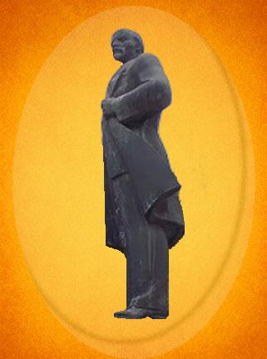
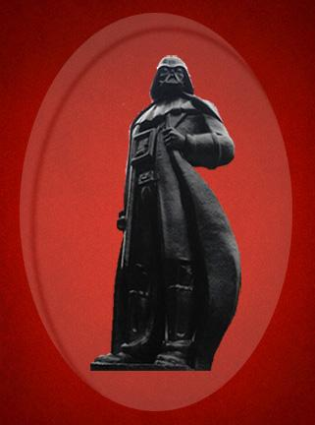
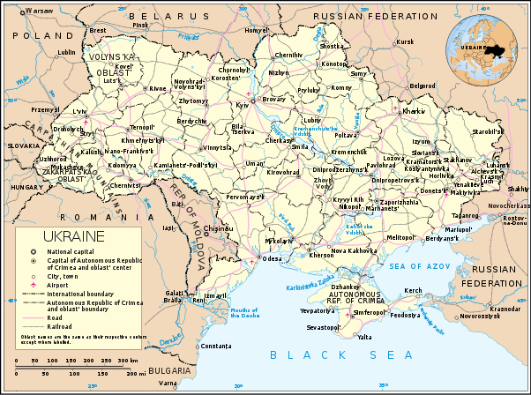
File:Map of Ukraine en.svg. (2015, March 2). Wikimedia Commons, the free media repository. Retrieved 05:24, April 15, 2019 from https://commons.wikimedia.org/w/index.php?title=File:Map_of_Ukraine_en.svg&oldid=151776850.
Ukraine: Lenin Statue Given Darth Vader Makeover. (2015, October 23). BBC News: News From Elsewhere. Retrieved from https://www.bbc.com/news/blogs-news-from-elsewhere-34594262
Images adapted from the article for the purposes of ADLC.
On the next slide, please answer these 2 questions;
What do you believe is meant by Semyon Horbunov’s quotes “Everything flows and nothing abides” and “ The Bronze Lenin was left inside, so that the grateful or not-so-grateful descendants could exhume him,if needed”? (Provide evidence for your answer)
2. What does the transitory nature of this statue suggest about all
ideologies (especially those from the Cold War)?
Read the above article and consider the images on this slide before answering the questions listed on the following slide.

Slide 24
Marking Rubric
Scoring criteria | Knowledge & Content | Quality of Communication | Quality of Visual Presentation
Excellent | Provides thoughtful ideas and thorough explanations Examples are specific, accurate and judiciously chosen Demonstrates a detailed and complete depiction of the Cold War 50 | Overall communication is eloquent and impressive Uses vocabulary that is precise, accurate and effective Controls confidently sentence construction, grammar, and mechanics 50 | Chooses visuals that are purposeful and compelling Makes highly effective use of the medium Presentation of information is creative and meticulous 10
Proficient | Includes meaningful ideas and appropriate explanations Examples are relevant and appropriate but may contain minor errors or be generalized Demonstrates a solid and clear picture of Cold War events 40 | Overall communication is effective and competent Uses vocabulary that is specific, accurate, and appropriate Controls proficiently sentence construction, grammar, and mechanics 40 | Chooses visuals that are convincing, and meaningful Makes effective use of chosen medium Presentation of information is purposeful 8
Satisfactory | Provides straightforward ideas and general explanations Uses support that is relevant but general and/or incompletely developed Demonstrates an acceptable understanding of Cold War events 30 | Overall communication is generally clear but may falter in certain spots Uses vocabulary that is specific, accurate but not specific Controls satisfactorily sentence construction, grammar, and mechanics; minor errors do not interfere seriously with communication 30 | Chooses visuals that are credible and conventional Uses chosen medium adequately, could be organized more effectively 6
Limited | Provides ideas and/or explanations that are limited and over-generalized Uses support that is superficial and may not always be relevant Demonstrates a limited or inaccurate understanding of the assigned task 20 | Writes unevenly and/or incompletely Uses vocabulary that is general and/or imprecise and/or inappropriate Controls falteringly sentence construction, grammar, and mechanics 20 | Chooses incomplete or inaccurate visuals Uses the medium ineffectively Presentation of information inappropriate and/or incomplete 4
Poor | Provides ideas and/or explanations that are minimal and/or tangential Uses support that, if present is superficial, incomplete, and/or marginally relevant. Demonstrates a minimal understanding of Cold War Events 10 | Writes unclearly and without organization Uses vocabulary that is ineffective and frequently incorrect Lacks control of sentence construction, grammar, and mechanics 10 | Chooses irrelevant, confused or inaccurate visuals Uses the medium unsuccessfully Presentation lacks effort 2

Slide 25
Bibliography (Photos/Research)

Slide 26
Comments and Notes:

