Slide 1
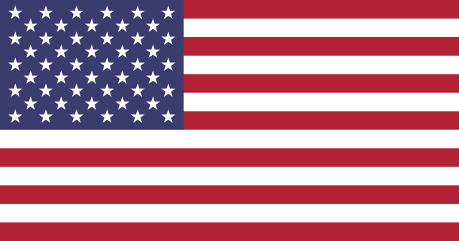
THE Political System of the United States of America
Understanding the Presidential Republican Democracy to the south

Slide 2
The American Constitution
Like the Canadian Constitution, The American Constitution outlines the structure of government, the function of each of its branches in addition to outlining the freedoms, rights and responsibilities of its citizens. Originally written in 1789, the document was ratified on December 15th, 1791.
The American Bill of Rights is a small, but very important section of the American Constitution, outlining the first 10 amendments which identify the rights and freedoms its citizens in all 50 states should expect to have. Similarly, The Canadian Constitution outlines its citizen’s rights and Freedoms in the Canadian Charter of Rights and Freedoms.
The Declaration of Independence
The American Constitution
Scene at the Signing of the Constitution of the United States
by Howard Chandler Christy

Slide 3
THE AMERICAN BILL OF RIGHTS
Amendment I
Congress shall make no law respecting an establishment of religion, or prohibiting the free exercise thereof; or abridging the freedom of speech, or of the press; or the right of the people peaceably to assemble, and to petition the Government for a redress of grievances.
Amendment II
A well regulated Militia, being necessary to the security of a free State, the right of the people to keep and bear Arms, shall not be infringed.
Amendment III
No Soldier shall, in time of peace be quartered in any house, without the consent of the Owner, nor in time of war, but in a manner to be prescribed by law.
Amendment IV
The right of the people to be secure in their persons, houses, papers, and effects, against unreasonable searches and seizures, shall not be violated, and no Warrants shall issue, but upon probable cause, supported by Oath or affirmation, and particularly describing the place to be searched, and the persons or things to be seized.
Amendment V
No person shall be held to answer for a capital, or otherwise infamous crime, unless on a presentment or indictment of a Grand Jury, except in cases arising in the land or naval forces, or in the Militia, when in actual service in time of War or public danger; nor shall any person be subject for the same offence to be twice put in jeopardy of life or limb; nor shall be compelled in any criminal case to be a witness against himself, nor be deprived of life, liberty, or property, without due process of law; nor shall private property be taken for public use, without just compensation.
Amendment VI
In all criminal prosecutions, the accused shall enjoy the right to a speedy and public trial, by an impartial jury of the State and district wherein the crime shall have been committed, which district shall have been previously ascertained by law, and to be informed of the nature and cause of the accusation; to be confronted with the witnesses against him; to have compulsory process for obtaining witnesses in his favor, and to have the Assistance of Counsel for his defence.
Amendment VII
In Suits at common law, where the value in controversy shall exceed twenty dollars, the right of trial by jury shall be preserved, and no fact tried by a jury, shall be otherwise re-examined in any Court of the United States, than according to the rules of the common law.
Amendment VIII
Excessive bail shall not be required, nor excessive fines imposed, nor cruel and unusual punishments inflicted.
Amendment IX
The enumeration in the Constitution, of certain rights, shall not be construed to deny or disparage others retained by the people.
Amendment X
The powers not delegated to the United States by the Constitution, nor prohibited by it to the States, are reserved to the States respectively, or to the people.
John Locke
Jean Jacques Rousseau
Montesquieu
The information above has been sourced from: https://www.archives.gov/founding-docs/bill-of-rights-transcript#toc-the-preamble-to-the-bill-of-rights-2

Slide 4

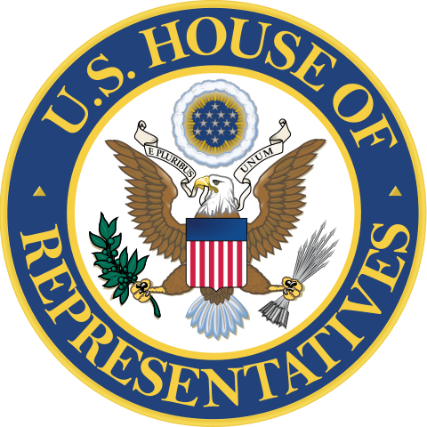
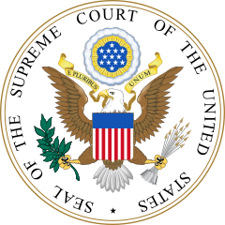
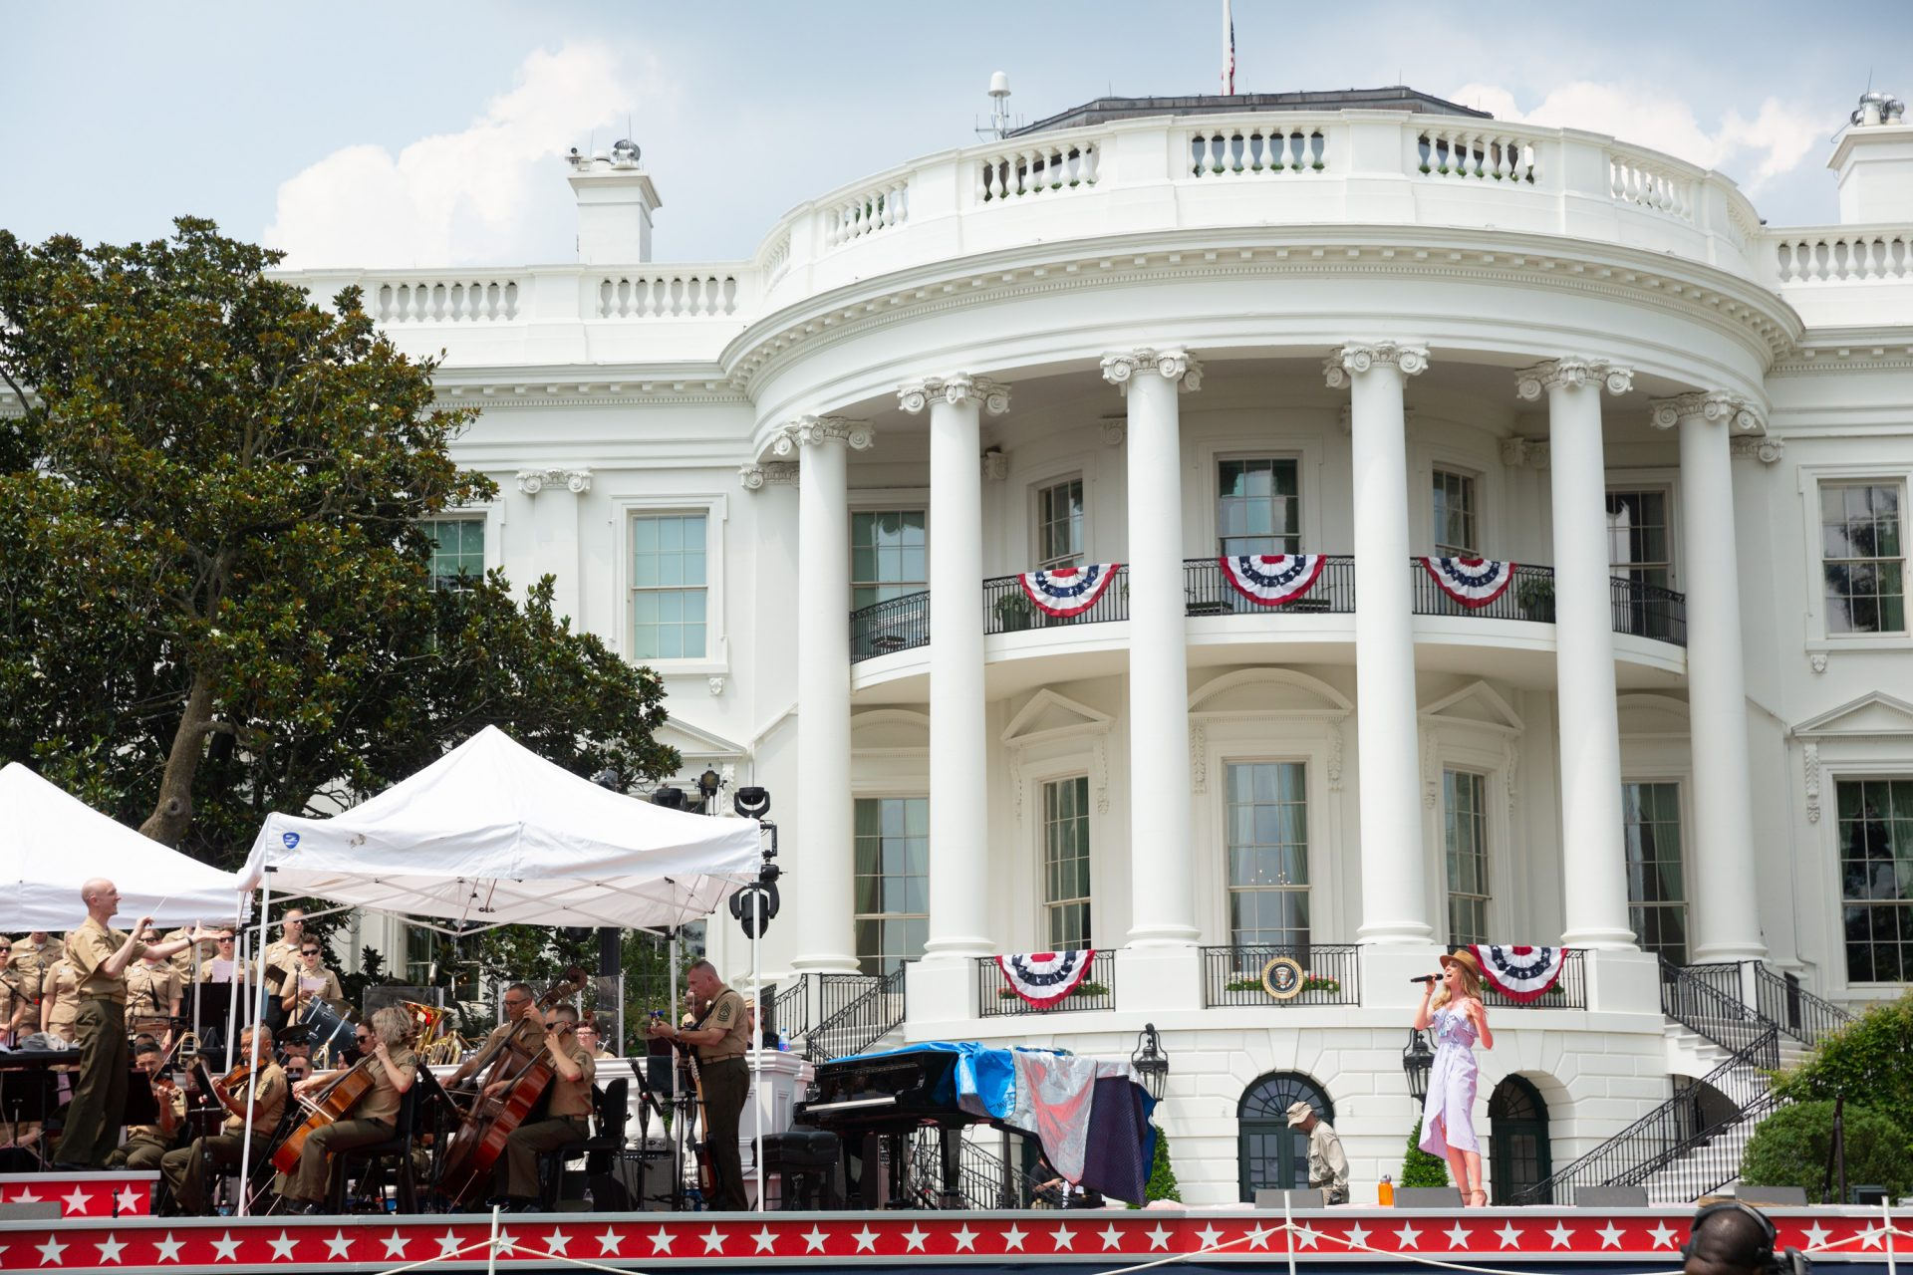
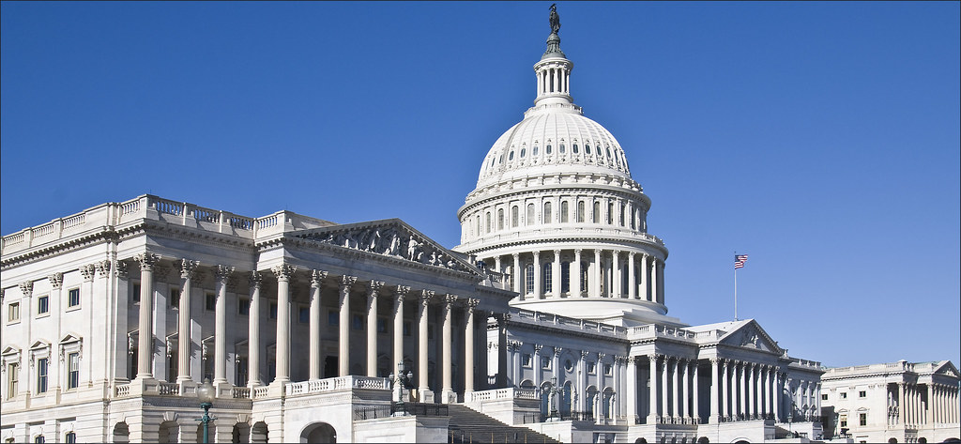
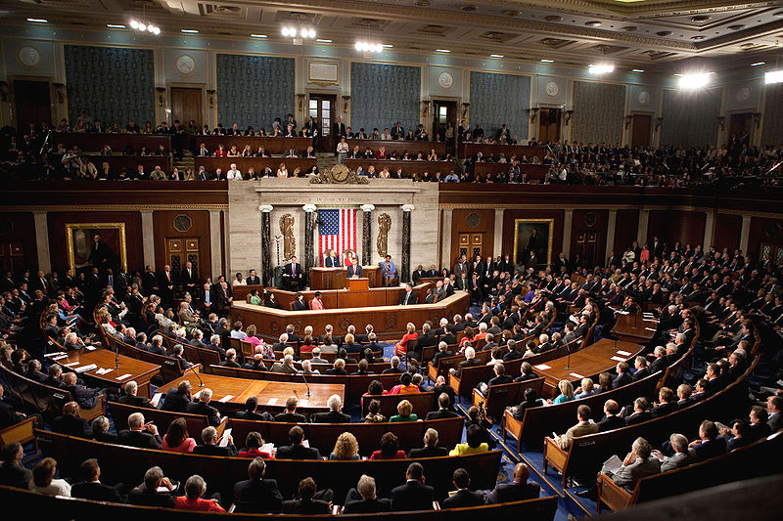
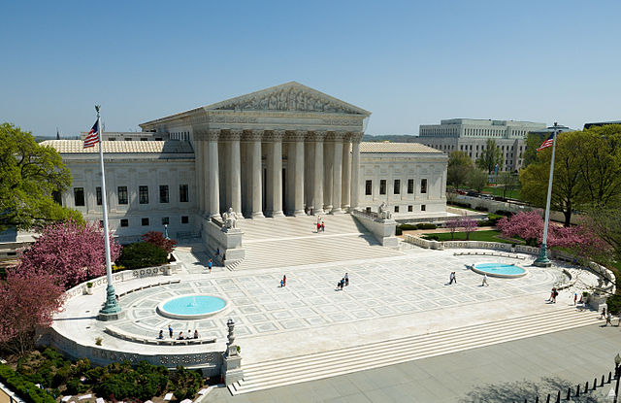
The United States FEDERAL SYSTEM
The United States, like Canada utilizes a separation of power at the Federal level that also sees the government divided into three branches; The Executive Branch, a bicameral Legislative Branch comprised of the Senate and House of Representatives (which form to make Congress) and a Judicial Branch represented by the Supreme Court (and lesser subsequent courts).
The United States is a Republican Democracy, meaning that the nation is governed by the people it represents, and its representatives are elected rather than appointed.
EXECUTIVE
LEGISLATIVE
(Congress)
JUDICIAL
“Enforces the law”
“Interprets the Law”
The Senate
“Makes the Laws”
The House of Representatives
The White House-Residence of the President of the United States
The United States Congress
The United States Supreme Court Building on Capitol Hill
The United States Senate Building

Slide 5
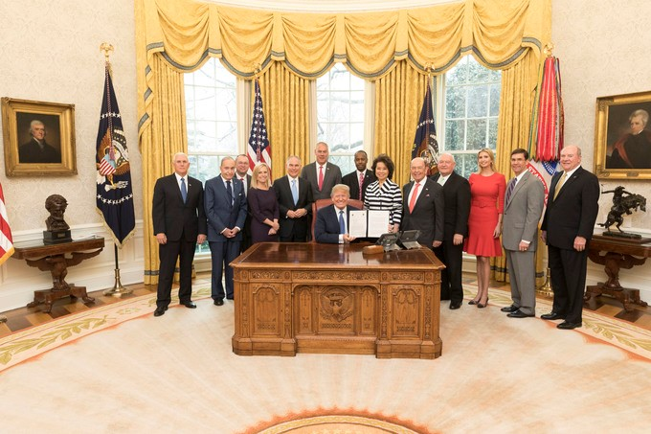
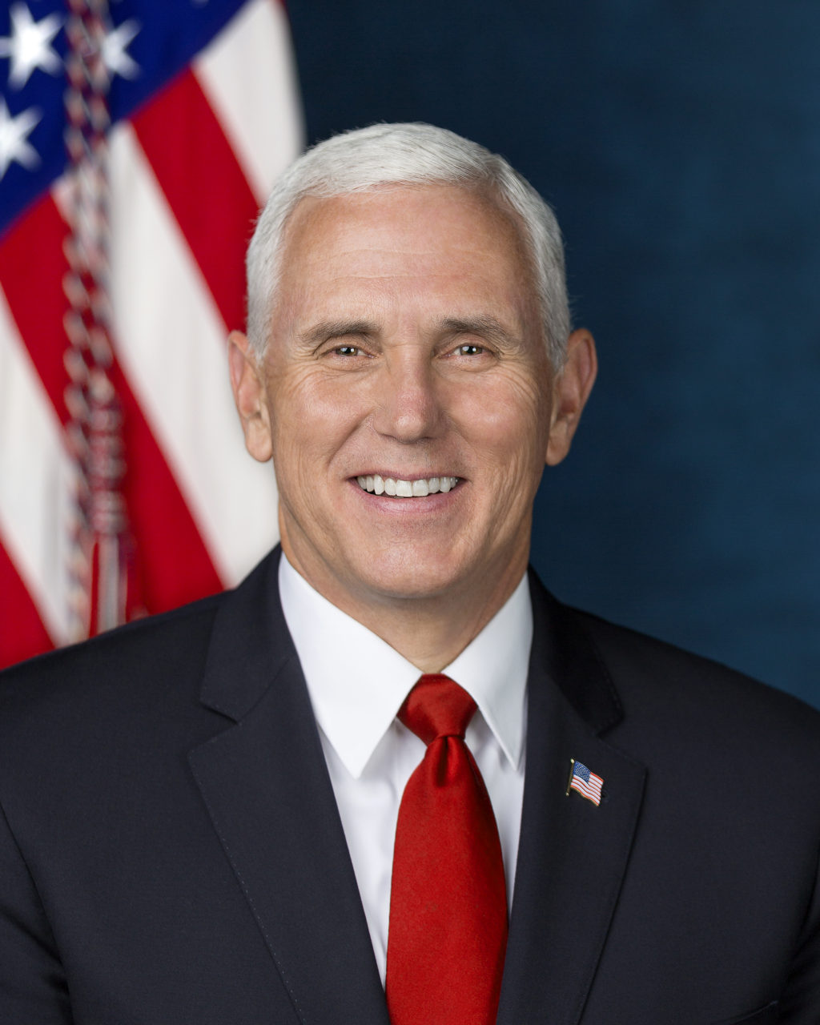

THE EXECUTIVE BRANCH
The Executive Branch, just as in Canada, is responsible for ”Carrying out the laws” of the nation. In the United States, the executive branch technically has three components; The President, Vice President, and Cabinet, but ultimately, the President is the sole source of governance. The President may only serve up to 2, 4-year terms.
Donald J. Trump (Rep.)
The 45th President of the United States (POTUS)
Michael R. Pence(Rep.)
The 48th Vice President of the United States
EXECUTIVE
The White House
Residence of the President of the United States of America
President Trump with his Vice President and Cabinet in the Oval Office
“Enforces the Law”

Slide 6
The Executive Branch
Unlike in Canada, The President of the United States holds many roles. He or she is the Head of State, The head of the executive branch (Chief Executive), Chief Diplomat and Legislator, head of his or her political party and directly represents every citizen within the nation. Additionally, the President is the Commander in Chief and the head of the American Armed Forces. The President is in charge of signing bills into law and for appointing their cabinet. Cabinet, which consists of members who are successfully confirmed by the Senate through a majority vote but may not have been themselves elected. Once confirmed they receive the title of Secretary and entrusted to run a department of the government (such as Defense or Agriculture)
CHECKS AND BALANCES
As Montesquieu argued for during the Enlightenment, The United States Utilizes a separation of power to prevent any group or one individual from perverting the government’s power to benefit themselves at the cost of the liberties and freedoms of others. As such, The Executive Branch (most specifically the President) directly shapes how the other two branches function, as well as who is put in charge of key political roles.
EXECUTIVE
“Enforces the law”
LEGISLATIVE
(Congress)
JUDICIAL
-The President can propose legislation
-Veto legislation that has passed congress (but can be overruled by a 2/3 vote in both the Senate and the House)
-Supreme Court Judges are nominated by the President

Slide 7
The Legislative Branch
Together, The United States Senate and the U.S. House of Representatives make up the bicameral legislative body of the United States government called Congress.
The Senate is comprised of senators from each of the 50 states. To ensure equality, 2 senators are elected to represent the states interests in this legislative body. The Senate offers a “sober second thought” ( A review of House recommendations)
Senate reviews possible legislation initiated by the President or from the House of Representatives. If successful, the Senate sends the legislation to the President to become a bill. Otherwise it is rejected. Unlike in Canada, senators can propose legislation. Senators hold 6 year terms.
The U.S. House of Representatives, acts similarly to its Canadian counterpart the House of Commons. The number of House of Representatives is based by a system of Representation by Population (Rep by Pop). Currently, 435 members sit in the House.
This means that equality of representation is achieved by ensuring each House Representative represents the same relative number of constituents , however this means that states with larger populations have more representatives. They serve terms of 2 years in office
The House of Representatives
LEGISLATIVE
(Congress)
The Senate
“Makes the Laws”

Slide 8
The Legislative Branch
CHECKS AND BALANCES
LEGISLATIVE
(Congress)
“Makes the Laws”
The United States Senate Building on Capitol Hill
Inside the United States House of Representatives
-Congress must approve the President’s Cabinet
-Congress control’s the budget
-Can override a presidential
veto with 2/3 majority
-Can impeach and remove the President from office
-Cabinet members cannot be members of the House
-Ensures Senate must approve the President’s selection of Supreme Court Judges
-Senate can change laws
-Senate can remove judges should they be found to be corrupt
-Legislative branch can change or abolish the court system
EXECUTIVE
JUDICIAL

Slide 9
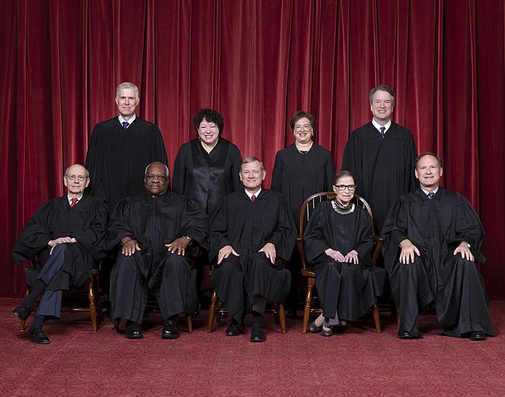
The Judicial Branch
The Judicial Branch is tasked with protecting the rights and freedoms of the people. This is achieved through consultation with the American Constitution, most often investigating how the laws are applied to all citizens equally through the rule of law and by faithfully upholding The American Bill of Rights. The Judiciary protects the people from the government and the people from each other in order to maintain their individual rights and freedoms. Members of the Supreme Court serve for life unless retired or removed from service
The American Supreme Court Building
The American Supreme Court Justices
JUDICIAL
“Interprets the Law”

Slide 10
THE JUDICIAL Branch
CHECKS AND BALANCES
JUDICIAL
“Interprets the Law”
A Judge’s Gavel
Blind Lady Justice
The U.S. Supreme Court Building
-The Judiciary can prevent any executive action through temporary stop measures known as injunctions.
-The Judiciary can also prevent executive orders should they be deemed to be unconstitutional
-If the President of the United States is ever put on trial, the
Chief Justice will oversee the
case directly.
The judicial system can strike down any legislation passed by Congress if such bills are considered to violate the constitution.
EXECUTIVE
LEGISLATIVE
(Congress)

Slide 11
Political Parties in the United States
Unlike Canada, the United States operates under a two-party system. The Democratic Party (or Democrats) tends, in general to be more liberal, embracing more positive freedoms and supporting a slightly more interventionalist government. The Republican Party however supports a significantly more “hands off approach” as a way of upholding individual liberties.
Voters often have to select between two ”extremes” on the right side of the spectrum (comparably more right than say the Conservative Party of Canada). As such voters often have to prioritize their votes to focus on specific economic, political or social issues in an election as politicians and voters can have a mixture of political or social leanings that may be more commonly found in the opposite party.
States that see heavy Republican voter influence are said to be “Red States”, while those states that vote predominantly for the the Democrats are “Blue States”. House Representatives, Judges, Members of the Senate as well as the President and Vice President typically vote and act along these party lines, especially without the benefit of having a substantial or influential independent party to moderate votes.
The Democrat Logo of the Donkey
The Republican Logo of the Elephant
”Blue States”
”Red States”

Slide 12
Bibliography
Flag of the United States of America, courtesy of the United States Federal Government, Title 17, Chapter 1, Section 105 of the US Code. Retrieved on May 23rd, 2020 from https://en.Wikipedia.org/wiki/File:Fllag_of_the_United_States.svg, Public Domain.
Donald J. Trump, 45th President of the United States, courtesy of the United States Federal Government. Photographed by Shealah Craighead on October 6th, 2017. Retrieved on May 23rd, 2020 from https://www.whitehouse.gov/people/Donald-j-trump, Public Domain
Michael R. Pence, 48th Vice President of the United States, Official Whitehouse Photo photographed by D.Myles Cullen on October 24th, 2017 courtesy of the United States Federal Government. Retrieved from www.whitehouse.gov/vice-president-mike-pense.
Seal of the President of the United States, Courtesy of the Executive Office of the President of the United States, sourced from PDF document at http://www.whithouse.gov/ncs.nss.pdf. Retrieved from https://commons.Wikimedia.org/wiki/File:Seal_of_the_President_of_the_United_States.svg, on May 23rd, 2020
Seal of the Vice President of the United States, courtesy of the United States Federal Government, Title 17, Chapter 1, Section 105 of the US Code. Retrieved on May 23rd, 2020 from https://commons.Wikimedia.org/wiki/File:Seal_of_the_Vice_President_of_the_United_States.svg.
President Donald J. Trump, Joined by Vice President Mike Pence and members of his Cabinet, taken at the Oval Office at the White House, Monday, April 9th, 2018, in Washington, D.C. Official White House Photo by Shealah Craighead, Creative Commons.
Singer Kelly Levesque rehearses “God Bless the USA” on the South Lawn of the White House, Tuesday, July 3, 2018, in preparation for a Fourth of July celebration at the White House. (Official White House Photo by Keegan Barber), retrieved from https://www.whitehouse.gov/articles/look-fourth-July-white-house-past-present/, retrieved on May 23rd, 2020’
U.S. Supreme Court, courtesy of Architect of the Capitol. Retrieved from www.publicdomainfiles.com/show_file.php?id=13974771622652 on May 25th, 2020. Originally sourced from Architect of the Capitol (Flickr Photostream)
“The Roberts Court, 2018” (Back row, left to right) Neil Gorsuch, Sonia Sotomayor, Elena Kagan, and Brett Kavanaugh. Front row (left to right): Stephen Breyer, Clarence Thomas, Chief Justice John Roberts, Ruth Bader Ginsburg, and Samuel Alito. Phot credit: Fred Schilling, Collection of the Supreme Court of the United States-http://supremecourt.gov/about/justices.aspx. Retrieved from https://simple.Wikipedia.org/wik/Supreme_Court_of_the_United_States on May 25th, 2020
Seal of the Supreme Court of the United States. Courtesy of the Supreme Court of the United States. Image retrieved from https://commons.wikimedia.org/wiki/File:Seal_of_the_United_States_Supreme_Court.svg, on May 25th, 2020
Seal of the United States Senate, sourced from archive.org copy of late 202 senate.gov website. Courtesy of the United States Senate, Retrieved from https://commons.wikimedia.org/wiki/File:Senate_cap.PNGP on May 26th, 2020. Public Domain
Resident Barack Obama speaks to a joint session session of Congress regarding health care reform, September 9, 2009. Photo by Lawrence Jackson, from Whitehouse.gov. Retrieved from https://commons.wikimedia.org/wiki/File:Obama_Health_Care_Speech_to_Joint_Session_of_Congress.jpg, on May 24th, 2020
Seal of the United States House Of Representatives. Courtesy of the United States Congress. Image retrieved from https://en.wikipedia.org/wiki/File:Seal_of_the_United_States_House_of_Representatives.svg, on May 25th, 2020. Public Domain
House of Representatives Building and the East Portico of the U.S. Capitol-Washington (DC) January 2013, Photograph by Ron Cogswell, Flickr. Image retrieved from https://www.flickr.com/photos/22711505@N05/8395638677 on May 23rd, 2020. CC-BY 2.0
US Capitol-U.S. Supreme Court Building, 7 Novemeber 2011. Image courtesy of Architect of the Capitol (Federal government). Image by USCapitol. Image retrieved at https://commons.wikimedia.org/wiki/File:Flickr_-_USCapitol_-_U.S._Supreme_Court_Building.jpg on May 24th, 2020, Public Domain
Lady Justice by JvL, Flickr. Image retrieved from https://www.flickr.com/photos/-jvl-/7962586726 on May 26th, 2020. CC-BY 2.0
Judge Gavel, Retrieved from https://www.publicdomainpictures.net/en/view-image.php?image=161503&picture=judge-gavel on May 26th, 2020. Public Domain
American Bill of Rights. Image courtesy of the National Archives and Records Administration: National Archives Identifier: 1408042. Image retrieved on May 26th, 2020. Public Domain
Constitution of the United States, page 1. Images courtesy of the National Archives and Records Administration: National Archives Identifier: 1667751, Image retrieved from https://commons.wikimedia.org/wiki/File:Constitution_of_the_United_States,_page_1.jpg on May 26th, 2020
Scene at the Sighing of the Constitution of the United States (1940) By Howard Chandler Christy. Image retrieved from https://commons.wikimedia.org/wiki/File:Scene_at_the_Signing_of_the_Constitution_of_the_United_States.jpg on May 26th, 2020. Image courtesy of the United States Capitol. Public Domain
High resolution image of the United States Declaration of Independence, created by w:Second Continental Congress., a reproduction by William Stone. Image retrieved from https://commons.wikimedia.org/wiki/File:United_States_Declaration_of_Independence.jpg, On May 26th, 2020. Public Domain
Laurel branch vector image, retrieved from https://publicdomainvectors.org/en/free-clipart/Laurel-branch-vector-image/81241.html on May 26th, 2020. Image by OpenClipart, Public Domain
Republican (Elephant) Logo. retrieved from https://commons.wikimedia.org/wiki/File:Republicanlogo.svg on May 26th, 2020. Image sourced from www.gop.com, and Imaged by the Republican Party of the United States, Public Domain
Democratic (Donkey) Logo. Retrieved from https://commons.wikimedia.org/wiki/File:DemocraticLogo.svg. On May 26th, 2020. Image created by Steven Brager, Public Domain
Portrait of John Locke by Godfrey Kneller (1697). Retrieved from https://commons.wikimedia.org/wiki/File:John_Locke.jpg on May 26th, 2020. Public Domain
Portrait of Jean-Jacques Rousseau by Maurice Quentin de La Tour. Image retrieved from https://en.wikipedia.org/wiki/Jean-Jacques_Rousseau#/media/File:Jean-Jacques_Rousseau_(painted_portrait).jpg, on May 26th, 2020. Public Domain
Portrait of Charles Montesquieu by Jacques-Antoine Dassier, originally uploaded by Maarten van Vliet. Image retrieved from https://en.wikipedia.org/wiki/Montesquieu#/media/File:Charles_Montesquieu.jpg on May 26th, 2020. Public Domain

