Slide 1
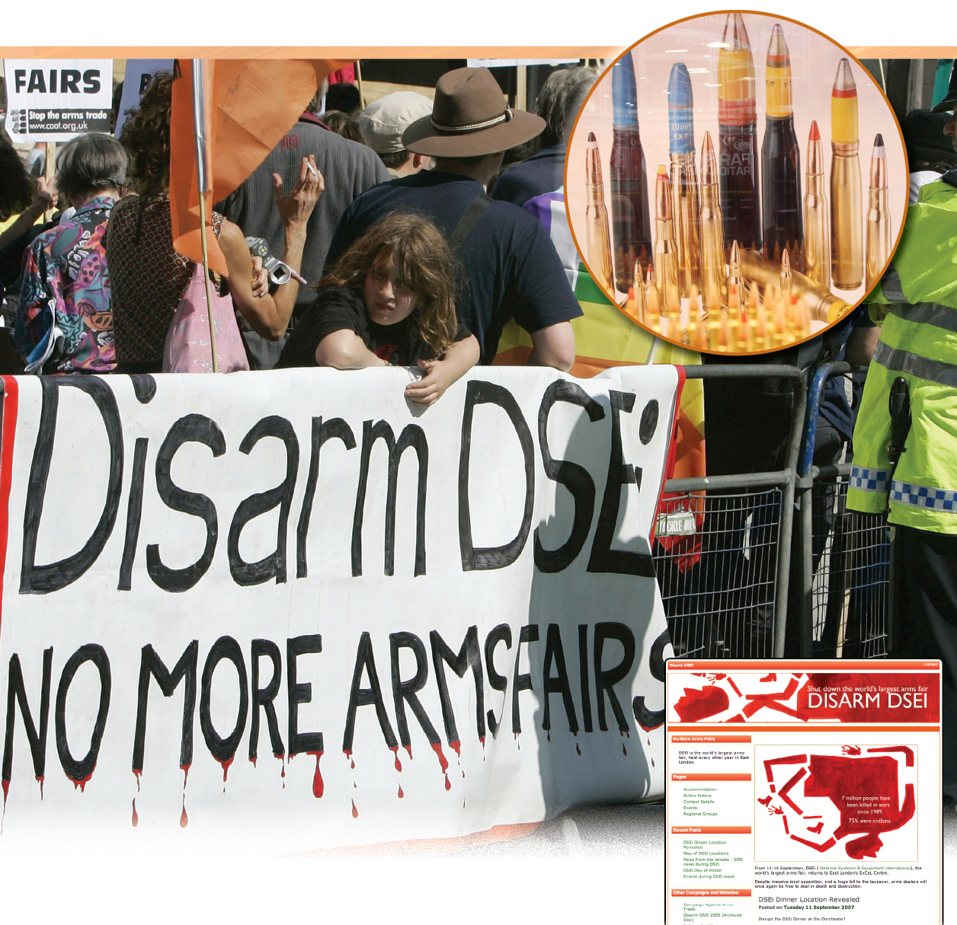
Internationalism and Nationalism
Chapter 11
To what extent do efforts to promote internationalism through world organizations affect nationalism?

Slide 2
International Arms Trade is big business
$200 billion a year spent on weapons.
SUPPORT Arms Fairs
Many groups and governments say that arms fairs serve an important purpose.
Arms fairs provide an opportunity to assess and buy technologically advanced weapons
weapons help promote safety and security
protect a country’s sovereignty
OPPOSE Arms Fairs
Critics argue that these fairs promote war and threaten everyone’s security.
Make weapons easily available
WHAT DO YOU THINK?
Can buying and manufacturing weapons be a purely defensive strategy?
How can the sale of weapons promote – and threaten – world peace?
Should the arms trade be regulated? If so – who should be responsible? If not – why?
Why might organizations have chosen to highlight the word “defense” in the fair’s name? Is this name accurate?

Slide 3
Key Terms
RYWK

Slide 4
voluntary balkanization
responsibility to protect
common human heritage
trickle-down-effect

Slide 5
In this chapter we are dealing with these questions:
IQ # 1 HOW HAVE CHANGING WORLD CONDITIONS PROMOTED THE NEED FOR INTERNATIONALISM?
IQ #2 HOW HAVE THE UNITIED NATIONS’ CHANGING INTERNATIONAL RESPONSES AFFECTED NATIONALISM?
IQ #3 HOW DO THE RESPONSES OF VARIOUS INTERNATIONAL ORGANIZATIONS AFFECT NATIONALISM?

Slide 6
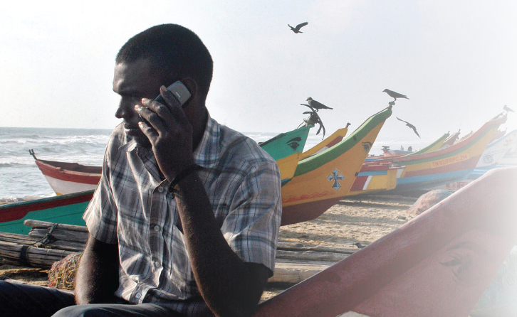
IQ # 1 HOW HAVE CHANGING WORLD CONDITIONS PROMOTED THE NEED FOR INTERNATIONALISM?
as the world becomes more globalized, challenges can no longer be confined within one country.
SARS 2003 Terrorism Climate change
Citizens can now communicate globally (independently)
Do technological advances like the cellphone support or threaten traditional ways of life?

Slide 7
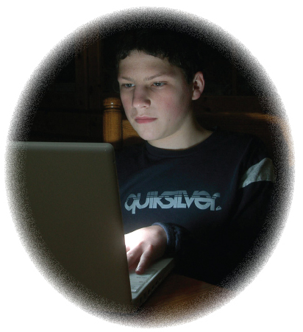
The Global Village
Internet, satellite, fibre optics, cellphones = information revolution
McLuhan’s “global village” - a single collective of citizens with common interests – not everyone accepts this idea
balkans is a Turkish word for “mountains” FYI
Has the Internet truly created a global village or merely a series of small, isolated online communities?
Some worry that young people are being electronically isolated at a time when socializing is important for the development of identity.
Do you think this concern is valid?

Slide 8
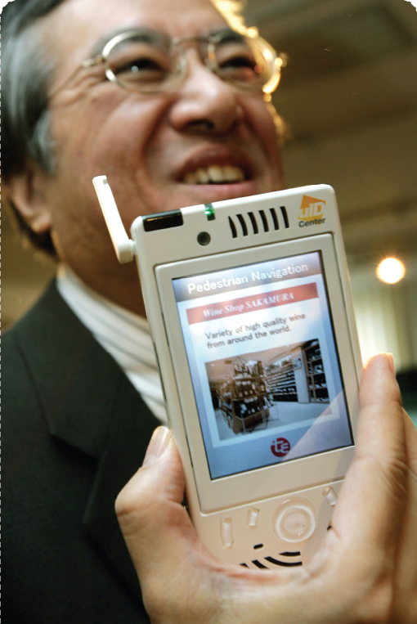
How might digital technology serve as an instrument of power?
How might it disempower people?
Does the use of technology reinforce national interest rather than internationalism?

Slide 9
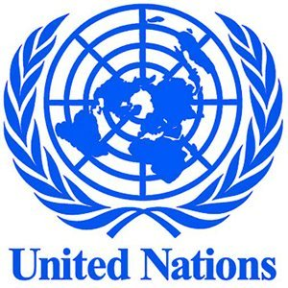
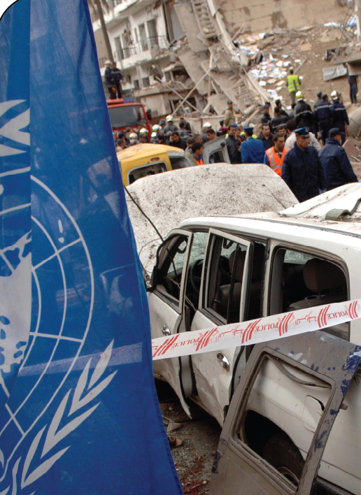
IQ #2 HOW HAVE THE UNITIED NATIONS’
CHANGING INTERNATIONAL RESPONSES
AFFECTED NATIONALISM?
Not everyone agrees that internationalism is the key to bring peace to the world.
Aggressive states, failed states, revolutionary movements challenge the international order and UN goals
Failure of peacekeeping missions in former Yugoslavia and Rwanda caused people to question the effectiveness of UN
2004, international leaders examined the future of the UN – produced a report titled A More Secure World: Our Shared Responsibility
Why was the report controversial? What did it recommend?

Slide 10
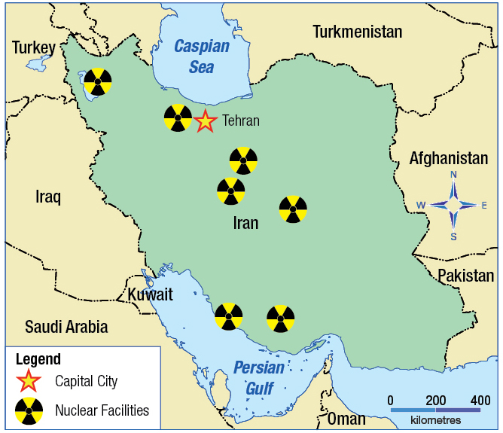
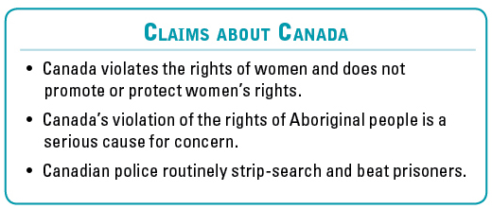
Iran’s Conflict with the UN
Iran signed the Nuclear Non-Proliferation Treaty
Secretly enriching uranium which can be used for developing nuclear power and nuclear weapons
UN told Iran to stop nuclear program and Iran refused
If the United States, Russia, Britain, France, China, India, Pakistan, North Korea and possibly Israel already have nuclear weapons, is it fair to stop Iran from developing them?
If Iran is planning to develop nuclear weapons, is this a situation in which the UN should intervene to exercise its responsibility to protect?
Nuclear Facilities in Iran
Spin buster – Some of Iran’s Claims about Canada

Slide 11
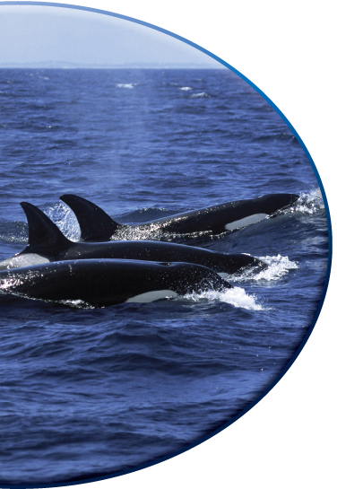
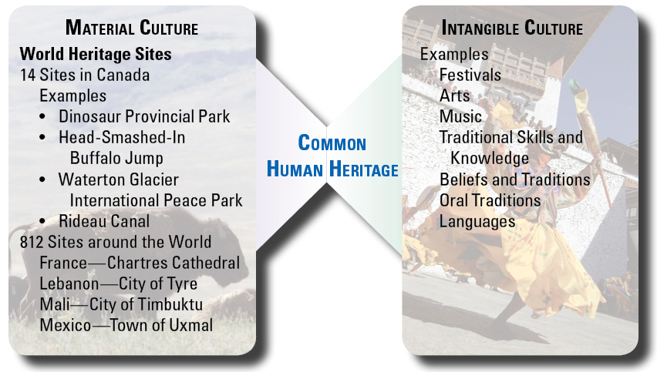
Protecting the Common Human Heritage
In 1945, the UN created UNESCO
UNESCO promotes international co-operation in the fields of education, science, culture, and communication
Works to create respect for the shared values and dignity of every culture
Part of UNESCO’s mandate is to preserve the common human heritage (world heritage sites, traditional skills and knowledge, and the arts)
UNESCO believes that peace will be promoted if people know about and help preserve this common human heritage

Slide 12
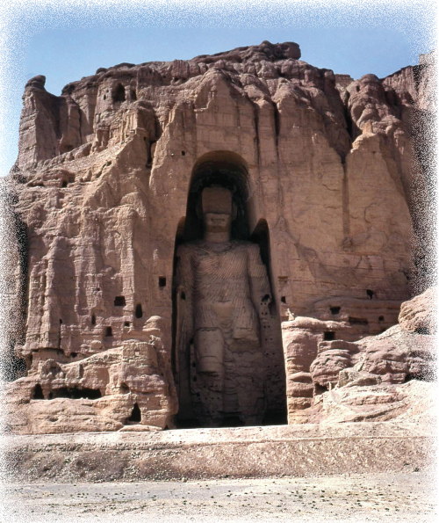
Identifying the Common Human Heritage
Threats to the Common Human Heritage
Although Canada may value the 14 sites that have received UNESCO’s world heritage designation, are these places part of the culture and heritage of all humanity?
Should works of art like this be considered the property of the state in which they are located or are they part of everyone’s heritage?

Slide 13
IQ #3 HOW DO THE RESPONSES OF VARIOUS INTERNATIONAL ORGANIZATIONS AFFECT NATIONALISM?
VOICES
“A world which fails to establish the rule of law over the nation-states cannot long continue to exist. We are living in a perilous period of transition from the era of the fully sovereign nation-state to the era of world government.”
- James Warburg, former financial adviser to U.S. president Franklin Roosevelt, in The West in Crisis, 1959
What is Warburg saying about the future of nation-states in an era of internationalism?
Do you agree?

Slide 14
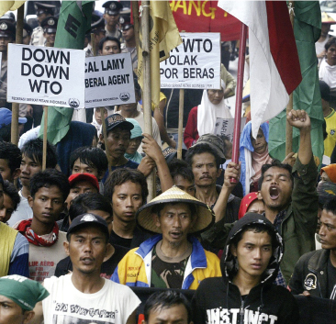
Economic Organizations
Supporters of international trade agreements believe that as the economies of developed countries become stronger and more prosperous, a trick-down effect is created.
The World Trade Organization:
1948, 23 countries signed GATT (rules for conducting trade)
1995, the GATT became WTO (150 + countries)
Not everyone agrees WTO help the world
Maude Barlow

Slide 15
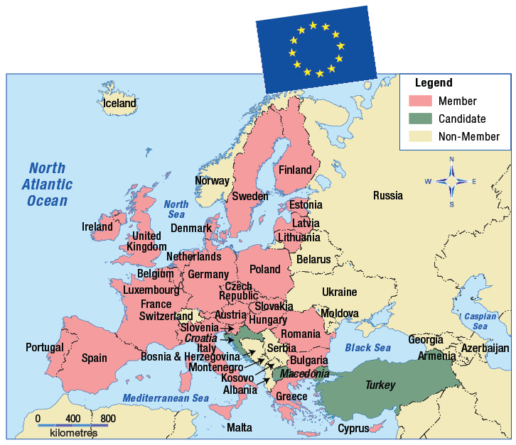
The European Union
EU became an official supranational body in 1991
Large free-trade zone – integrating economies of member countries
Most members have adopted the euro as a common currency (Britain and Denmark resisted euro – belief in loss of identity and sovereignty
Both WWI and WWII became as conflicts between European countries and spread around the world.
Do you believe that co-operating in the EU reduces the chances that another war will start in the same way?

Slide 16
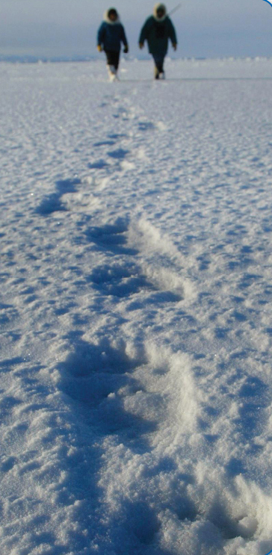
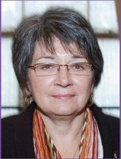
Cultural and Language-Based Organizations
Early Indigenous Peoples’ Initiatives
The Arctic Council
La Francophonie
Would you describe Mary Simon as a nationalist or an internationalist – or both?

Slide 17
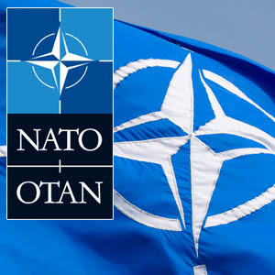
Security Organizations
Countries have always formed defensive military alliances to ensure their security
NATO (North Atlantic Treaty Organization) was formed in 1949 when the Cold War began
Countries of Western Europe and North America feared military threat posed by communist-controlled Soviet Union.

Slide 18
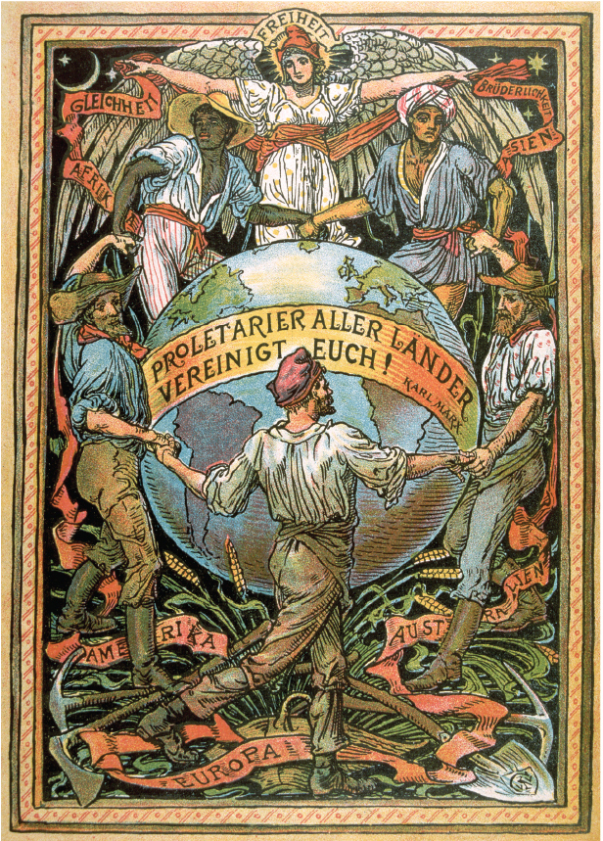
Reproduction of the cover of alate 19th – century German socialist pamphlet.
The woman at the top represents Freedom (Freiheit). Shis is shown extending her welcome to all the peoples of the world. The words on the banner say, “Workers of the world unite.” This motto is attributed to the famous socialist thinker Karl Marx.
What does this poster say about nationalism and internationalism? If you were to revise this poster to send the same message to contemporary audiences, what images would you select?

