Slide 1

SOCIAL 30
What is an Ideology?

Slide 2
What is an ideology?
An ideology is a system of values and beliefs, usually political or economic in nature, that help to describe an ideal system or world, and that typically answer the following questions;
What are humans like (what is their nature?), and why do they do what they do?
What is the nature of society? (is society naturally positive or negative in its scope?)
What is our role as individuals in society?

Slide 3
Is collectivism or individualism an ideology?
No, Individualism and collectivism describe approaches to an ideology. Individualist ideologies typically value the rights, influences and actions of individuals over those of the group(collectives).Collectivist ideologies on the other hand tend to favour outcomes that benefit the group over the individual.
Principles of both individualism and collectivism can be utilized together, and at the same time to form an ideology. An example of this would be Socialism, which does value limited individual rights (such as democratic rights) but largely values the interests of a group over the individual.
Ideologies that have some degree of individualism are said to “liberal” in nature and utilize liberal freedoms, even if they might be predominantly focusing on collectivist principles.

Slide 4
Examples of Ideologies
POLITICAL IDEOLOGIES
ECONOMIC IDEOLOGIES
-Anarchism
-Liberalism
-Conservatism
-Fascism
-Communism
-Communitarianism
-Statism
-Libertarianism
-Socialism
SOCIAL IDEOLOGIES
-Capitalism
-Communism
-Globalism
-Mercantilism
-Protectionism
-Keynesianism
-Monetarism
-Market Fundamentalism
-Multiculturalism
-Feminism
-Nationalism
-Ethnocentrism
-Tribalism
-Supremacism

Slide 5
Political Ideologies
-Create an ideal political system that clearly identifies the roles of the individual and the role of government within society. Political Ideologies answer these questions:
What does the structure of government look like?
What values does it maintain or protect?
What should the government provide for the people, and when?
Do citizens have a voice? Is the will of the people administered?
What, if any individual rights and freedoms do people have?
Is the success of the group more important than the individual?
What are the roles, responsibilities and rights of the citizen?
How are decisions made and by whom?
How is the government formed and for how long do they stay in power?
How is the government justified in making decisions for the people?

Slide 6
Economic Ideologies
-Create an ideal economic system that clearly identifies the roles of the individual and the role of government within the economy. Economic Ideologies answer these questions:
Who is responsible for providing individuals with their needs and wants?
What is the purpose of the economy? To create profit or to provide goods and services that are both necessary for life/or improve it?
What is made and why?
Do individuals have the authority to run the market or are decisions made by the government?
Are business/industries owned privately or publicly?
Are the rights and freedoms of workers protected or abused by those who own the means of production?
Should the environment be protected?
Should the government be involved in creating laws, collecting taxes or using to protect workers or companies within their own nation-state?
Who controls the market and how? Consumers and Producers or Governments?
How is freedom viewed? Is freedom about choice or is it about economic equality?

Slide 7
Social Ideologies
-Create an ideal social system that clearly identifies the roles of the individual and the role of government within the economy. Economic Ideologies answer these questions:
What is the goal of society?
What/whom are valued? Who is not?
Are rights and freedoms equal amongst all people?
How are outsiders treated? Are their differences encouraged or are they assimilated or persecuted?
Is there a division between people of various religions or political backgrounds
Are men, women valued in the same ways?
What are the roles of various individuals in society?
Are individuals or collectives more important?

Slide 8
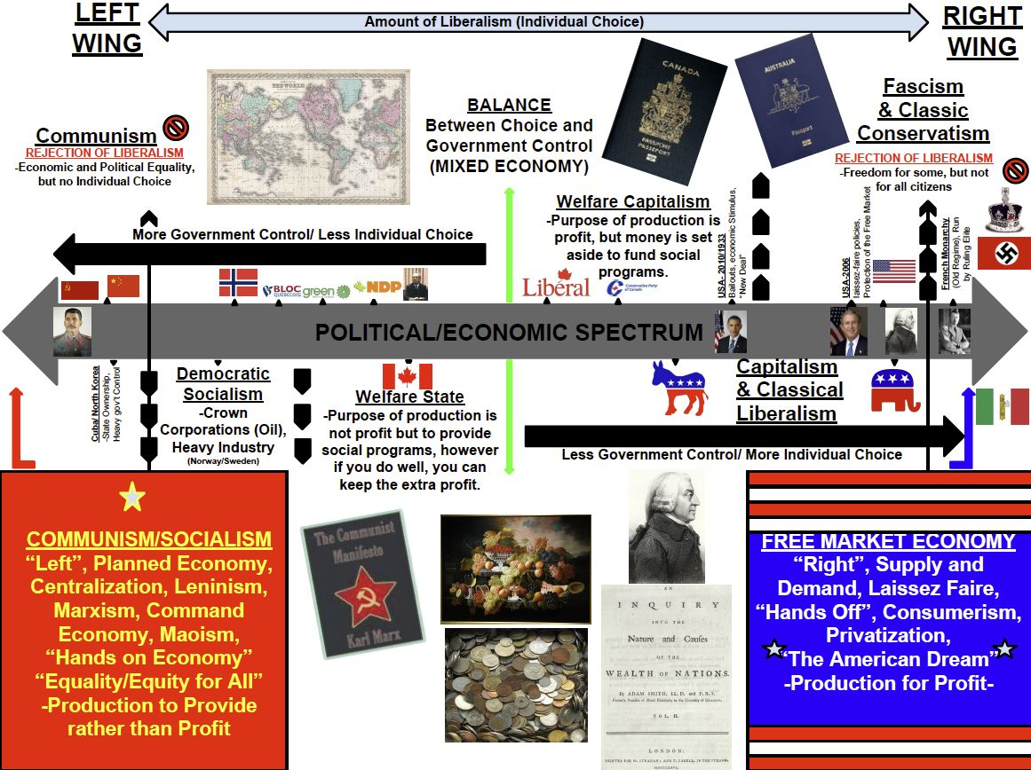

Slide 9
COLLECTIVISM | INDIVIDUALISM
The group, or collective is important and more valuable than a single individual | Individuals are important, and entitled to make decisions.
It is important to contribute to the group and to be liked the group. | Individuals are unique.
The strength of the group relies on the contributions of everyone, and the individual may need to sacrifice. | Individual's effort is valued and each individual should be allowed to develop his or her potential.
The group is stronger if it knows what its members think, and privacy is not a priority. | Individuals have the right to privacy and to think freely.
The entire group is responsible for its member’s actions. | The individual is responsible for his or her own actions.
The efforts of the group are most important, and individual efforts may not always be celebrated. | The individuals should take initiatives and value personal achievements.
Cooperation is the best way to succeed. | Competition promotes excellence.
The group is responsible for its members’ welfare. | The individual is responsible for his or her own welfare.
Wealth is shared. | Private property and individual wealth are valued.
The well-being of the group is more important than individual rights. | Laws should protect individual rights.

Slide 10
Collectivism and Individualism
When investigating ideologies, it is important to note that ideologies change as time passes. Many ideologies have strong leanings towards either collectivism or individualism, however, most ideologies embrace a mixture of both individualism and collectivism.
Since our experiences affect how we see and interact in the world, it is natural to see the link between personal experience/collective experience and the formation and maturation of an ideology. Additionally, ideologies change as our beliefs and values are changed throughout our lives.

Slide 11
FACTORS THAT INFLUENCE BELIEFS AND VALUES
Culture: The circumstances and life practices that people hold on to help to frame how individual interpret the world and the values they hold. Language:The language you use limits the types of people you interact with. Additionally, languages define words based on gender and based on purpose and can reflect cultural bias. Religion and Spirituality: Your religion or spirituality forms your beliefs and values as it demonstrates how you relate to others through a collective identity that is formed by tight knit groups whether small or large.Spirituality can also be related to the culture and environment/relationship of land. Environment and Relationship to Land: Individual and collective values are shaped by the environment in which we live in. Since culture is also shaped this way, the resources and geography of our land may have areas of greater importance which may help to explain where you live, the lifestyle you choose and how you interact with your surroundings. Gender: Determines some of the options and expectations an individual has in society or within a collective. Gender can also affect how you see the world as a result. Media: Books, Radio, Tv, Internet, Social Media, Newspapers etc...Help to inform/persuade/indoctrinate you. A way to spread messages/ideas. Ideology: A set of political or economic beliefs that shape how individuals or collective see and interact in the world.
Adapted from Chapter 1 of Perspectives on Ideology, published by Oxford Canada

Slide 12
Themes of Ideology
Nation- Can be from a recognized nation-state/country or a group that sees itself as unique through a common culture, language, customs or goals Ex: (Metis, Quebecois, First people's), Assembly of First Nations (AFN) Religion-Often a basis of individual/collective ethics and morality. These beliefs and values help to form ideologies by answering a variety of questions about human nature. Religion can cause conflict between groups with varied goals or altered beliefs and values. Class- Social class can be divided between the upper class (or elite), middle class and lower class. These classes and their experiences shape the occupations people have, the amount of money they make, the opportunities that are provided them and is the basis of some ideologies such as socialism and communism. Relationship to Land and the Environment-Determines how individuals view their surroundings as well as the methods in which they live off the land or extract resources. Some cultures believe that the world is meant to provide for humankind, while others such as the first peoples of Canada think that mankind is meant to act as a steward for Nature. Adapted from Chapter 1 of Perspectives on Ideology, published by Oxford Canada

Slide 13
CITATIONS: (Political Economic Spectrum)
IMAGE CITATIONS (APA FORMAT)
1.File:1855 Colton Map of the World on Mercator Projection - Geographicus - WorldMercator-colton-1855.jpg. (2018, September 5). Wikimedia Commons, the free media repository. Retrieved 04:26, October 26, 2018 from https://commons.wikimedia.org/w/index.php?title=File:1855_Colton_Map_of_the_World_on_Mercator_Projection_-_Geographicus_-_WorldMercator-colton-1855.jpg&oldid=3186630332.File:NewCanadianPassport.jpg. (2016, November 29). Wikimedia Commons, the free media repository. Retrieved 04:31, October 26, 2018 from https://commons.wikimedia.org/w/index.php?title=File:NewCanadianPassport.jpg&oldid=224343719.
3.File:Australian Passport "P" Series.jpg. (2017, May 25). Wikimedia Commons, the free media repository. Retrieved 04:32, October 26, 2018 from https://commons.wikimedia.org/w/index.php?title=File:Australian_Passport_%22P%22_Series.jpg&oldid=245390116.
4.File:Wealth of Nations title.jpg. (2016, April 23). Wikimedia Commons, the free media repository. Retrieved 04:35, October 26, 2018 from https://commons.wikimedia.org/w/index.php?title=File:Wealth_of_Nations_title.jpg&oldid=194189102
5.File:Kiloware.JPG. (2018, August 2). Wikimedia Commons, the free media repository. Retrieved 04:37, October 26, 2018 from https://commons.wikimedia.org/w/index.php?title=File:Kiloware.JPG&oldid=313403404.
6.File:AdamSmith.jpg. (2017, September 28). Wikimedia Commons, the free media repository. Retrieved 04:39, October 26, 2018 from https://commons.wikimedia.org/w/index.php?title=File:AdamSmith.jpg&oldid=260201281.
7.File:Flag of German Reich 1935–1945 (reverse).svg. (2018, June 19). Wikimedia Commons, the free media repository. Retrieved 04:43, October 26, 2018 from https://commons.wikimedia.org/w/index.php?title=File:Flag_of_German_Reich_1935%E2%80%931945_(reverse).svg&oldid=307125966.
8.File:Flag of Fascist Italy (fictional).svg. (2016, October 6). Wikimedia Commons, the free media repository. Retrieved 04:44, October 26, 2018 from https://commons.wikimedia.org/w/index.php?title=File:Flag_of_Fascist_Italy_(fictional).svg&oldid=209000555.
9.File:Flag of Canada.svg. (2018, August 26). Wikimedia Commons, the free media repository. Retrieved 04:48, October 26, 2018 from https://commons.wikimedia.org/w/index.php?title=File:Flag_of_Canada.svg&oldid=316655247.
10.File:Republicanlogo.svg. (2016, August 4). Wikimedia Commons, the free media repository. Retrieved 04:53, October 26, 2018 from https://commons.wikimedia.org/w/index.php?title=File:Republicanlogo.svg&oldid=203124660.
11.File:DemocraticLogo.svg. (2017, August 12). Wikimedia Commons, the free media repository. Retrieved 04:55, October 26, 2018 from https://commons.wikimedia.org/w/index.php?title=File:DemocraticLogo.svg&oldid=255195627.
12.File:Flag of the United States.svg. (2018, October 21). Wikimedia Commons, the free media repository. Retrieved 04:57, October 26, 2018 from https://commons.wikimedia.org/w/index.php?title=File:Flag_of_the_United_States.svg&oldid=324841822.
13.File:Stalin Museum Batumi.jpg. (2018, September 28). Wikimedia Commons, the free media repository. Retrieved 05:01, October 26, 2018 from https://commons.wikimedia.org/w/index.php?title=File:Stalin_Museum_Batumi.jpg&oldid=322198870
14.File:Official portrait of Barack Obama.jpg. (2016, November 26). Wikimedia Commons, the free media repository. Retrieved 05:02, October 26, 2018 from https://commons.wikimedia.org/w/index.php?title=File:Official_portrait_of_Barack_Obama.jpg&oldid=220760306.
15.File:TommyDouglas-c1971-crop.jpg. (2015, April 13). Wikimedia Commons, the free media repository. Retrieved 05:05, October 26, 2018 from https://commons.wikimedia.org/w/index.php?title=File:TommyDouglas-c1971-crop.jpg&oldid=156964773.
16.File:Logo Green Party of Canada.svg. (2018, April 6). Wikimedia Commons, the free media repository. Retrieved 05:08, October 26, 2018 from https://commons.wikimedia.org/w/index.php?title=File:Logo_Green_Party_of_Canada.svg&oldid=295888084.
17.File:NDP logo.jpg. (2017, May 15). Wikimedia Commons, the free media repository. Retrieved 05:10, October 26, 2018 from https://commons.wikimedia.org/w/index.php?title=File:NDP_logo.jpg&oldid=244156217.
18.File:Bloc Québécois-logo.svg. (2018, October 10). Wikimedia Commons, the free media repository. Retrieved 05:12, October 26, 2018 from https://commons.wikimedia.org/w/index.php?title=File:Bloc_Qu%C3%A9b%C3%A9cois-logo.svg&oldid=323530394.
19.File:Flag of Norway.svg. (2018, July 20). Wikimedia Commons, the free media repository. Retrieved 05:15, October 26, 2018 from https://commons.wikimedia.org/w/index.php?title=File:Flag_of_Norway.svg&oldid=311910017.
20.File:Liberale Partei Kanadas Logo.svg. (2018, October 11). Wikimedia Commons, the free media repository. Retrieved 05:21, October 26, 2018 from https://commons.wikimedia.org/w/index.php?title=File:Liberale_Partei_Kanadas_Logo.svg&oldid=323635997.
21.File:Flag of the People's Republic of China.svg. (2018, August 24). Wikimedia Commons, the free media repository. Retrieved 05:24, October 26, 2018 from https://commons.wikimedia.org/w/index.php?title=File:Flag_of_the_People%27s_Republic_of_China.svg&oldid=316324141.
22.File:Flag of the Soviet Union (1936–1955).svg. (2018, August 19). Wikimedia Commons, the free media repository. Retrieved 05:26, October 26, 2018 from https://commons.wikimedia.org/w/index.php?title=File:Flag_of_the_Soviet_Union_(1936%E2%80%931955).svg&oldid=315311384.
23File:Imperial State Crown.png. (2017, December 11). Wikimedia Commons, the free media repository. Retrieved 13:19, October 26, 2018 from https://commons.wikimedia.org/w/index.php?title=File:Imperial_State_Crown.png&oldid=271334113.7.
24.File:Adolf Hitler Berghof-1936.jpg. (2018, October 3). Wikimedia Commons, the free media repository. Retrieved 05:50, October 26, 2018 from https://commons.wikimedia.org/w/index.php?title=File:Adolf_Hitler_Berghof-1936.jpg&oldid=322784484
25.https://commons.wikimedia.org/w/index.php?title=Special:CiteThisPage&page=File%3AAbundance_of_Fruit_by_Severin_Roesen%2C_1860%2C_oil_on_canvas_-_New_Britain_Museum_of_American_Art_-_DSC09427.JPG&id=286052389
26.Conservative Party of Canada Logo https://www.ctvnews.ca/politics/conservative-riding-association-in-winnipeg-says-95k-is-missing-1.2706062

