Slide 1

Unit 2
To what extent should nationalist interest be pursued?

Slide 2
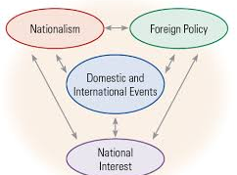
How are Nationalism and National Interest Related?
Aspects of National Interest
People who govern democratic communities and nations make decisions based on what is the best interest of the community or nation.
Whether a people’s nationalism is based on a shared ethnicity and culture or shared beliefs and values, they want certain benefits for themselves and their communities.

Slide 3
Aspects of National Interest
National Interest may focus on one or more of the following:
  Economic prosperity – This includes stable employment and a decent standard of living.
  Security and Safety – Measure to maintain national security and physical protection include laws that protect citizens within the country, as well as secure borders that can be defended against intruders.
  Beliefs and values – These include affirming and promoting citizens’ values, beliefs, and cultures. Governments try to safeguard and respect the shared worldviews, ways of life, traditions, and languages of their citizens.

Slide 4
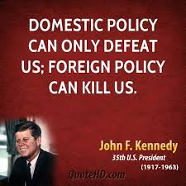
Domestic Policy
Guides decisions about what to do within the country. In Canada, domestic policy may guide decisions about changing federal laws, settling Aboriginal land claims and spending tax revenues.
Foreign Policy
Guides decisions about official relations with other countries. It is often called external relations or foreign affairs and may involve cooperating with international organizations such as the UN.

Slide 5
Changing views of National Interest
Just as people’s understanding for nationalism may differ, their opinions on what is in the national interest may also differ.
National interest is not static or unchanging. Events within a country can change people’s opinion about what is in the national interest. For example, what was the national interest regarding the Haiti earthquake of 2009?

Slide 6

Differing Views of National Interest
People often decide what is in the national interest based on the understanding on nation and national identity.
For example, many Canadians take pride in Canada’s reputation as a nation of peacekeepers. While other Canadians believe Canada’s role should shift to peacemaking, which allows soldiers to use force for reasons other than self-defense (ex: Afghanistan)

Slide 7
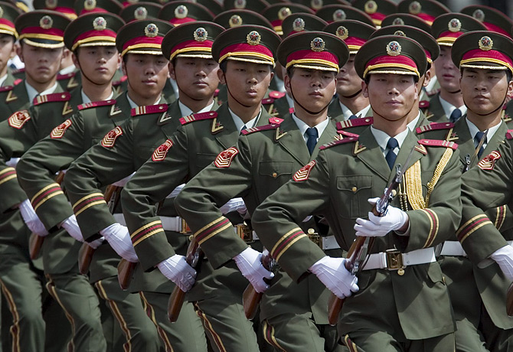
National Interest in China
Another example is China. The Chinese government believes that a strong military is essential. “China’s military might is meant to deter any hostile attempts towards China’s national interest.

Slide 8
How are Nationalism and
National Interest Related?
People’s choices are often inspired by loyalty. Nationalism and national loyalty can inspire people to pursue the national interests of their country or nation.
The Summer Olympics of 2008 in Beijing allowed the Chinese to show the world how proud they were of their nation. This would be a national interest.
It also allowed for those opposed of China and the Chinese rule over Tibet to show their conflicting national interest.

Slide 9
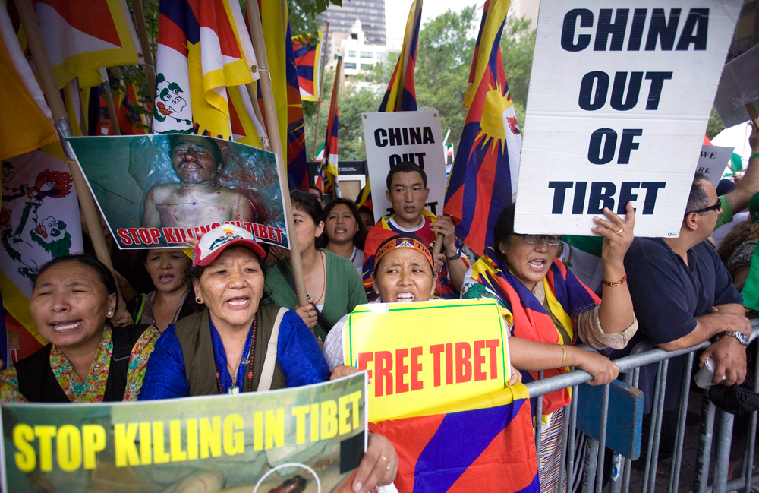

Slide 10
How has national interest shaped foreign policy?
A policy is a plan of action that has been deliberately chosen to guide or influence future decisions.
A country’s government is responsible for developing both domestic policy and foreign policy.
Foreign policy decisions may have short term effects or long term effects.
Some foreign policy decisions made at the end of World War I are still affecting the world today. Many people believe that the turmoil in the Middle Eastern countries related directly to the foreign policy decisions of the United States and European countries as they pursued their own national interest.

Slide 11
How has foreign policy shaped national interest?
Just as national interest shapes foreign policy, foreign policy can also affect national interest.
For example, a government’s foreign policies can affect its citizens’ safety and security, their economic future, and their values and culture.
National governments often make decisions about what is in the national interest, then work to persuade citizens to support it.
Canada’s effort on the War on Terrorism in Afghanistan is part of a foreign policy. Canada is part of NATO (North Atlantic Treaty Organization) and when NATO decided to go to war with the Taliban, Canada went to war as well. How did this affect our national interest?

