Slide 1

Identity, the Media, and Communication Technology
“To what extent is identity affected by communication technology and the media in a globalizing world?”
Notes:
‹#›

Slide 2
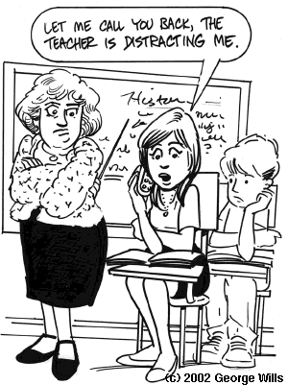
Key Terms
Digital Divide
Propaganda
Pop Culture
Universalization
Hybridization
Notes:
‹#›

Slide 3
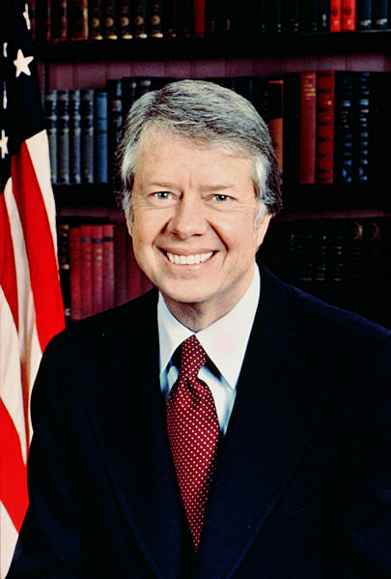
Jimmy Carter
“Globalization, as defined by rich people like us, is a very nice thing…you are talking about the Internet, you are talking about cellphones, you are talking about computers. This doesn’t affect two-thirds of the people of the world”
Notes:
‹#›
I want you to brainstorm for two minutes and come up with three ways that you communicate?
When you want to share information with someone how do you go about doing this?
Let’s make a list:
Everyone come up to the board and write down one of the ways that you communicate with someone!
Now have the students think about why they use these types of communication.

Slide 4

Brainstorm
How do you communicate?
Notes:
‹#›
Text message, call someone, go on Facebook, messengers
These types of technology are allowing you to connect with people all around the world.
From your friends that are sitting next to you at lunch, to your parents that are across the city to family who live in different provinces or countries as a matter of fact.
Digital technology enables you to even interact with people on TV programs.

Slide 5
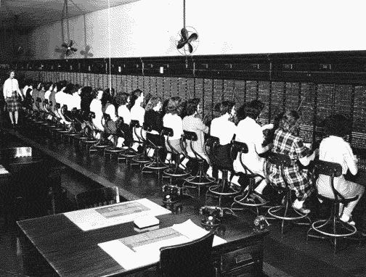
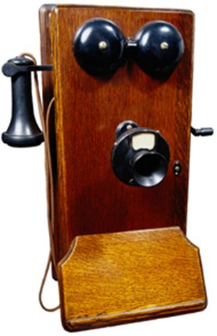

Life Before...
At one time, distance was a huge barrier to communication.
Notes:
‹#›
Do you know what is going on in the black and white picture?
People used the mail to send letters to people they couldn’t reach as a way to communicate.
When the telephone was invented, there were numerous operators that connected people through switch boards, quite different than the current situation.

Slide 6

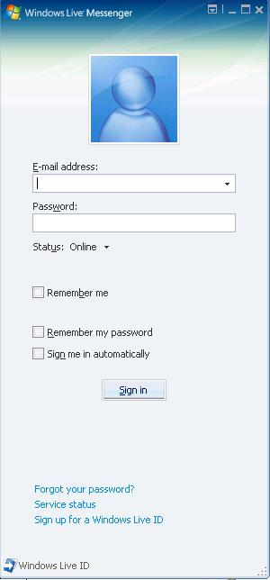
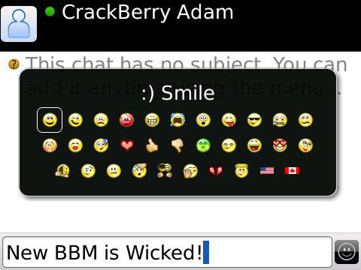




Life Now...
Notes:
‹#›
Closer to home, you can establish an electronic network of people you go to when you want to discuss or find out information about something.

Slide 7
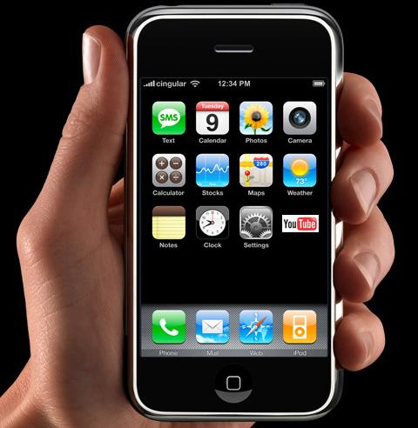
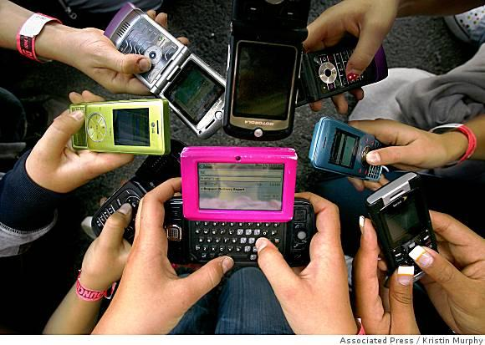
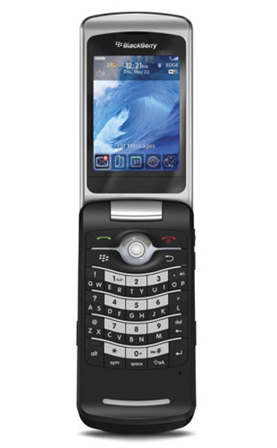
Cell Phones
How many of you have a cell phone?
How many of your friends have cell phones?
What are the different ways that you can communicate using that one single device?
Notes:
‹#›

Slide 8
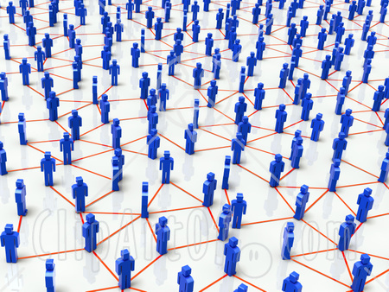
Affirming People’s Membership
Connections like the one’s that we have been talking about help affirm people’s membership in the world community.
They provide opportunities for people to share their views with others beyond their local community.
Notes:
‹#›
Highest: North America
Lowest: Africa

Slide 9


Digital Divide
Digital Divide: The gap that separates people who do – and do not – have access to up-to-date digital technology.
Examine Figure 3-3 (p. 69):
  Where is Internet the highest?
  Where is Internet the lowest?
  How might this affect identity?
Notes:
‹#›
When transnational media corporations such as ESPN set up channels in other countries, they often recruit local production crews and on-air personality.
Why do you suppose they do this?
Is this an effective strategy for promoting diversity?

Slide 10
Digital Divide
Discuss ways communication technologies are widening the digital divide.
Discuss ways communication technologies are narrowing the digital divide.
Notes:
‹#›

Slide 11
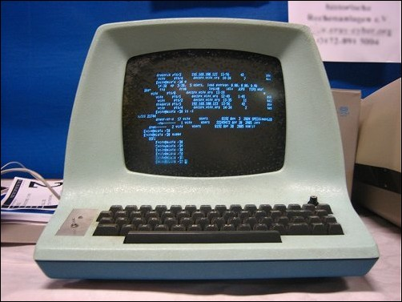
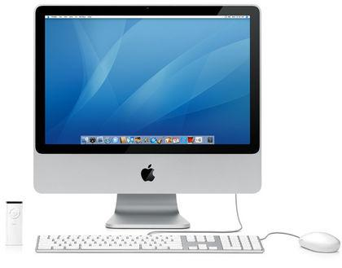
Widening
New software demands up-to-date computers.
Cell phones and computers are expensive.
New technology is making older technology obsolete.
Notes:
‹#›

Slide 12
Narrowing
Cell phones can be used in areas that land lines cannot.
Certain technologies are becoming more affordable and accessible.
Notes:
‹#›

Slide 13

Digital Divide and Canada
Within Canada there still exists the “digital divide”.
  Rural Areas: High speed internet access is not always acceptable.
  Money: Cannot afford Internet service.
  Language
Notes:
‹#›
Which do you believe?
Text message vs. Conversations
MP3 players:
Customized soundtrack blocks you off from the rest of the world.
New York: owners of MP3 players listen to one another’s music.

Slide 14
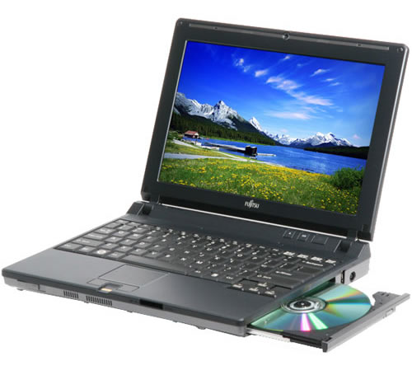
Making Choices: 69
Nicholas Negroponte – One Laptop Per Child
  Read and think about question 1
Notes:
‹#›
Four passengers airliners were hijacked in the United States.
Two were flown into the WTC in New York City, the third crashed in the Pentagon in Washington, D.C., the fourth crashed in a field in Pennylvania

Slide 15

Profile: 70
Marshall McLuhan: Living in the Global Village
https://www.youtube.com/watch?v=09ML9n5f1fE
Notes:
‹#›
Where were you when you found out?
How did you find out?
This week Michael Jackson has been the number 113 most talked about person in the World and the number 24 most talked about person in North America.

Slide 16
Profile: 70
McLuhan’s believed that electronic technology is an extension of the human senses. Technological devices form an extension of a human’s:
sight (e.g., night-vision binoculars, digital cameras), hearing (e.g., electronic bugging devices,
loudspeakers, earphones), smell (e.g., electronic drug detectors, electronic scent dispensers),
taste (e.g., electronic food production, chemically enhanced flavours), and touch (e.g., virtual reality games).
Notes:
‹#›
The examples that we went over are examples of the kind of TV coverage people in Western countries have come to expect when these types of events occur.

Slide 17
Diversity and Global Media Concentration
Mass Media have the power to reach millions
Encourages: “Cultural Diversity”
OR
Promote: “Cultural Homogenization”
Example: ESPN International is the most popular global sports broadcaster.
  Appeal to local tastes, it emphasizes soccer in South America, table tennis in Asia, and cricket in India.
Notes:
‹#›

Slide 18
Free Flow of Information
American Author and Columnist: Jill Nelson:
Media convergence “may be good for business, but it’s bad for people and the free flow of information. This can only increase the public’s deep skepticism of the quality of the news.”
Notes:
‹#›
Here are some ways that it is widening the gap.

Slide 19
Propaganda
Ideas and information spread for the purpose of achieving a specific goal.
Al-Jazeera in North America
Pg. 73
To what extent are Canadian media outlets set out to achieve a specific goal?
Courtesy YouTube: What is Propaganda http://www.youtube.com/watch?v=9ejTf0iu6yY (9:33 min.) Note: the info. is good; but, voices are very annoying...
Nazi Propaganda Machine http://www.youtube.com/watch?v=oVurfhMw1UU&feature=related (6:25 min.)
Notes:
‹#›

Slide 20
Propaganda
Notes:
‹#›

Slide 21


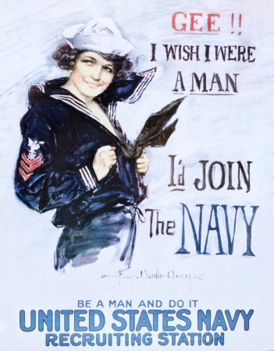

Examples
Notes:
‹#›
Than does globalization really benefit the other two-thirds of the people of the world?

Slide 22
Techno-Isolation: 75
Read together
The Debate
Increases connections among people
VS
Promotes Social Isolation
Notes:
‹#›
Campaigned in Canada to raise money for the crisis-torn Darfur region of Sudan
50 000 people had been killed
1.5 million had been driven from their homes
Money raised: $350 000

Slide 23

Media
To what extent does media play a role in your life?
Let’s read page 76
Lee Harvey Oswald Assassination http://www.youtube.com/watch?v=0xU7Lhd7Wwo (1:01 min.)
Hi quality footage of JFK Assassination http://www.youtube.com/watch?v=1q91RZko5Gw (5:49 min.)
Rate this on a scale from 1 to 10:
1 – Very Little
10 – Runs my life

Slide 24
Please Identify the Following Images
Notes:
‹#›

Slide 25

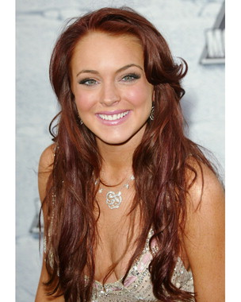
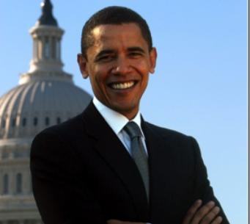


Notes:
‹#›
Maybe:
So much of pop culture is produced in the United States and exported around the world.

Slide 26
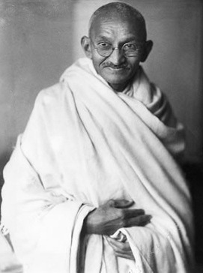
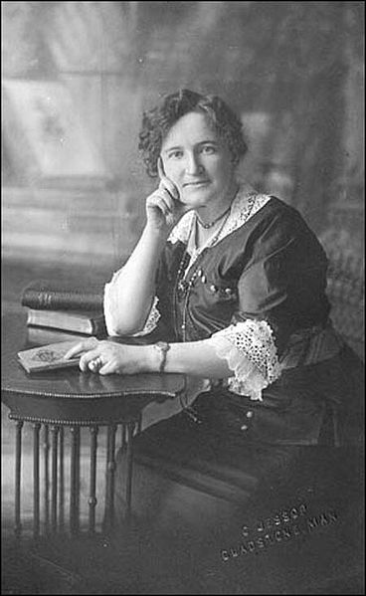
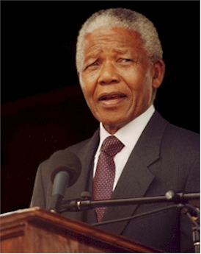
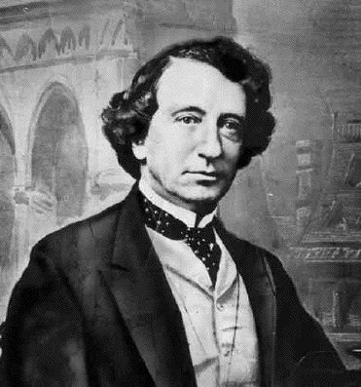
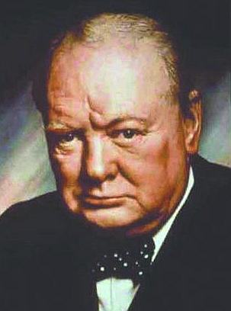
Notes:
‹#›

Slide 27
...And your total is?
SLIDE # 1 | SLIDE # 2
Notes:
‹#›

Slide 28
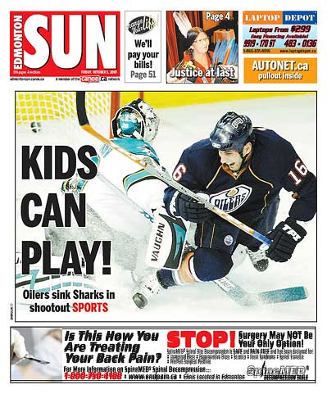
Newsworthiness
What makes a story newsworthy?
Why are some left out and others are not?
FRONT PAGE NEWS IN EDMONTON
Notes:
‹#›
Britney Spears
Elmo
Obama
Lindsay Lohan
Sidney Crosby

Slide 29
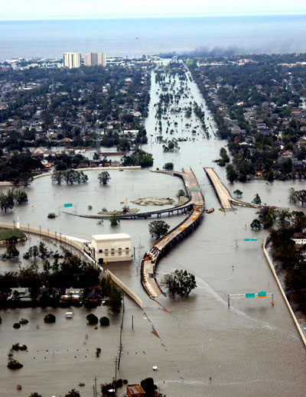
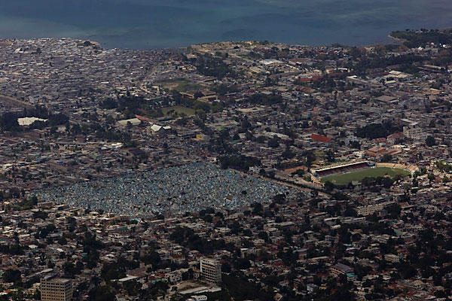
Newsworthiness
Examine Disasters:
International Federation of Red Cross:
The disasters that attract the most coverage are those that are unusual but can be explained.
“Editors sort stories by death tolls” – Red Cross
Notes:
‹#›
Ghandi
John A. McDonald
Nelson Mandela
Nellie McClung: Nellie McClung was one of the most important leaders of Canada's first wave of feminism, and she is still remembered for her role in the famous "Person's Case" which saw Canadian women declared persons in 1929
Winston Churchill

Slide 30
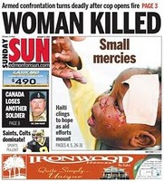
Stories that are told
Examining “Haiti”:
How many days was this on the front page of the newspapers?
How much room did it get in the newspaper?
How much money, in terms of donations were given for Haiti relief?
Notes:
‹#›

Slide 31
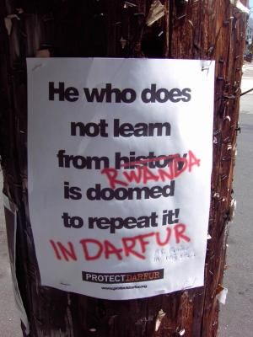
...And those that are not
Darfur (Google Slides)
On Our Watch ... genocide in Darfur https://www.youtube.com/watch?v=EJetVuDSusw (55:06 min.)
Viewing Guide (here)
Formal Writing Assessment
How many of you know
about this?
What is it about?

Slide 32
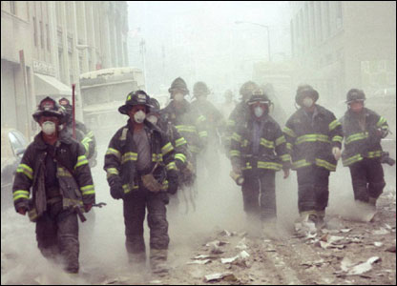
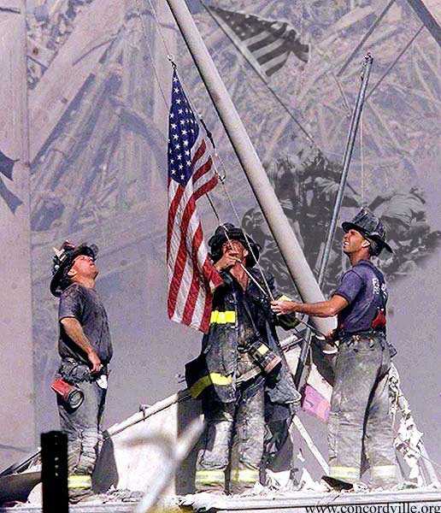
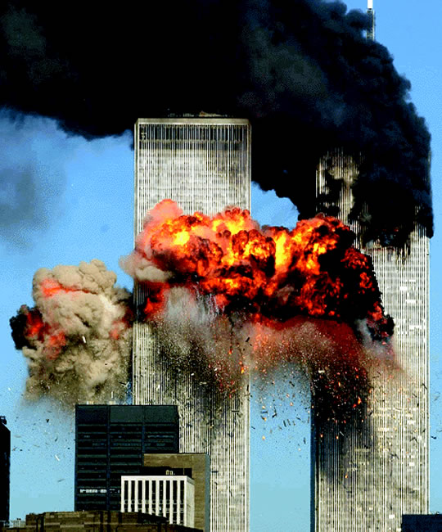
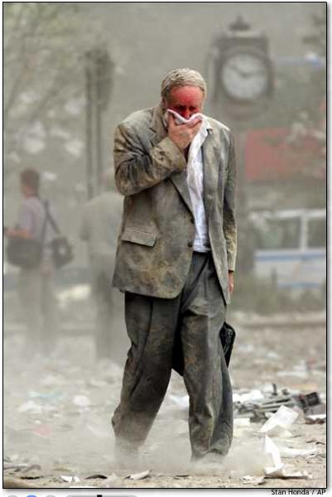
I.Q. #3: How is Identity Affected by Media Coverage of World Events?
September 11, 2001
What happened on this day?
Notes:
‹#›

Slide 33
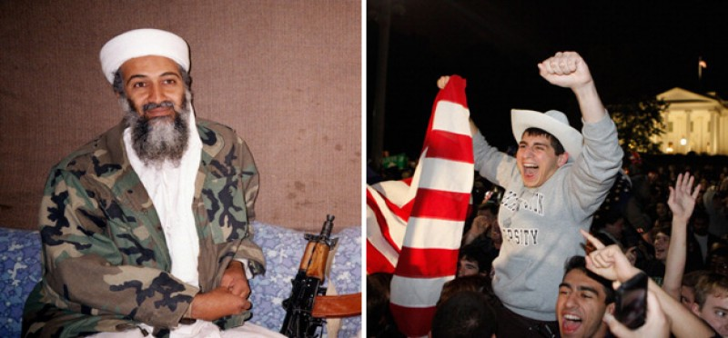
Medias Impact on Historical Events
History as Subjective: New Media's Impact on the World http://www.youtube.com/watch?v=CXSWBeuR6_E (6:14 min.)
Notes:
‹#›

Slide 34
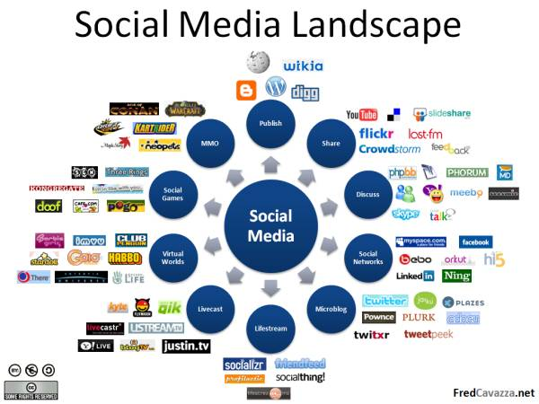
History of Social Media
http://www.youtube.com/watch?v=PuebaqkEumU
(3:07 min.)
Notes:
‹#›
Scale of 1 – 10: individually write down your answer
Share

Slide 35
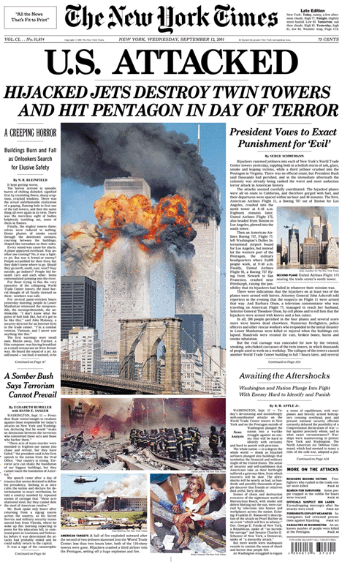
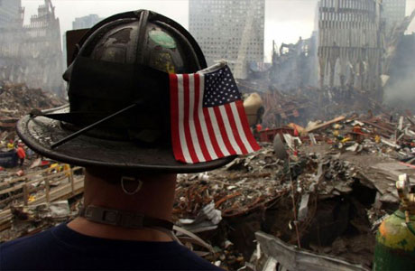
September 11, 2001
“To what extent do you think your feelings/the world’s feelings of 9/11 would change if there was no visual media coverage of this event?”
Notes:
‹#›
What does this mean?

Slide 36
Media Coverage
Momentous events such as these are viewed by millions around the country and even the world.
During events such as these many people remember exactly where they were and what they were doing.
People who have access to communication technologies have become accustomed to witnessing events in real time as they happen all over the world.
NOW
Notes:
‹#›

Slide 37
Taking Time to Read
Yesterday’s top news
Today’s top news
Notes:
‹#›

Slide 38
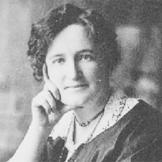
Nelly McClung
Quick Review
Nellie McClung was one of the most important leaders of Canada's first wave of feminism, and she is still remembered for her role in the famous "Person's Case" which saw Canadian women declared persons in 1929

Slide 39
Filling in the Gaps
Propaganda
Is a form of communication aimed at influencing the attitude of a community toward some cause or position.
Selective facts:
  Encourage a particular synthesis
  Produce an emotional rather than a rational response.
Desired response: change in attitude.
  Many times it’s a political action
Notes:
‹#›

Slide 40
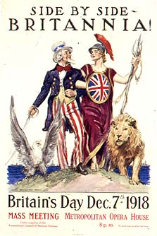

Britannia with the British Lion and Uncle Sam with the American Bald Eagle on a World War I poster.
Propaganda to urge immigrants to move to California, 1876
California: The Cornucopia of the World. Room for millions of Immigrants. Propaganda Poster created to get immigrants to move to California.
Notes:
‹#›

Slide 41
Media and Identity
To what extent do you think the media coverage of the events of September 11 influence the treatment of Mahar Arar?
  Read page 77
  Write down a quick answer to this question
Notes:
‹#›

Slide 42
American Media Concentration
Pop Culture: The culture of the people.
Pop Culture = American Culture?
Many people believe this because they believe the commercial mass media are controlled by American transnational corporations.
Have the power to decide what becomes popular around the world.
Notes:
‹#›

Slide 43
“Entertainment” Media/News
Robin Williams Dead at 63 - footage house Robin Williams 8/11/2014 https://www.youtube.com/watch?v=NKeq4c8RHdY (3:25 min.)
Patch Adams (5/10) Movie CLIP - The Children's Ward (1998) HD https://www.youtube.com/watch?v=byPJ22JDFjI (3:28 min.)
Canada: Women’s Hockey Winning Gold (5:09 min.)
The Oscars – 2014
Notes:
‹#›

Slide 44
Identity and Pop Culture
When you take part in activities associated with pop-culture it influences your values and beliefs and helps define your identity.
Mac vs. PC
Notes:
‹#›

Slide 45
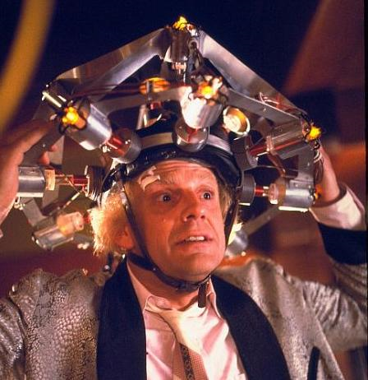
American Media Concentration
To what extent is the Canadian news American news?
To what extent is Canadian news driven by American events?
Notes:
‹#›

Slide 46
Global Media
Global Media and communication technologies enable the creators of pop culture to sell their products anywhere in the world.
Universalization: The spread of culture, trends, customs, and practices around the world.
Cultural Homogenization?
Notes:
‹#›

Slide 47
Sesame Street
One of the main themes: “Cultural Diversity”
  Multicultural cast
  1969: some U.S television stations would not run the show.
Characters: well known elements of pop culture in North America and around the world.
The MuppetsThe Muppets - Popcorn http://www.youtube.com/watch?v=AvDvTnTGjgQ (3:26 min.)
Notes:
‹#›

Slide 48
Sesame Street - Hybridization
Global enterprise
2005 🡪 120 countries
Sometimes dubbed into local languages OR co-produced by local media companies.
Hybridization:
The combining of elements of two or more different things to create something new.
  Sesame Street: Combines elements of American culture with those of the country where the show is co-produced.
Notes:
‹#›

Slide 49
Sesame Street
Around the World
“Exporting American culture often is greeted with skepticism or even hostility, yet Sesame Street seems to find a warm reception wherever it goes.”
WHY
Notes:
‹#›
Which do you believe?
Text message vs. Conversations
MP3 players:
Customized soundtrack blocks you off from the rest of the world.
New York: owners of MP3 players listen to one another’s music.

