Slide 1

Early Global Interaction
The power of international trade

Slide 2
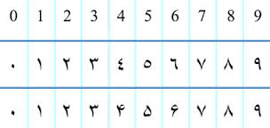
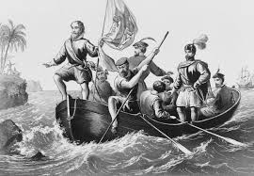

Steps to our current state of globalization
  Step One: Arab civilizations share knowledge of mathematics (number system), medicine and literature with Europe
  Step Two: Columbus’ voyage to “new world” (1492) accelerates globalization (historical globalization)
    The Industrialization of the economy
  Step Three: 20th Century improvements in technology and Cold War lead to rapid growth of global markets (contemporary globalization)

Slide 3
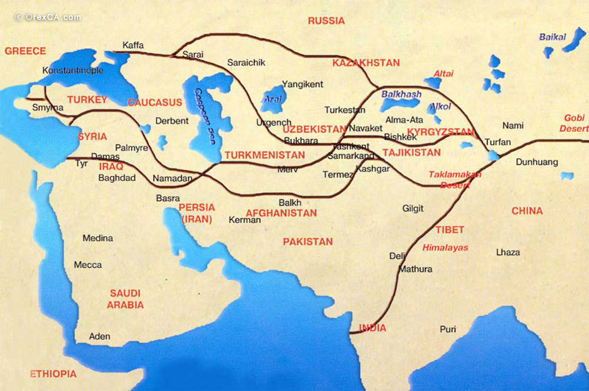
The Silk Road

Slide 4
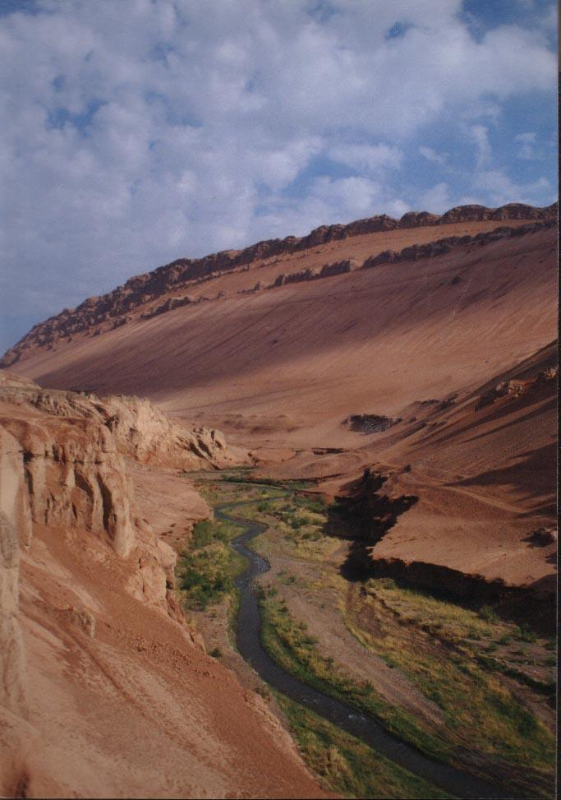
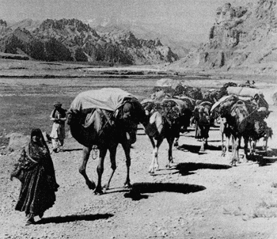
The route covered almost ¼ of the distance around the globe
Considered one of the most significant links connecting various cultures
              https://www.youtube.com/watch?v=vn3e37VWc0k
Dangerous – bandits, lack of water, heat/sandstorms or freezing winds in the mountains

Slide 5
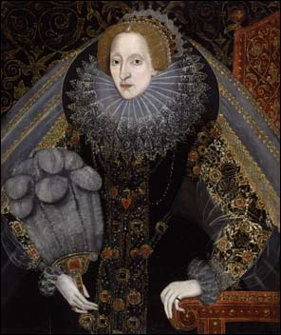
Mercantilism
(Early International trade prior to the 18th Century)
https://www.youtube.com/watch?v=aWxvfkFbKy0
government controlled international trade by granting monopolies (like HBC)
focus on exploiting natural resources of colonies
limited international trade (only with colonies and mother country)
high levels of government regulations
Individuals were controlled and had very little rights
made the monarchy and allies rich
  This created tensions between people/rulers
Corporations were given monopolistic control of a good or service from the Monarch.
Think HBC

Slide 6
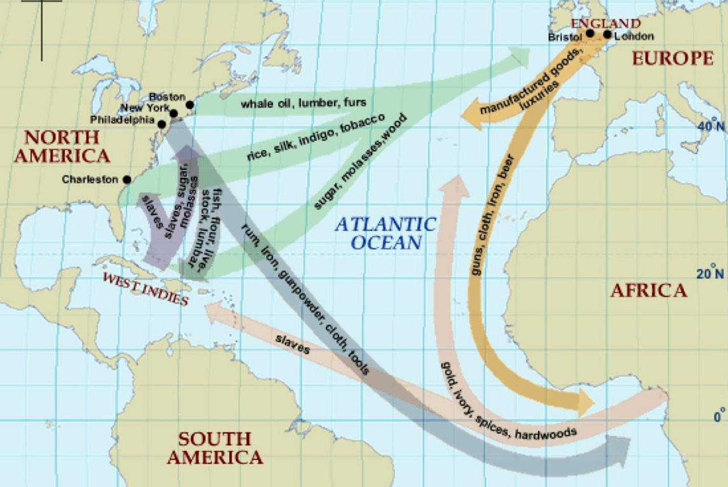
Triangular Trade
Profits
Profits

Slide 7
The Industrial Revolution
The growth of economic globalization or Capitalism:
History of Consumerism
https://www.youtube.com/watch?v=dIuaW9YWqEU

Slide 8
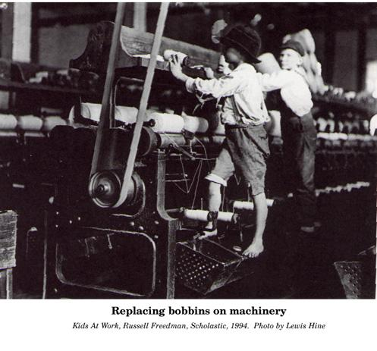
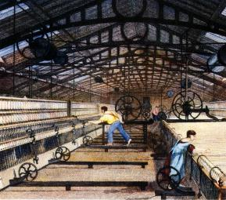
Industrial Revolution
(1700s-1900)
using new sources of power to run machinery
causes complete change in people’s lives = revolution

Slide 9
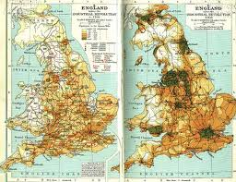
Requirements
https://www.youtube.com/watch?v=DnW9h2HTx_Q
Excess capital ($)
  Available labor (modernization of farms)
Encouragement of capitalist entrepreneurs (can be related to religious/social values) Freedom from control by government***
Natural resources (e.g. iron ore, coal)
Energy resources (e.g. fossil fuels, water)
Transportation and communication
Stable government
  People felt like they had some power.

Slide 10

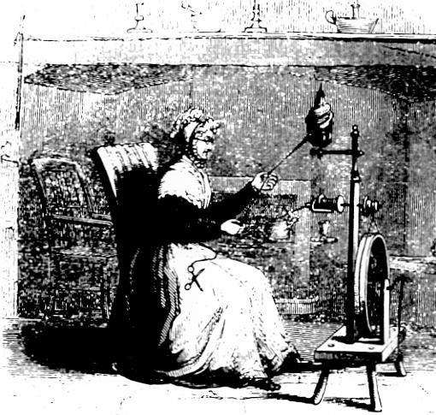
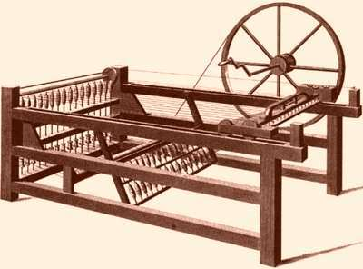
https://www.youtube.com/watch?v=BUnCmpD78Dg
demand for British cloth increasing, especially in colonies
gadgets being created in homes to make spinning and weaving easier
some gadgets hooked up to water source
when steam engines were hooked up, that meant factories could be built anywhere

Slide 11
The impact of the
Industrial Revolution

Slide 12
Political Effects | Social Effects | Economic Effects
Child labor laws to end abuses Reformers urging equal distribution of wealth (e.g. Karl Marx) Trade unions Social reform movements, such as utopianism, socialism | Long hours worked by children in factories instead of going to school Increased urban populations Poor city planning Loss of family stability Expansion of the middle class Employee care vs laissez-faire economics Encouragement of technological progress | New inventions and development of factories Increased production and higher demands for raw materials Growth of worldwide trade Population explosion Development of sophisticated banking and investment systems Advances in transportation, agriculture and communication

Slide 13
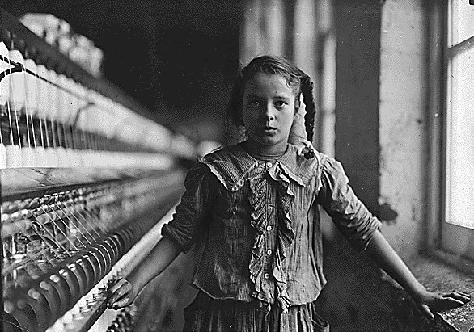
Conditions for the Working Class (During the early part of the Industrial Revolution)
child labor (women and children paid less)
12-16 hour days
limited or no breaks for meals
corporal punishment
fear of losing job
living miles away from the factory
poor living conditions/short life span

Slide 14
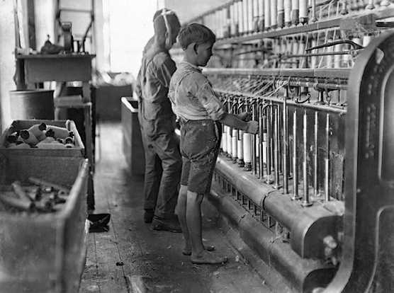
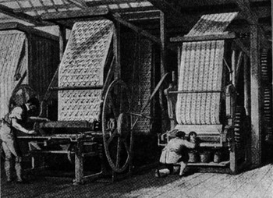

Slide 15
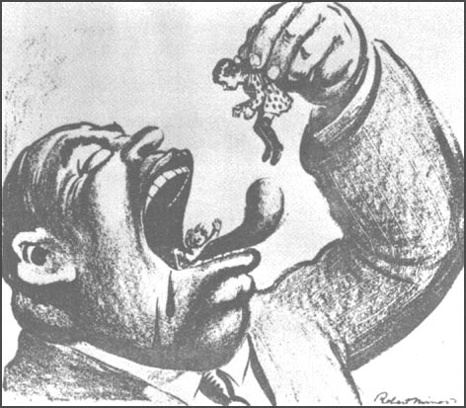
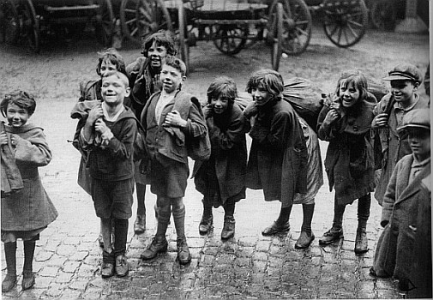
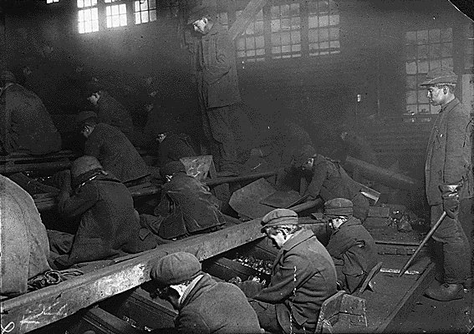

Slide 16
Effects of the Industrial Revolution - Short Term
Positive
lower costs for items like clothing (= change of clothing that could be washed = more sanitary)
death rates went down due to access to better food and medical care
Negative
slums created in cities
abuse of the working class while the middle and upper class reaped the benefits

Slide 17
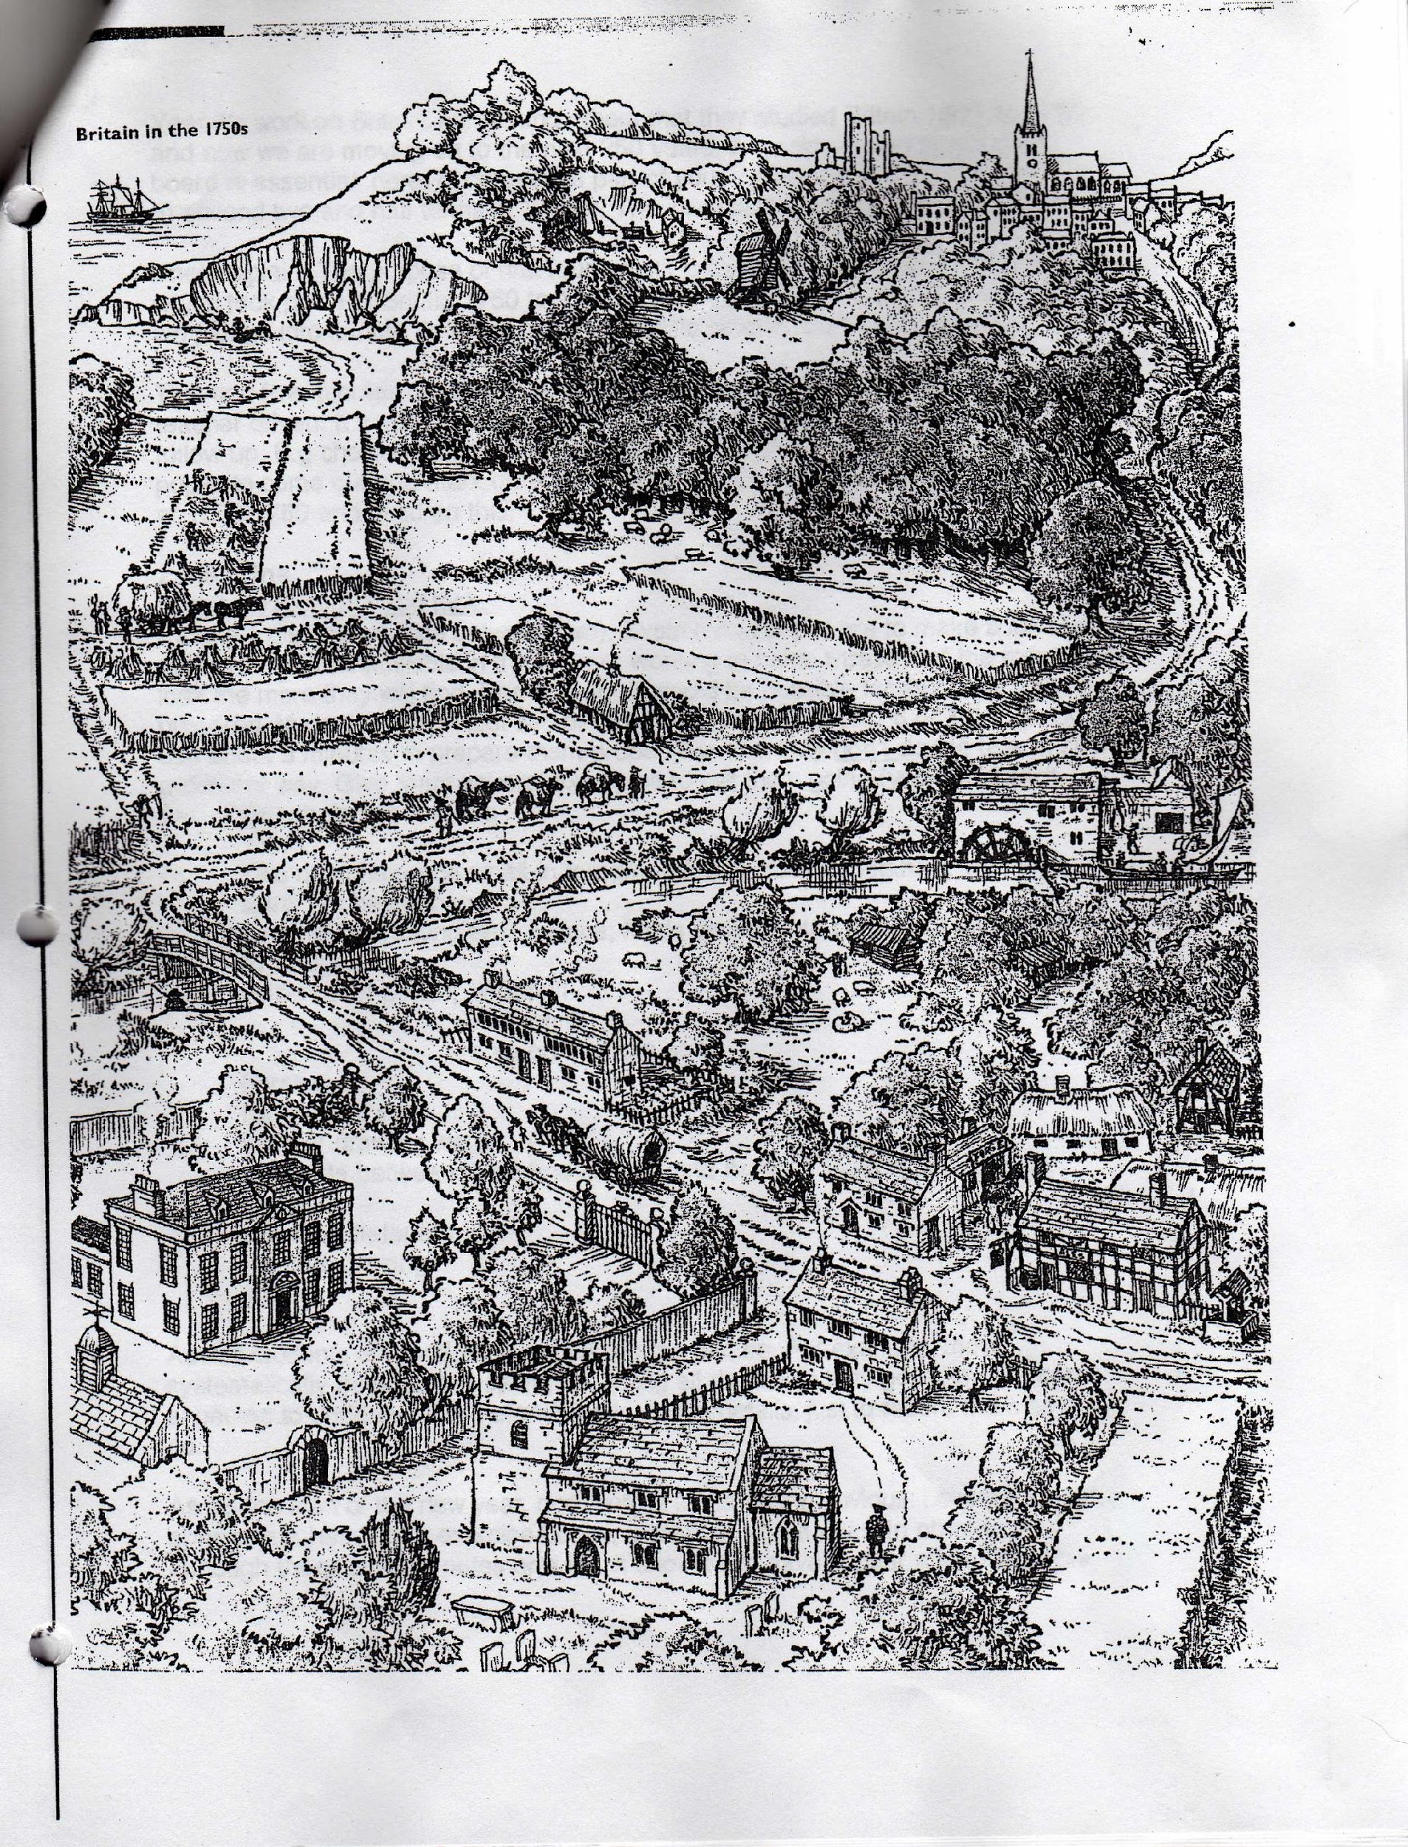

Slide 18
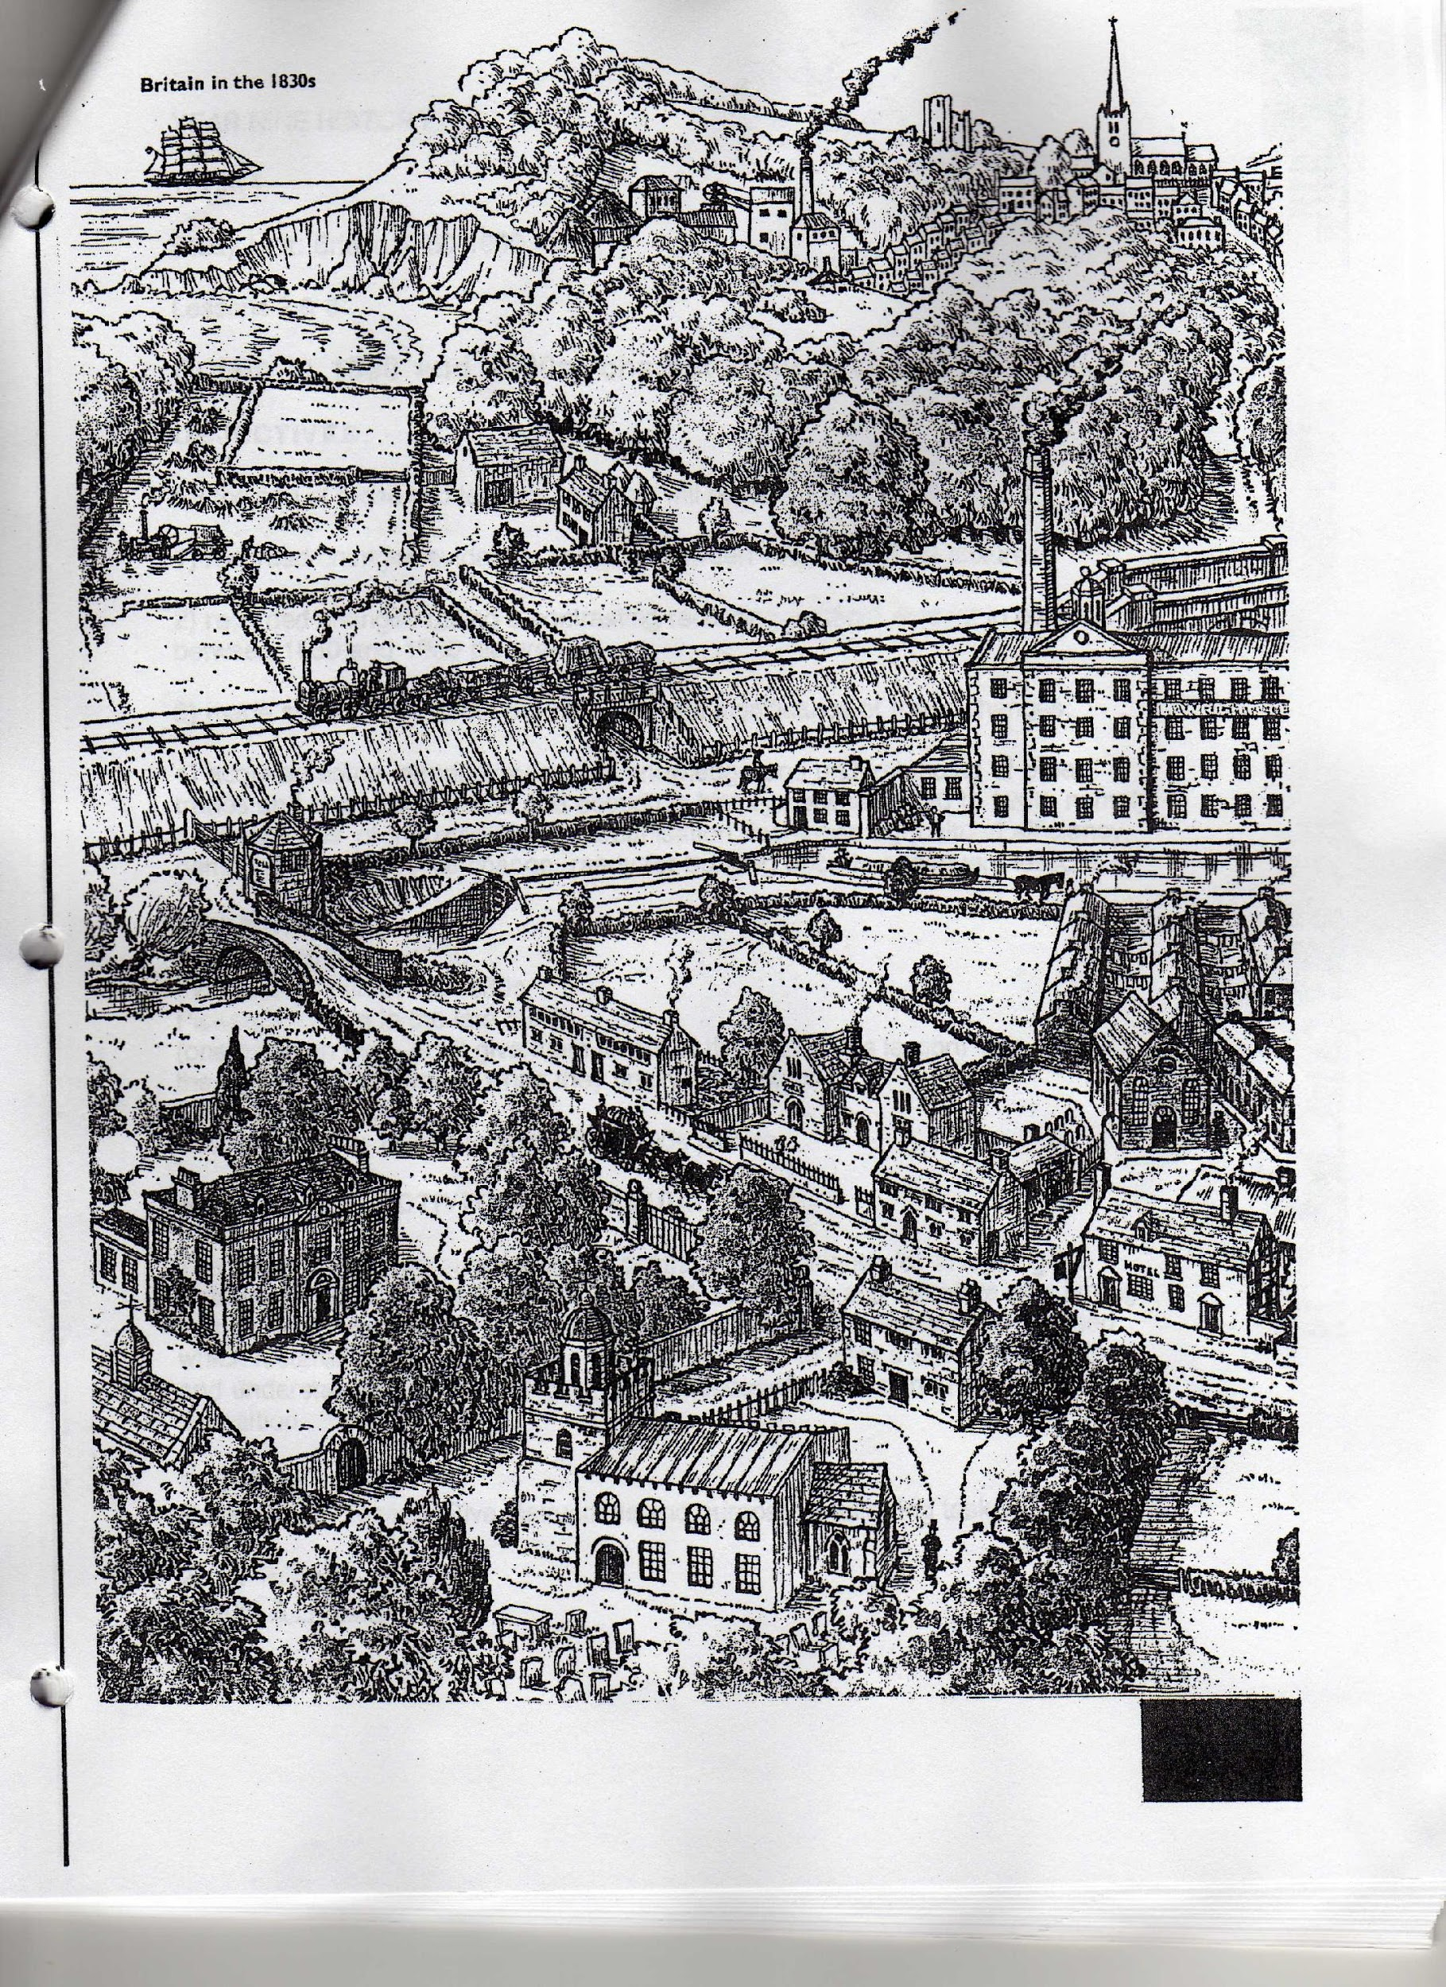

Slide 19
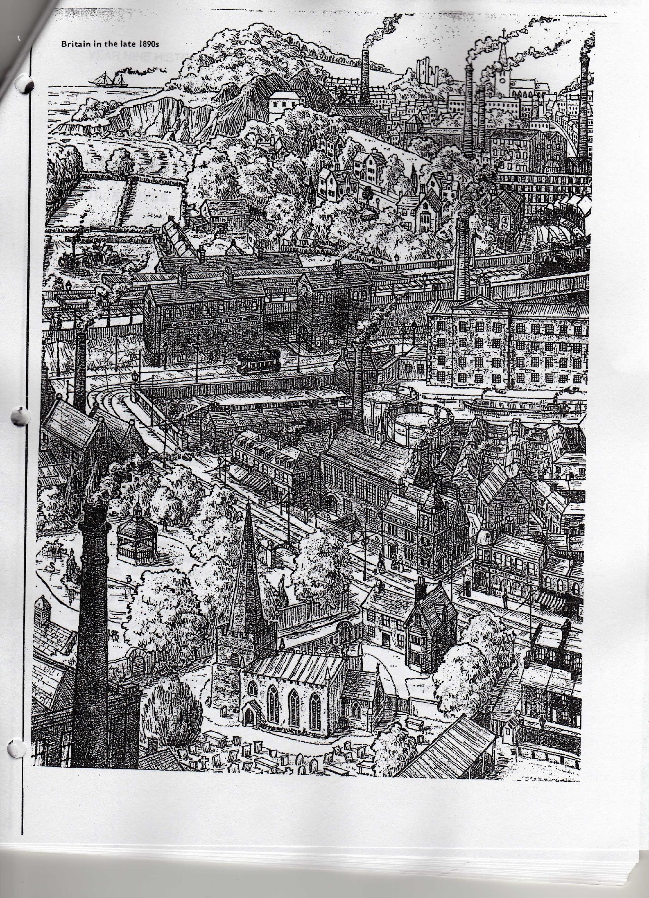

Slide 20
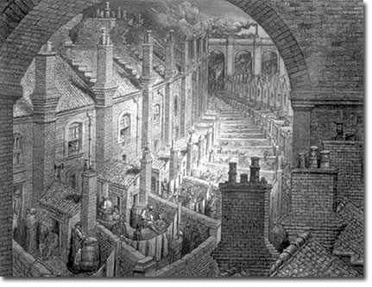

Slide 21
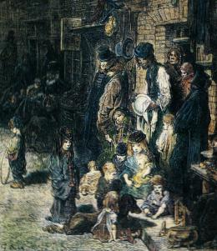

Slide 22
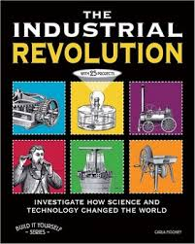
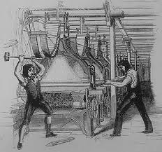
Effects of the Industrial Revolution - Long Term
Positive
Access to cheaper goods increases middle class
governments began to intervene on behalf of workers (laws to protect them).
The life of the poor had always been difficult, now society began doing something about it
Negative
factory work can be very boring causing stress
unemployment due to technological advances
pollution, overpopulation, changes to family and social structures, military capability to destroy civilization

Slide 23
Political and Economic Thought
Adam Smith – capitalism
  https://www.youtube.com/watch?v=ulyVXa-u4wE
Malthus, Ricardo – treatment of the poor, Social Darwinism
  Malthus:https://www.youtube.com/watch?v=vVmAb8N5nQY
  Ricardo:https://www.youtube.com/results?search_query=Iron+law+of+wages Comparative Advantage
Robert Owen, New Lanark – socialism
Karl Marx – communism (extreme socialism)
https://www.youtube.com/watch?v=Vz3eOb6Yl1s&t=3s

Slide 24
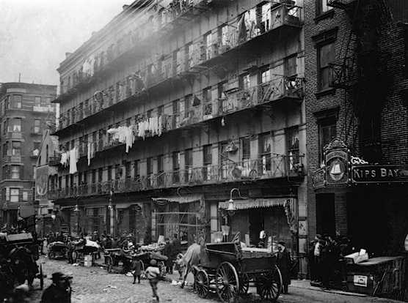

Slide 25
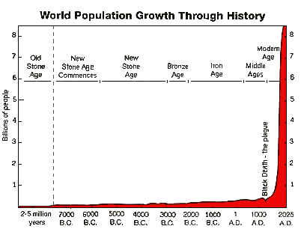

Slide 26
