Slide 1
Unit 4 Key Terms
You will be required to KNOW the folliwng DEFINITIONS

Slide 2
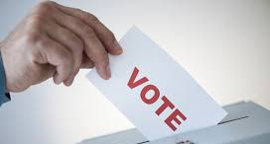
RIGHTS of
CITIZENSHIP
The benefits of being a citizen of a country.

Slide 3
ROLES of
CITIZENSHIP
The actions expected of or permitted of citizens within their society.

Slide 4
RESPONSIBILITIES of CITIZENSHIP
The involvement and active participation of every citizen in exchange for the benefits and rights of citizenship.

Slide 5
CIVIL
DISOBEDIENCE
Acting in a way that breaks the laws or rules governing a society.

Slide 6
CITIZENSHIP
The responsibilities, rights and privileges of being a citizen.

Slide 7
GRASSROOTS
MOVEMENT
A campaign about a particular issue usually begun by a few people but which spreads among the people.
Grassroots movements often form spontaneously around an issue by a previously unknown individual or small group of individuals and then grown in strength.

